Slide 1
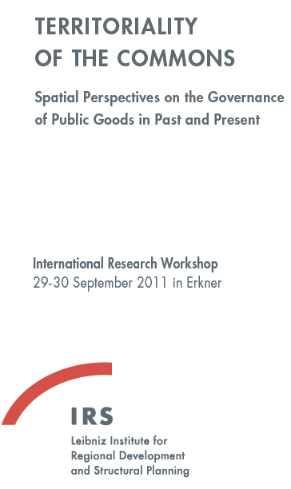
Paving the road in virtual spaces How to materialize rights to immaterial commons
Rainer Kuhlen Department of Computer and Information Science University of Konstanz, Germany

Slide 2
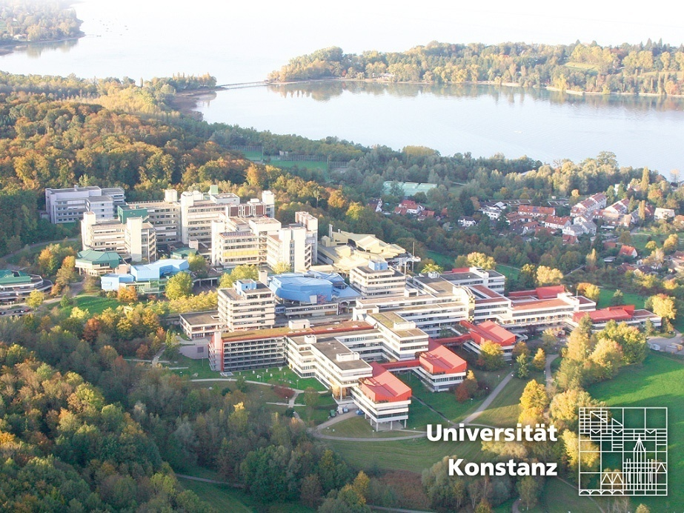
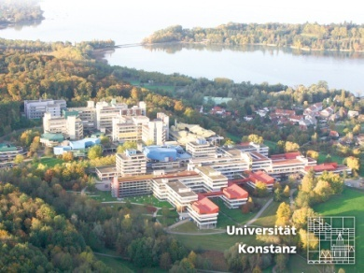
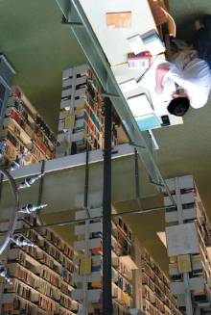

Slide 3
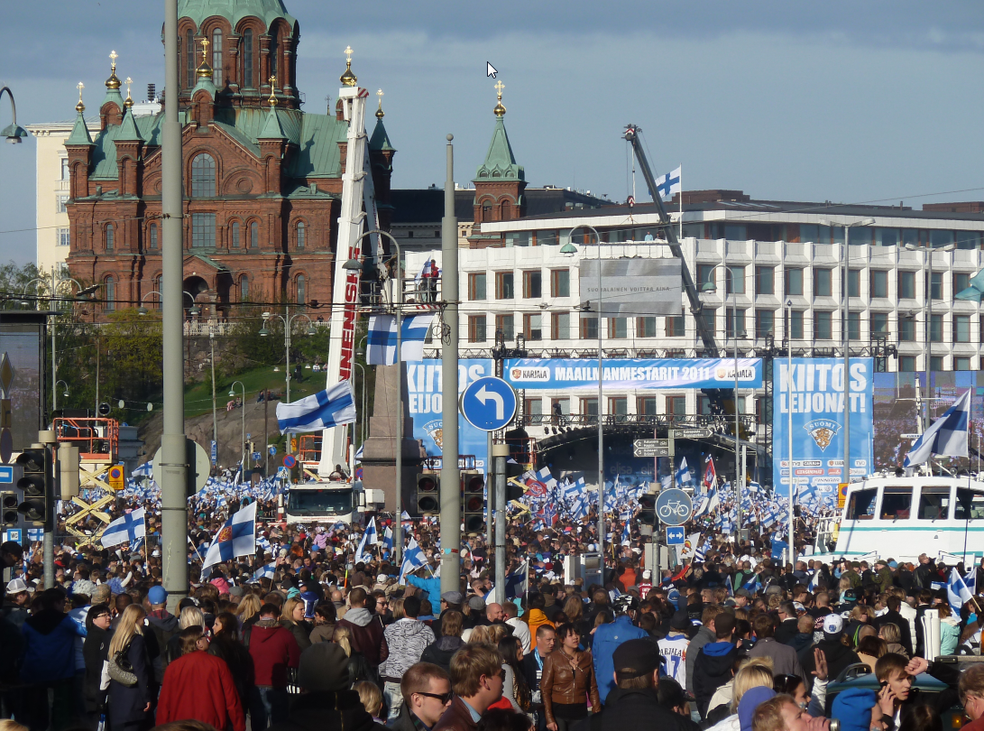

Slide 4
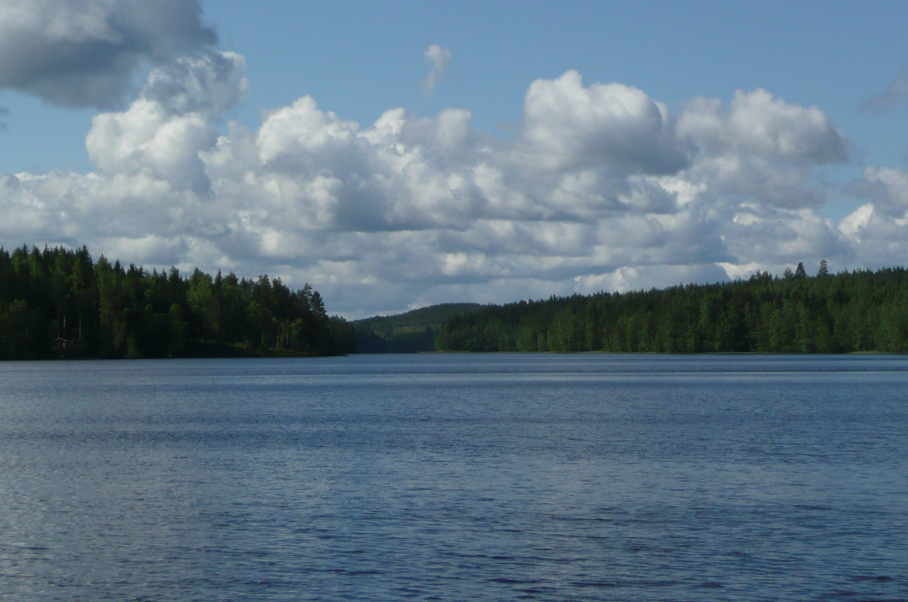

Slide 5
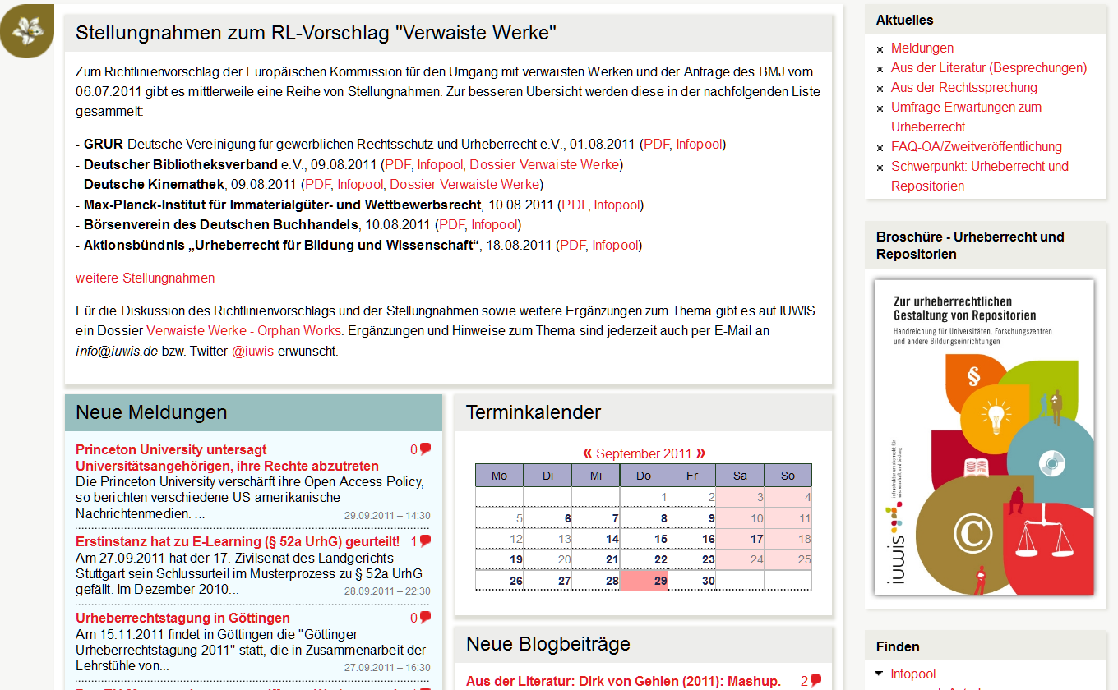
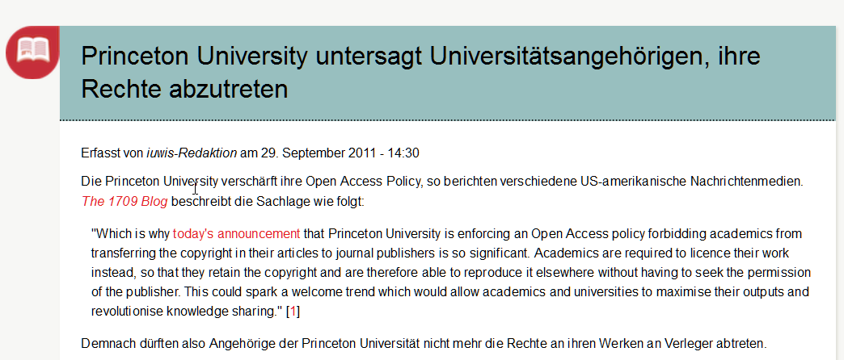
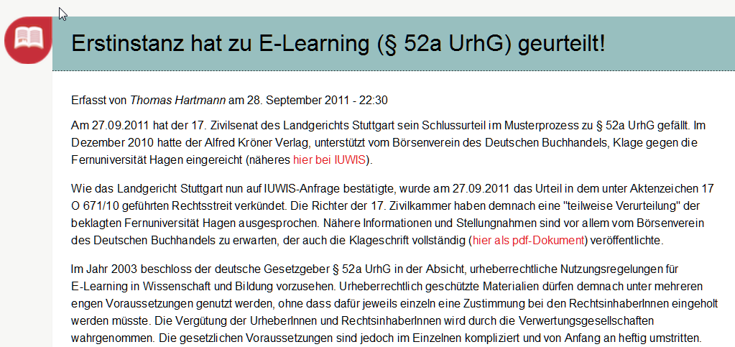

Slide 6
Content - Topics
Virtual spaces
Knowledge spaces, knowledge road
(Knowledge) ecology
Commons
Towards an understanding of knowledge as a commons
Who owns knowledge?
Access – institutionalization of knowledge
Copyright as a form of institutionalizing knowledge
Open Access as a form of institutionalizing knowledge
Models for the institutionalization of knowledge
What needs to be done? Consequences
6

Slide 7
Paving the road
Are there roads in virtual spaces?
CC

Slide 8
Virtual spaces
CC

Slide 9
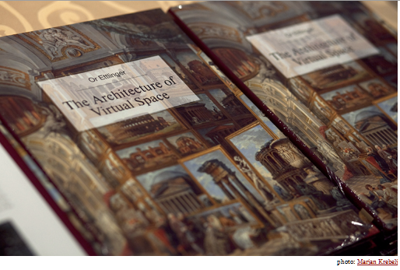
Virtual spaces
… seeks to define virtuality in terms of the actual space that is perceived through visual media.
http://virtualspacetheory.com/book/
CC

Slide 10
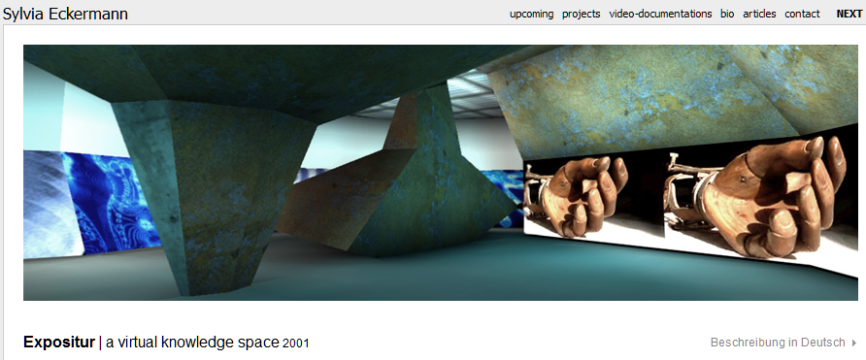
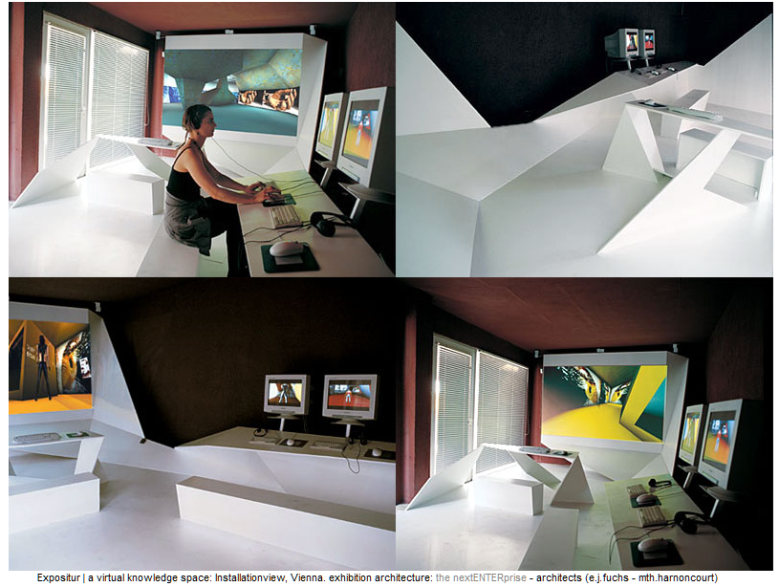
Virtual spaces
Expositur | a virtual knowledge space
In the framework of "Unternehmen Capricorn" project we developed a virtual knowledge space ["Virtueller Wissensraum"] in collaboration with 10 Austrian museums. The programme…enables 3 users to enter a cross-disciplinary environment based upon objects … which then were translated into a spatial structure of rooms, corridors and places of different size, shape, remoteness or proximity.
http://syl-eckermann.net/expositur/index.html
CC

Slide 11
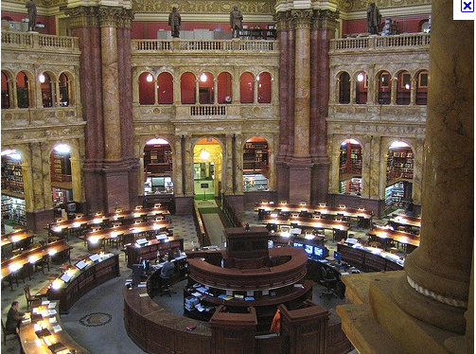
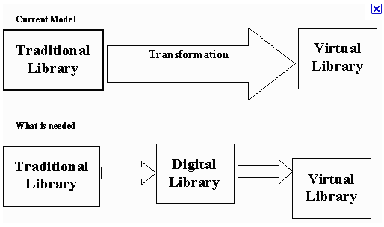
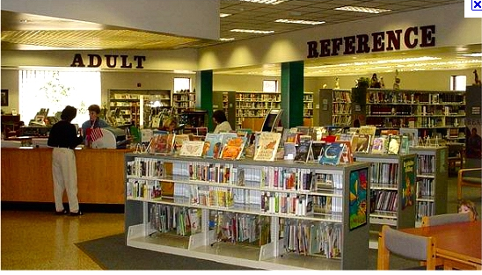
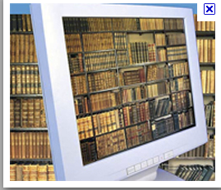
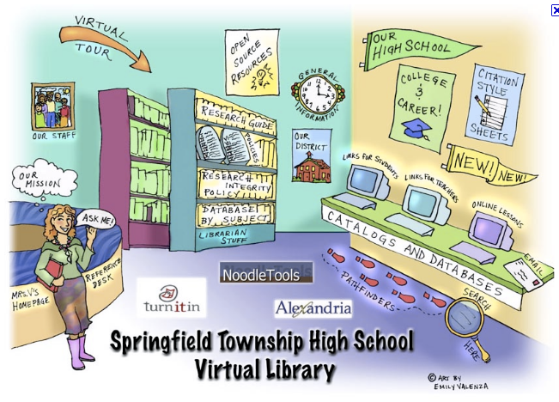
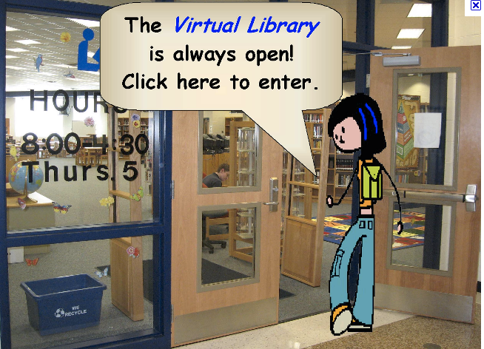
Virtual spaces/libraries
http://bit.ly/pL8D2b
http://bit.ly/nM8Pxj
http://bit.ly/rjFboy
http://bit.ly/q1JCsA
http://online.darton.edu/student_resources/library.php
http://bit.ly/pGTm6a
http://bit.ly/pfecZI
http://bit.ly/oot01B
CC
http://bit.ly/piXMGB

Slide 12
Knowledge spaces

Slide 13
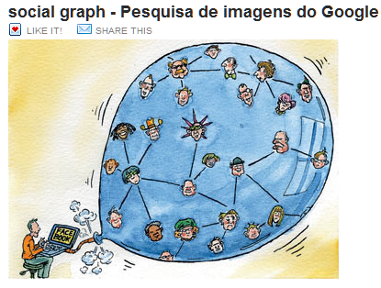
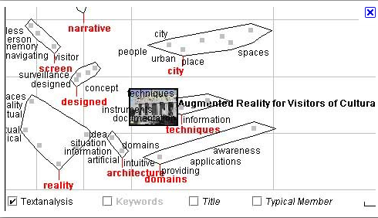
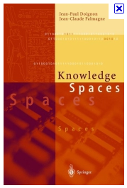
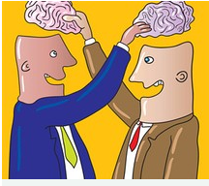
Knowledge spaces
http://bit.ly/ou7fSr
http://bit.ly/ombf1w
http://bit.ly/qeXNoY
http://bit.ly/pLkw1q
http://bit.ly/ou7fSr
http://bit.ly/rkqIPj
http://bit.ly/qtFYDf
CC

Slide 14
(Knowledge) ecology

Slide 15
(Knowledge) ecology
Ecology in general is concerned with the sustainability of natural resources (for instance water, air/climate, wildlife, forests) by protecting these resources from overuse.
Knowledge ecology is also concerned with sustainability
but sustainability of immaterial goods. This can only be achieved by making knowledge an open space and providing free access to it and unrestricted use.

Slide 16
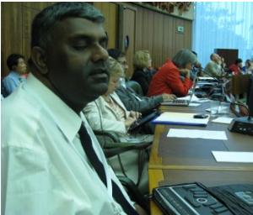
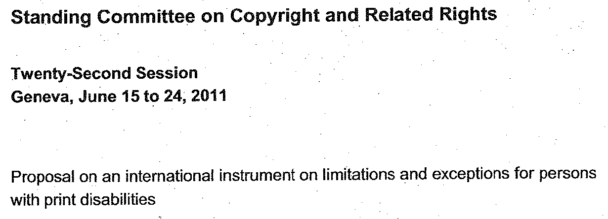
Knowledge ecology
Open space
Right to Read for Persons with Reading Disabilities
Let’s eliminate the need for making special, accessible copies and all that, and instead let's build access into the e-publishing technology from the ground up. That way we all can access the same content on our e-readers or computers, whether or not the person using it happens to be sighted or blind.
Robert Englebretson, Prof. of Linguistics at Rice, in a comment on the WIPO proposal
16

Slide 17
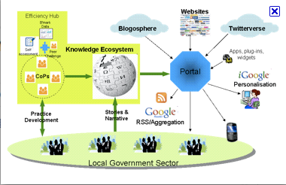
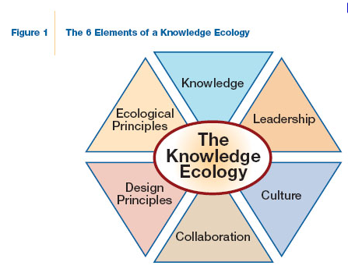
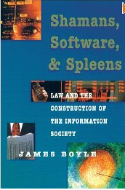
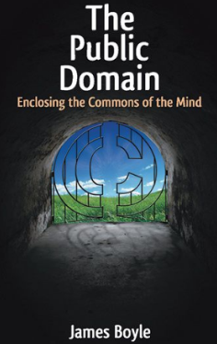
Knowledge ecology
http://bit.ly/nQMWNn
http://bit.ly/pFyq8l
A Politics of Intellectual Property: Environmentalism For the Net?
James Boyle 2007

Slide 18
Open Access – part of knowledge ecology
Open access is part of knowledge ecology
Open Access provides an alternative or complement
both
to existing commercial publishing models on the international information markets and
to international copyright regulations,
which, in the last 20 years, have mainly emphasized the economic impact of knowledge and information
and thus have made knowledge a scarce resource
18

Slide 19
knowledge ecology/economy
economy
ecology
?
knowledge economy
knowledge ecology
Thesis
Knowledge ecology does not object to the commercial use of knowledge,
but suggests that publishing models are only acceptable when they acknowledge the status of knowledge as a commons,
allowing free and open access for everyone
not claiming exclusive property rights.
19

Slide 20
Commons
Commons is the central concept of
knowledge ecology

Slide 21
Commons
Commons are often understood either as common goods/common-pool resources
or as public goods
http://en.wikipedia.org/wiki/Public_good
But commons are neither common goods
nor public goods
21

Slide 22
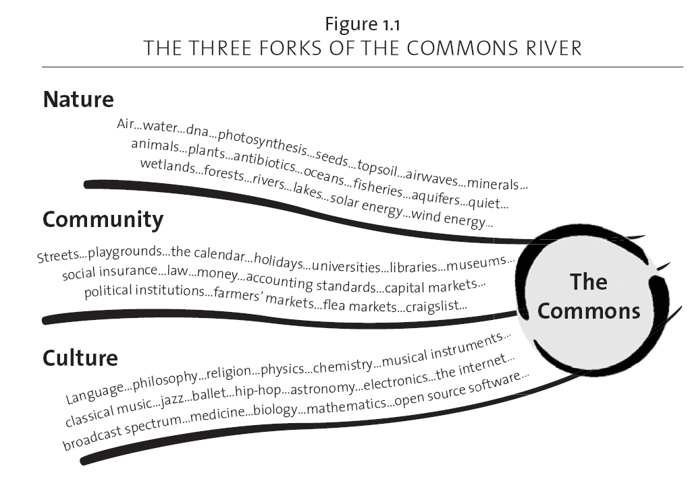
Commons
What are commons?
common heritage
of
nature
Commons are institutionalized common-pool resources
common heritage
of
social life
common heritage
of
cultural
creativity
Aus: Peter Barnes: Capitalism 3.0
22

Slide 23
Institutionalizung common-pool resources making them commons
sharing
justice, fairness
inclusion
sustainabilty
Common Pool Resources
principles
Commons
institution-alization
procedures
clean air and water
oil pools
air
knowledge
communication (reaching a consensus)
commitments
contracts
rules, laws, legal norms
control mechanisms, sanctions
23

Slide 24
Towards an under-standing of knowledge as a commons
24

Slide 25
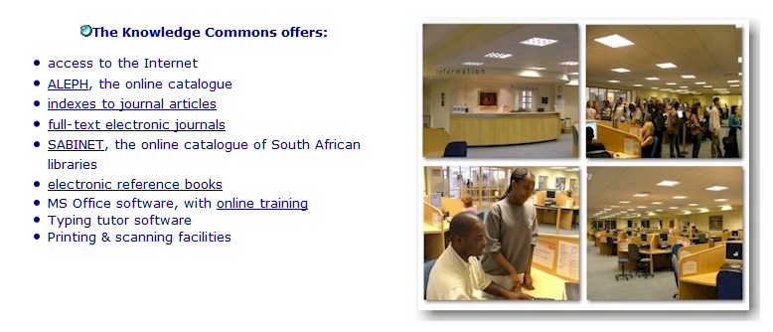
Knowledge commons
http://www.lib.uct.ac.za/kc/
http://www.ercim.eu/publication/Ercim_News/enw66/ioannidis.html
The Open Knowledge Commons (OKC) works to make the record of human knowledge as broadly available as possible. We envision development of a “knowledge commons”—a distributed, interoperable universal access digital library of information that may be queried, combined, annotated, mined, manipulated and shared to extract new information.
http://www.knowledgecommons.org/category/mhl/

Slide 26
Institutionalizing knowledge as a commons
privatization
enclosure of the mind
profitability
scarce resource
sharing
justice, fairness
open
inclusion
sustainabilty
It´s our choice
knowledge resources
principles
access to information products
services
systems
institution-alization
procedures
rules
commitments
contracts
control mechanisms
sanctions
26

Slide 27
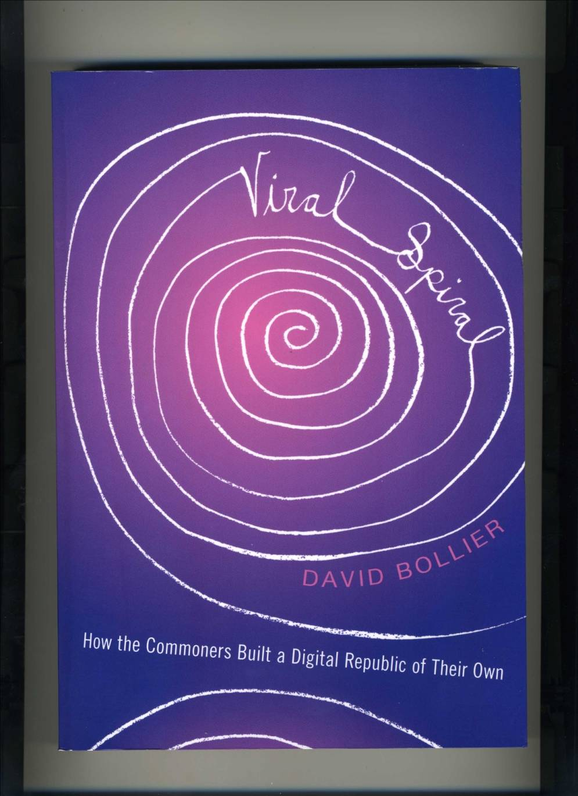
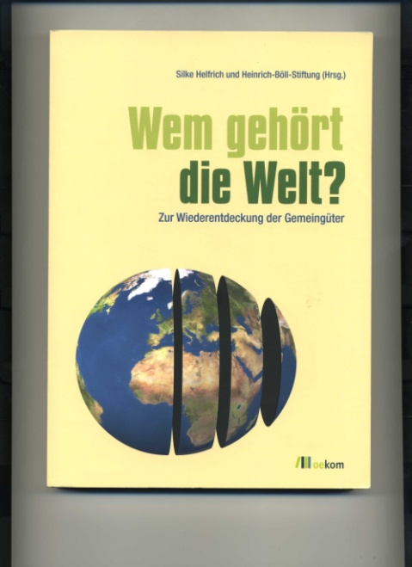
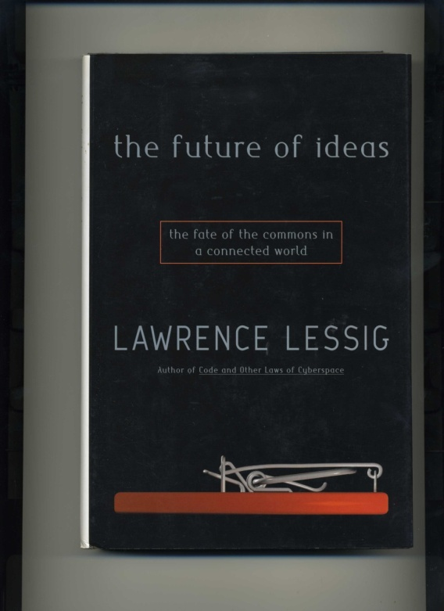
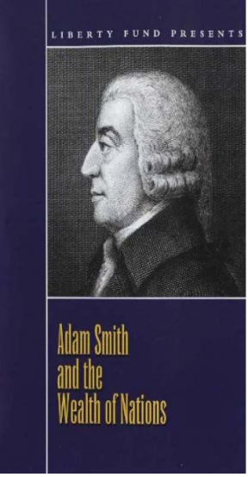
Knowledge as a commons
27

Slide 28
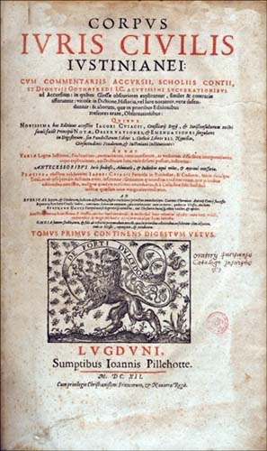
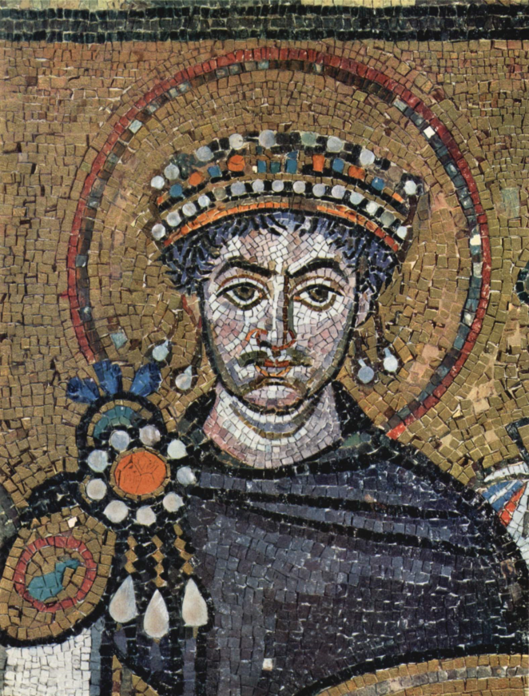
An understanding of knowledge as a commons
res nullius
res privatae
res publicae
res communes
What is the status of knowledge?
Justinian I., Mosaikdetail aus der Kirche San Vitale in Ravenna
http://bit.ly/pUgtds
28

Slide 29
Who owns knowledge?
29

Slide 30
An understanding of knowledge as a commons
Who owns knowledge?
producers/authors?
exploiters/content providers/publishers?
users/those who need it for their work?
knowledge is part of the commons – of the res communes
nobody should own knowledge exclusively
30

Slide 31
Who owns knowledge?
is it the right question?
knowledge itself, ideas, facts, theories, …data(??)
is not protected by copyright laws
If nature has made any one thing less susceptible than all others of exclusive property, it is the action of the thinking power called an idea, which an individual may exclusively possess as long as he keeps it to himself; but the moment it is divulged, it forces itself into the possession of every one, and the receiver cannot dispossess himself of it. Its peculiar character, too, is that no one possesses the less, because every other possesses the whole of it. He who receives an idea from me, receives instruction himself without lessening mine; as he who lights his taper at mine, receives light without darkening me.
31

Slide 32
Who owns knowledge?
is it the right question?
knowledge is a commons
but only usable when it is accessible
32

Slide 33
Who owns knowledge?
Who has access to knowledge?
Who controls the access to knowledge?
The question is not one of knowledge but one of information
Who has access to information – who controls information?
33

Slide 34
Access – institutionalization of knowledge
Open access is one of many forms of institutionalizing knowledge and making it a commons, a common property
but
Copyright regulation is also one of many forms of institutionalizing knowledge and making it a
private property,a (scarce) good
34

Slide 35
Copyright as a form of institutionalizing knowledge
35

Slide 36
Copyright as a regulative model for institutionalizing knowledge
International main-stream assumption
Strong copyright - an appropriate means to further progress in the arts, science and education
36

Slide 37
Copyright as a regulative model for institutionalizing knowledge
What is a strong copyright?
((a) One that makes knowledge and information a scarce good – a commodity ?
or
(b) One that supports open, free access to knowledge and information ?
37

Slide 38
Copyright as a regulative model for institutionalizing knowledge
The enforcement of strong copyright regulations (in Europe and North America in the last 20 years) heavily supports the commercial exploitation of knowledge and information (not necessarliy creators´ rights).
This makes it more and more difficult to freely access world-wide information resources, in principle available on world-wide information markets.
38

Slide 39
Copyright as a regulative model for institutionalizing knowledge
The default in copyright law is the exclusive right of the rightholders – authors or (by contract) exploiters/publishers/content providers
The right to exclude others from access to published knowledge and from using it freely
The interests of the public, in particular for science and education, are only taken into account through exceptions and limitations to the exclusive rights of the right-holders
under the control of the three-step-test
39

Slide 40
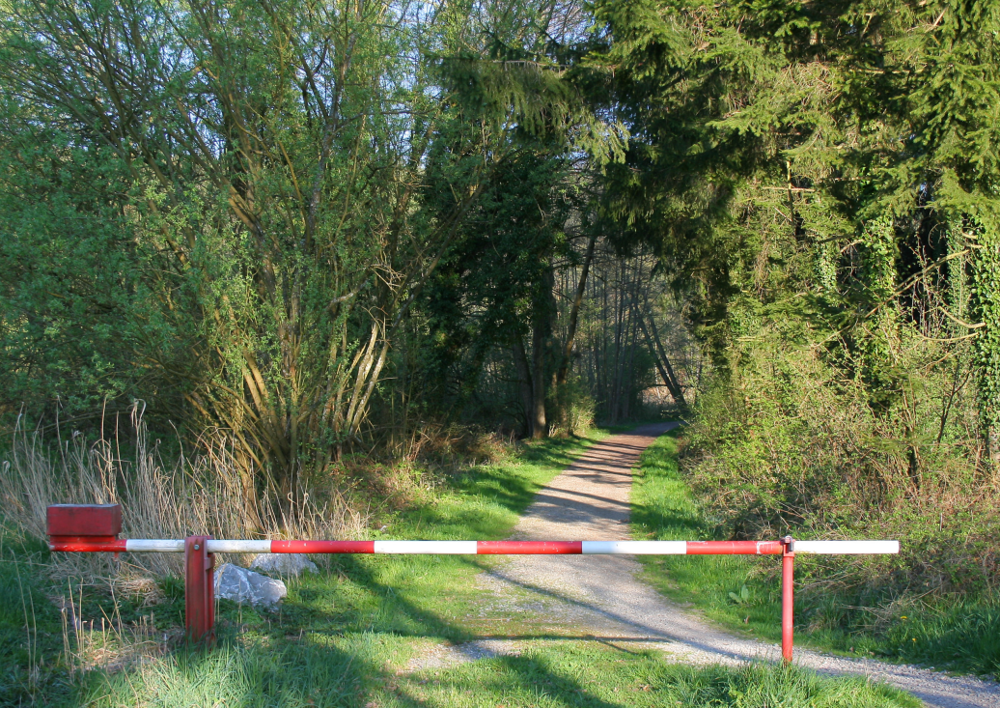
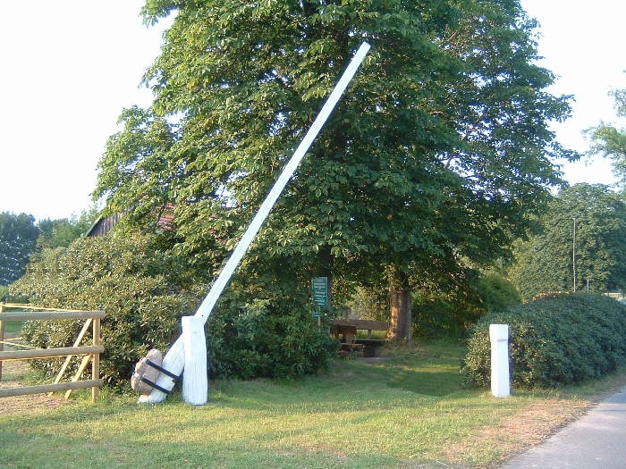
under the control of the three-step-test
disabling?
enabling?
„Schranke“ (barrier, gate) is a German copyright term (in international law: „exceptions, limitations“) which abridges the otherwise exclusive rights of knowledge producers.
http://bit.ly/otoybc
CC

Slide 41
Copyright as a regulative model for institutionalizing knowledge
TRIPS - Agreement on Trade-Related Aspects of Intellectual Property Rights
Article 13
Limitations and Exceptions
Members shall confine limitations or exceptions to exclusive rights to certain special cases which
do not conflict with a normal exploitation of the work
and do not unreasonably prejudice the legitimate interests of the right holder.
41

Slide 42
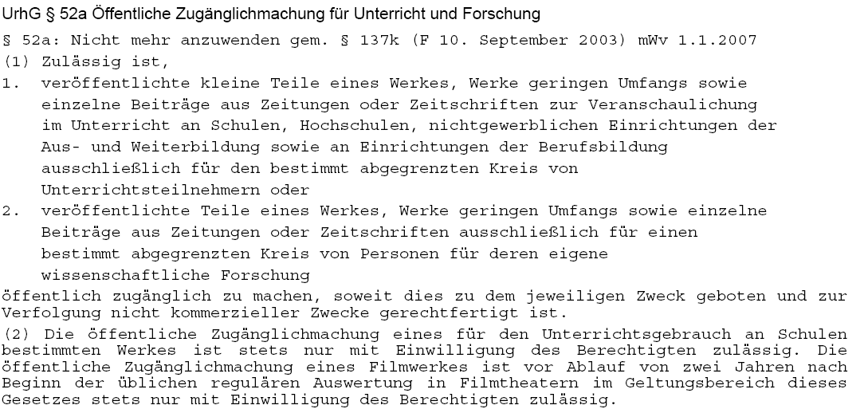
Exceptions for science, education (§ 52a German copyright law)
Only for use in classroom
Only small parts of works
Time limit end of 2006, then 2008, now 2012
For the use of defined research groups
A reasonable fee needs to be paid to collecting societies in any case
Only for registered students in classes
without any direct or indirect commercial interest
Use of copyrighted material in schools only with special permission of rightholders
Use of movie/video material only 2 years after public performance
42

Slide 43
German coalition copyright in favour of research and education
2.539 answers
Question: Is § 52a UrhG too liberal (restricting exclusive rights of rightholders too much) or too restrictive (useless for research and education)
http://www.urheberrechtsbuendnis.de/befragung2011-auswertung1.pdf

Slide 44
German coalition copyright in favour of research and education
2.539 answers
Question: Should published knowledge, at least knowledge produced through public financial means, be freely accessible and usable by everyone?
http://www.urheberrechtsbuendnis.de/befragung2011-auswertung1.pdf

Slide 45
Open Access as a form of institutionalizing knowledge

Slide 46
But copyright is not the only form of institutionalizing knowledge and making it a commons, a common property
Open access is a form of institutionalizing knowledge, not by law but through the initiative of the commoners – the people who are concerned in the production, publishing and usage of knowledge.
The Berlin Declaration of Open access is an example for establishing guidelines for the publication and the usage of knowledge and information by acknowledging the moral rights (die Persönlichkeitsrechte) of the authors
46

Slide 47
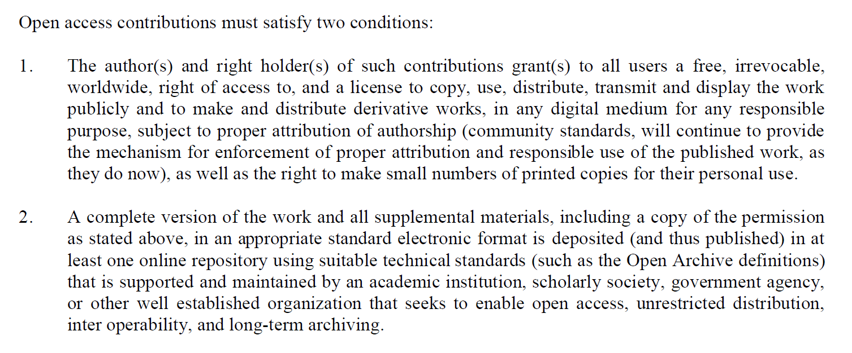
But copyright is not the only form of institutionalizing knowledge, making it a commons, a common property
From the Berlin Declaration of Open - 2003
http://www.zim.mpg.de/openaccess-berlin/berlin_declaration.pdf
47

Slide 48
Models for the institutionalization of knowledge
48

Slide 49
Models for the institutionalization of knowledge
(1) Proprietary commercial information markets
objects
exclusive rights for the exploitation
trade with information objects
with the consequence that
transformation of authors´ rights into
exploiters´ rights
knowledge is made a scarce good
copyright law
contractual agreement
licenses
DRM
49

Slide 50
Models for the institutionalization of knowledge
(2) Freeconomics markets – prototpye Google
profit
objects
information objects
search engines
not through information itself
but
as
by using user search profiles for advertisement
private property rights
but
merchandizing
cross financing
value-added effects
free use
Will SpringerOpen mutate into a freeconomics model?
Usage open/free, copyright remains by the authors – the public finance the production costs and the profit of a company on the information market
50

Slide 51
Models for the institutionalization of knowledge
(3) Open free markets
possible
default
Information objects
in the copyright paradigm
but
free open use
non-exclusive commercial exploitation rights
given for open access
as
claimed as
a means of development
exploitation
personal moral rights
Creative Commons
or
type 2
freeconomics
type 1
proprietary markets
given into the commons, directly
Open Access
51

Slide 52
Models for the institutionalization of knowledge
(4) commons-based information markets
Commons
air/sky
water
wildlife
natural resources
the public space
knowledge
….
A property of mankind
but
private rights for exploitation possible and often necessary
but only
with non-exclusive exploitation rights
with sufficient compensation to the public
as long as free access to everyone is guaranteed
52

Slide 53
What needs to be done? Consequences

Slide 54
Consequences
Needed
a new understanding of intellectual property
knowledge as a commons is not to be considered a
res nullius, which can be used ad libitum by everyone for whatever purpose
Knowledge and its derivative information products cannot be the subject of exclusive private property rights

Slide 55
Consequences
a new understanding of intellectual property
a new understanding of copyright
free access → the default
commercial exploitation → the exception
developing a concept of common property rights without denying private individual property rights

Slide 56
Conclusion
Knowledge and its derivative information products cannot be the subject of exclusive private property rights
Production and use of knowledge and its derivative information products depend on commons-based institutionalization forms appropriate to electronic environments
Commons-based information markets do not make the commercial use of knowledge and its derivative information products impossible but rather are the realistic chance for the information economy to survive successfully
56

Slide 57
Resumé
Paving the road in knowledge spaces
and
materializing rights to immaterial commons
means to institutionalize rights to free access and
usage to published knowledge as a commons

Slide 58
Thank you for your attention
Slides under a CC-Licence from www.kuhlen.name
Notes:
58

Slide 59
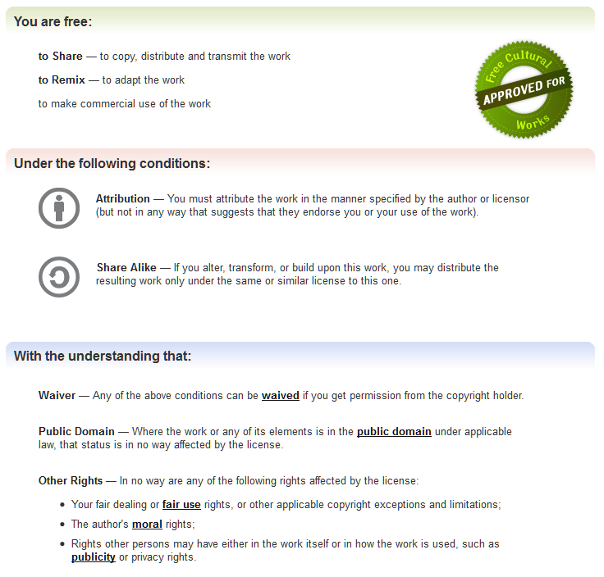
http://creativecommons.org/licenses/by-sa/3.0/
Notes:
59

