Slide 1
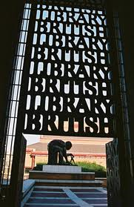
Expert Workshop "Copyright fit for the Internet Age: National and International Strategies to support Education and Research“ British Library, London, UK Friday, 27 May 2011
The need for a European-wide general Exception in favor of Research and Education
Rainer Kuhlen Department of Computer and Information Science University of Konstanz, Germany
CC

Slide 2
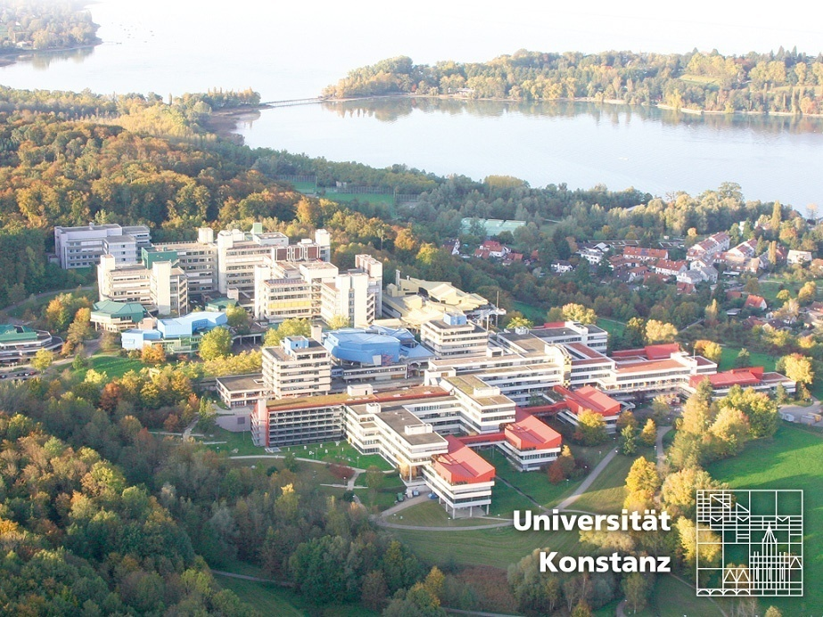
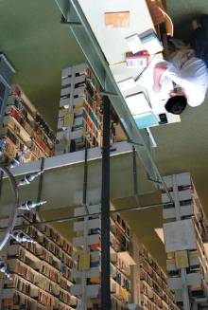
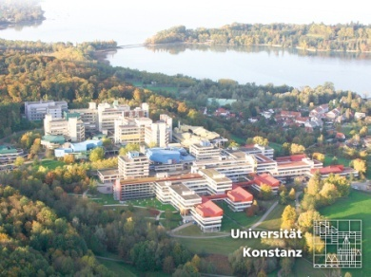
University of Konstanz
2

Slide 3
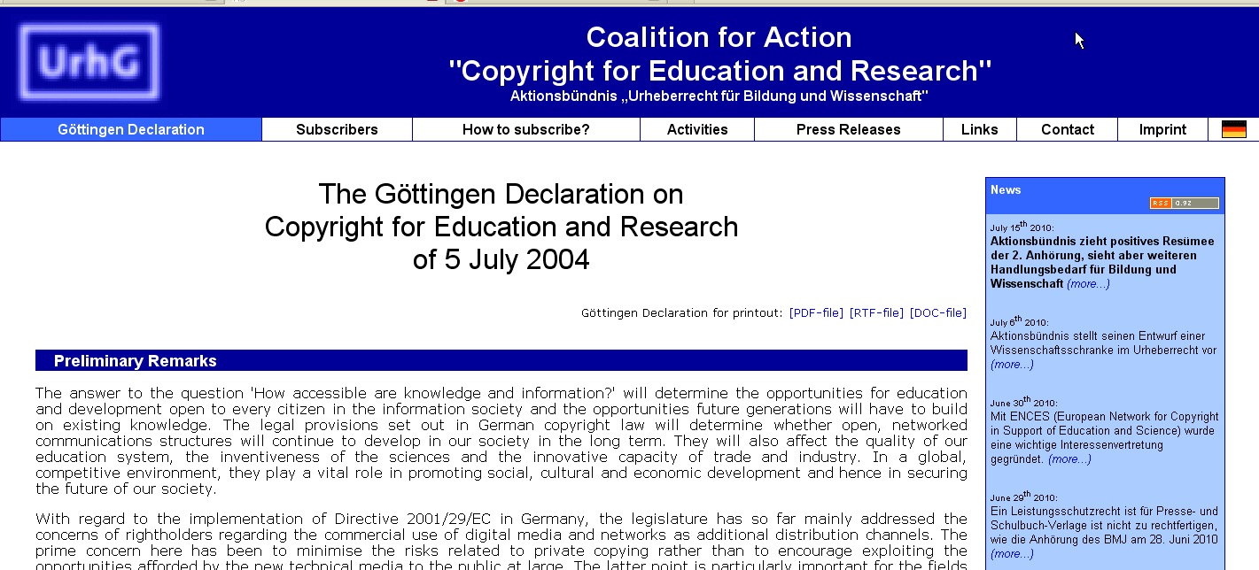

Slide 4
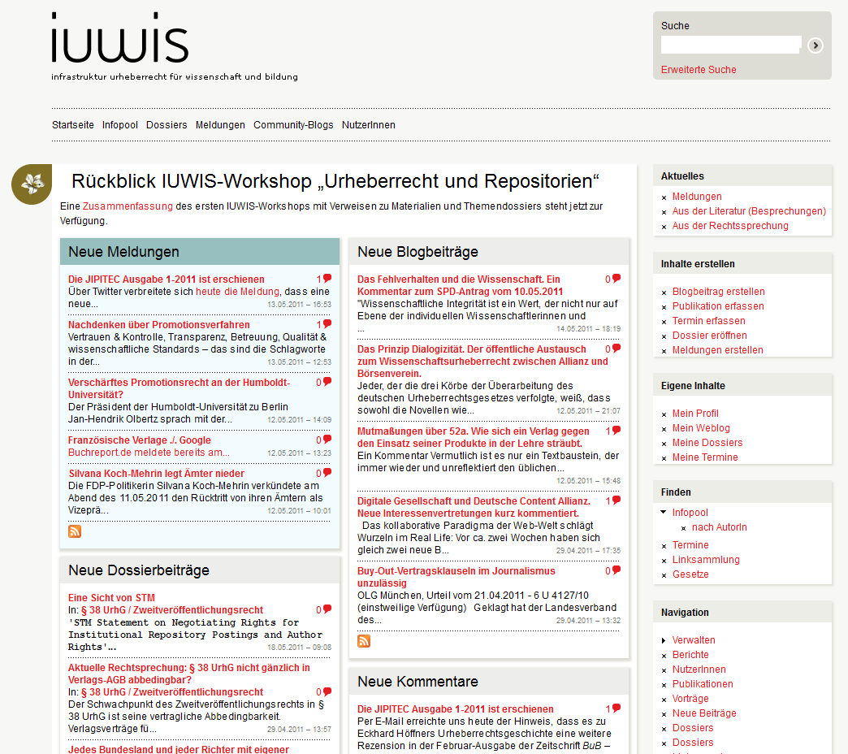
Infrastructure Copyright for Research and Education
Funded by the German Research Community (DFG)

Slide 5
Content - Topics
Questions – Objectives – Assumptions
Limitations and exception - EU-policy – Guideline 2001
New Thinking in the EU? Green paper „Copyright in the Knowledge Industry“ 2008
The Wittem proposal – use without permission – with remuneration?
A science-friendly copyright privilege – a proposal of the German Coalition for Action Copyright for Science and Education
Consequences
CC
5

Slide 6
Content - Topics
Questions – Objectives – Assumptions
Limitations and exception - EU-policy – Guideline 2001
New Thinking in the EU? Green paper „Copyright in the Knowledge Industry“ 2008
The Wittem proposal – use without permission – with remuneration?
A science-friendly copyright privilege – a proposal of the German Coalition for Action Copyright for Science and Education
Consequences
6

Slide 7
Questions – Objectives – Assumptions
7

Slide 8
Questions – Objectives – Assumptions
Is a strong copyright an appropriate means to further progress in science and education?
It depends
on what one considers a strong copyright to be
8

Slide 9
Questions – Objectives – Assumptions
What is a strong copyright?
1. One that it is built on the idea of a homogenous copyright irrespective of the domain of knowledge, of the interests and expectations of authors or of those of the users, respectively
2.1 One that sets emphasis on public interests by providing society (users) with information products and with unhindered access to them under fair conditions
2.2 One that sets emphasis on individual private rights of either authors or exploiters
3. One that fosters the progress of science and the arts
4.1 One that admits public (political) responsibility for the production and usage of knowledge and information by explicitly acknowledging priority to their regulation by (copyright) law rather than on contractual agreements as a means of the market
4.2 One that leaves space for contractual agreements (between producers, exploiters and users, respectively intermediaries) for the exploitation and usage of knowledge and information rather than on explicit regulation by means of the law
9

Slide 10
Questions – Objectives – Assumptions
What is a strong copyright?
5. One that supports economic innovation and growth of the economy in general by providing unhindered access to published knowledge under fair conditions
6. One that protects the interests of information (publishing) industry and encourages innovation (value-adding effects)
7. One that stimulates the production of new knowledge by providing effective incentives to creative people and by ensuring strong protection of their work
7.1 either by turning the attention to authors rights by strengthening their moral rights (personality rights – Persönlichkeitsrechte)
7.2 or by turning the attention to authors rights by strengthening their interest in appropriate remuneration
8. One that is flexible and easily adoptable to perpetual changes in the arenas for the production, exploitation and usage of knowledge and information
9. One that is able to find a general consensus for a copyright balance between the different actors (actor groups) involved in the domains of knowledge and information
10

Slide 11
Questions – Objectives – Assumptions
What is a strong copyright?
(a) One that makes knowledge and information a commodity – and thus a scarce good ?
or
(b) One that supports open free access to knowledge and information ?
11

Slide 12
Questions – Objectives – Assumptions
Enforcement of strong copyright regulations
(type a)
in Europe and North America in the last 20 years,
makes it more and more difficult to freely access the world-wide information resources
in principle available on world-wide information markets.
12

Slide 13
Questions – Objectives – Assumptions
Copyright regulation does not acknowledge
access to knowlegde a right in itself
Copyright regulation does not find a systematic compromize between copyright norms and other humans rights
such as freedom of expression or
freedom of science
13

Slide 14
Limitations and exceptions
14

Slide 15
Questions – Objectives – Assumptions
There is no special copyright privilege for science and education
or for intermediaries/libraries
The interests of science and education are only taken into consideration by exceptions of and limitations to exclusive rights of the right-hoilders
according to a
strong interpretation of the three-step-test
15

Slide 16
Limitations and exceptions - three-step-test
Article 13 Limitations and Exceptions [TRIPS/WTO]
(1) Members shall confine limitations or exceptions to exclusive rights to certain special cases which
(2) do not conflict with a normal exploitation of the work
(3) and do not unreasonably prejudice the legitimate interests of the right holder.
16

Slide 17
Limitations and exceptions in the EU
17

Slide 18
Limitations and exceptions
Leaves this directive sufficient space for adequate norms for research and education?
18

Slide 19
Limitations and exceptions
This Directive provides for an exhaustive enumeration of
exceptions and limitations to the reproduction right and
the right of communication to the public. (32)
Member States should be given the option of providing for certain exceptions or limitations for cases such as educational and scientific purposes, for the benefit of public institutions such as libraries and archives, … (34)
Member States may provide for an exception or limitation for the benefit of certain non-profit making establishments, such as publicly accessible libraries and
equivalent institutions, as well as archives. However, this should be limited to certain special cases covered by the reproduction right. Such an exception or limitation should not cover uses made in the context of on-line delivery of protected works or other subject-matter. (40)
19

Slide 20
Limitations and exceptions
When applying the exception or limitation for noncommercial educational and scientific research purposes, including distance learning, the non-commercial nature of the activity in question should be determined by that activity as such. The organisational structure and the means of funding of the establishment concerned are not the decisive factors in this respect. (42)
(a) use for the sole purpose of illustration for teaching or scientific research, as long as the source, including the author's name, is indicated, unless this turns out to be impossible and to the extent justified by the non-commercial purpose to be achieved;
Art. 5, 3, a
20

Slide 21
Limitations and exceptions
(a) use for the sole purpose of illustration for teaching or scientific research, as long as the source, including the author's name, is indicated, unless this turns out to be impossible and to the extent justified by the non-commercial purpose to be achieved;
but
When applying the exceptions and limitations provided for in this Directive, they should be exercised in accordance with international obligations. Such exceptions and limitations may not be applied in a way which prejudices the legitimate interests of the rightholder or which conflicts with the normal exploitation of his work or other subject-matter. (44)
21

Slide 22
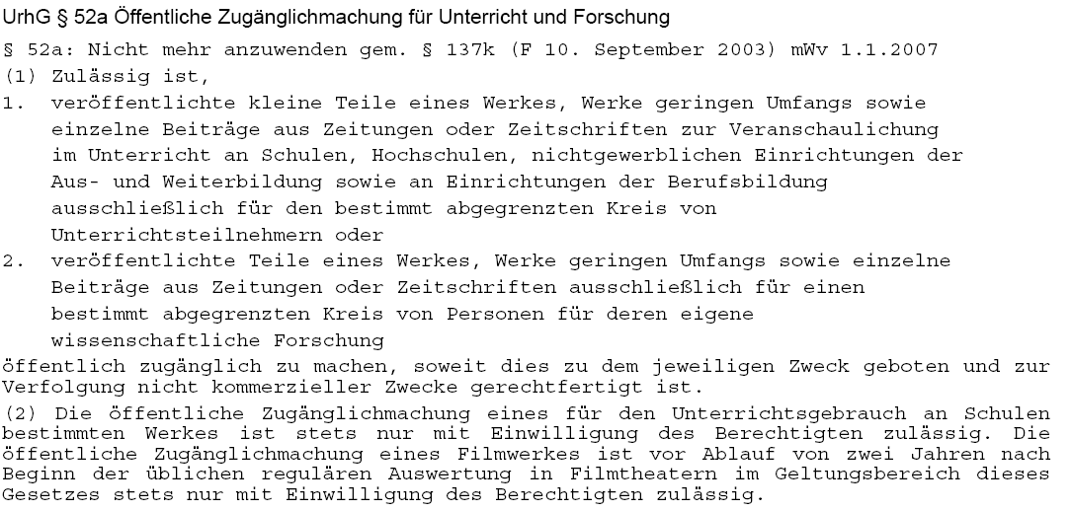
Exceptions for science, education (§ 52a German copyright law)
Only for use in classroom
Only small parts of works
Time limit end of 2006, then 2008, now 2012
For the use of defined research groups
A reasonable fee needs to be paid to collecting societies in any case
Only for registered students in classes
without any direct or indirect commercial interest
Use of copyrighted material in schools only with special permission of rightholders
Use of movie/video material only 2 years after public performance
Notes:
22

Slide 23
Limitations and exceptions - three-step-test
Development of a strong copyright (type b) depends on a balanced liberal flexible interpretation of the three-step-test
((a) One that makes knowledge and information a scarce good – a commodity ?
(b) One that supports open free access to knowledge and information ?
DECLARATION
A BALANCED INTERPRETATION
OF THE “THREE-STEP TEST” IN COPYRIGHT LAW
(Geiger, Hilty, Griffiths, Suthersanen 2008)
The Three-Step Test does not require limitations and exceptions to be interpreted narrowly.
They are to be interpreted according to their objectives and purposes.
23

Slide 24
Limitations and exceptions - three-step-test
A BALANCED INTERPRETATION
OF THE “THREE-STEP TEST” IN COPYRIGHT LAW
(Geiger, Hilty, Griffiths, Suthersanen 2008)
Development of a strong copyright (type b) depends on a balanced liberal flexible interpretation of the three-step-test
In applying the Three-Step Test, account should be taken of the interests of original rightholders, as well as of those of subsequent rightholders.
24

Slide 25
Limitations and exceptions - three-step-test
A BALANCED INTERPRETATION
OF THE “THREE-STEP TEST” IN COPYRIGHT LAW
(Geiger, Hilty, Griffiths, Suthersanen 2008)
Development of a strong copyright (type b) depends on a balanced liberal flexible interpretation of the three-step-test
The Three-Step Test should be interpreted in a manner that respects the legitimate interests of third parties, including
interests deriving from human rights and fundamental freedoms; interests in competition, notably on secondary markets; and
other public interests, notably in scientific progress and cultural,
social, or economic development.
25

Slide 26
New Thinking in the EU?
http://ec.europa.eu/internal_market/copyright/docs/copyright-infso/greenpaper_en.pdf
26

Slide 27
The Green Paper will focus on how research, science and educational materials are disseminated to the public and whether knowledge is freely circulating in the internal market.
http://ec.europa.eu/internal_market/copyright/docs/copyright-infso/greenpaper_en.pdf
27

Slide 28
The Copyright Directive allows Member States to provide for exceptions or limitations to the rights of reproduction and communication to the public when a work is used "for the sole purpose of illustration for teaching or scientific research, as long as the source, including the author's name, is indicated, unless this turns out to be impossible and to the extent justified by the non-commercial purpose to be achieved.“ (Article 5, 3, a)
This exception has often been implemented in a narrow sense and distance or Internet-based learning at home is not covered.
Also, the exception often only covers copying excerpts of the research material rather than the entire work. Sometimes Member States have opted for a teaching exception, while having no exception for research.
http://ec.europa.eu/internal_market/copyright/docs/copyright-infso/greenpaper_en.pdf
28

Slide 29
In the Member States where the exception for teaching and research is reflected in the national law, the relevant provisions differ to a significant extent. While some countries extend the exception to the rights of communication and making available to the public (e.g. Belgium, Luxembourg, Malta, and France (as of January 2009)), others restrict it to the right of reproduction (Greece, Slovenia) or allow communication to the public only on the condition that it cannot be received outside the premises of the educational institution (UK).
Germany, on the other hand, makes a distinction between teaching and research activities; for the former, it allows the use of protected works only for teaching in the classroom and by intranet where it is limited to a group of students attending a particular course. The approach towards research is less restrictive as the making available of works is permitted "for purposes of own research" and "to a limited number of participants"
http://ec.europa.eu/internal_market/copyright/docs/copyright-infso/greenpaper_en.pdf
29

Slide 30
Different treatment of the same act in different Member States may lead to legal uncertainty with regard to what is permitted under the exception, especially when teaching and research are carried out within a transnational framework.
An increasing number of students and researchers prefer to have access to relevant learning resources not only in a traditional classroom environment, but also using online networks, without any constraints of time or geography.
Provisions only allowing reprographic copying of works or requiring students to
be physically present on the premises of the educational institutions do not allow these establishments to exploit the potential of the new technologies and engage in distance learning programs.
http://ec.europa.eu/internal_market/copyright/docs/copyright-infso/greenpaper_en.pdf
30

Slide 31
Questions
(19) Should the scientific and research community enter into licensing schemes with publishers in order to increase access to works for teaching or research purposes? …
(20) Should the teaching and research exception be clarified so as to accommodate modern forms of distance learning?
(21) Should there be a clarification that the teaching and research exception covers not only material used in classrooms or educational facilities, but also use of works at home for study?
(22) Should there be mandatory minimum rules as to the length of the excerpts from works which can be reproduced or made available for teaching and research purposes?
(23) Should there be a mandatory minimum requirement that the exception covers both teaching and research?
http://ec.europa.eu/internal_market/copyright/docs/copyright-infso/greenpaper_en.pdf
31

Slide 32
Therefore, there have been calls to introduce a mandatory exception for teaching and scientific research, with a clearly defined scope in the Directive.
For example, the Gowers Review recommends that the educational exception "should be defined by category of use and activity and not by media or location''.
Gowers Review of Intellectual Property 2006, para. 4.15
32

Slide 33
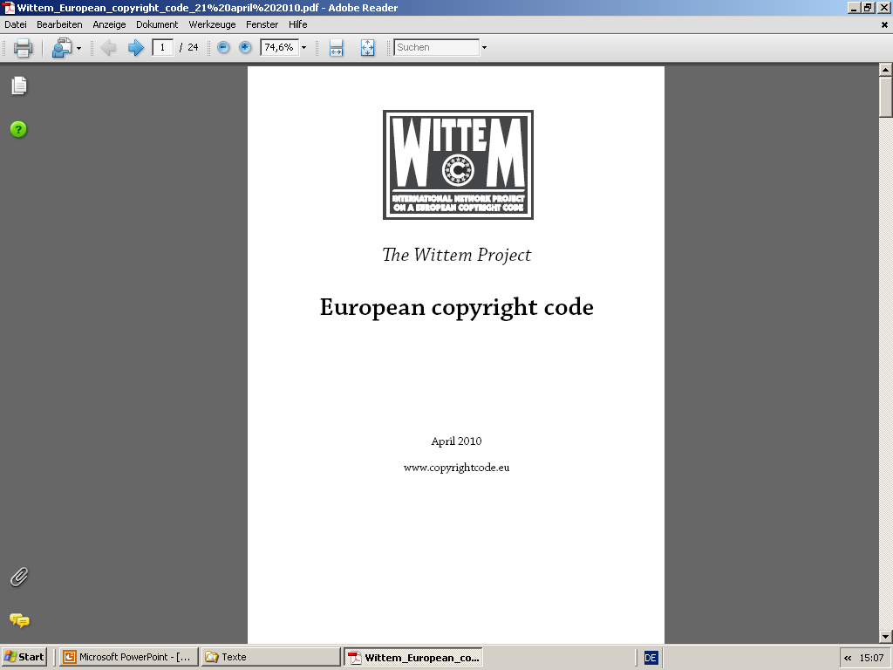
The Wittem proposal – groundbreaking?
33

Slide 34
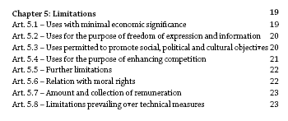
The Wittem proposal – groundbreaking?
34

Slide 35
The Wittem proposal – groundbreaking?
Art. 5.2– Uses for the purpose of freedom of expression and information
(2) The following uses for the purpose of freedom of expression and information are permitted without authorisation, but only against payment of remuneration and to the extent justified by the purpose of the use:
(a) use of single articles for purposes of internal reporting within an organisation;
(b) use for purposes of scientific research.
35

Slide 36
The Wittem proposal – groundbreaking?
Art. 5.3 – Uses permitted to promote social, political and cultural objectives
(2) The following uses for the purpose of promoting important social, political and cultural objectives are permitted without authorisation, but only against payment of remuneration, and to the extent justified by the purpose of the use:
(a) reproduction by a natural person for private use, provided that the source from which the reproduction is made is not an obviously infringing copy;
(b) use for educational purposes.
36

Slide 37
The Wittem proposal – groundbreaking?
The approach of the Wittem group is both
traditional, conservative (realistic) and surprinsingly innovative
focus on a set of exceptions
focus on single author and unitary closed work
unrestricted use for purposes of
scientific research
unrestricted use for educational purposes
without authorisation, but only against payment of remuneration
37

Slide 38
A generic clause for science and education
A proposal of the German Coalition for Action „Copyright for Research and Education“
Similar proposal by the German Alliance of the Research Organizations
Similar proposal by the Conference of Culture of the States in Germany
38

Slide 39
A generic clause for science and education education
§ 45b Education and Science
(1) Copying, distributing and making published works available to the public is permitted for personal use in science and for educational purposes in schools, institutions of higher education (such as universities), and other non-commercial institutions dedicated to education, continuing and professonal training.
The right to make works publicly available (and to use these works) is restricted in each case to a well-defined group of people in science and education. Sentence 1 is also valid for scientific and educational purposes in documentation, archiving and preservation, in particular for services provided by publicly financed libraries, archives, documentation centers and museums which support scientific usage and serve educational purposes.
39

Slide 40
A generic clause for science and education education
§ 45b Education and Science
(1) Copying, distributing and making published works available to the public is permitted for personal use in science and for educational purposes in schools, institutions of higher education (such as universities), and other non-commercial institutions dedicated to education, continuing and professonal training.
provided that the source from which the reproduction is made is not an obviously infringing copy
from a legitimately acquired copy only, e.g. from a library or bought from a commercial provider
not restricted to publicly financed science
40

Slide 41
A generic clause for science and education education
§ 45b Education and Science
... The right to make works publicly available (and to use these works) is restricted in each case to a well-defined group of people in science and education. …
Scientists within a research group (local but also remote)
Members (students) of a course (local but also remote - e-learning)
41

Slide 42
A generic clause for science and education education
§ 45b Education and Science
… Sentence 1 is also valid for scientific and educational purposes in documentation, archiving and preservation, in particular for services provided by publicly financed libraries, archives, documentation centers and museums which support scientific usage and serve educational purposes. ...
42

Slide 43
A generic clause for science and education education
§ 45b Education and Science
(2) The usage of published works according to para (1) requires remuneration. Remuneration can only be claimed by a collecting society or by another legitimized institution.
(3) Contractual agreements which rule out para (1) are invalid.
43

Slide 44
Consequences
needed
needed
needed
a new understanding of copyright
free access in R&E is not an exception but as right
a new understanding of copyright
free access in R&E → the default
commercial exploitation → the exception
New business models for knowledge and information in recognition of
the free access paradigm
Notes:
44

Slide 45
Consequences
needed
needed
needed
A European-wide initiative for a research- and education friendly copyright
ENCES
Overcoming the shortcomings of the system of exceptions
Introducing a general clause for research and education
„to promote the Progress of Science and useful Arts“ (US Constitution, Article I, Section 8, Clause 8)
Notes:
45

Slide 46
Thank you for your attention
Slides under a CC-Lincence from www.kuhlen.name
Notes:
46

Slide 47
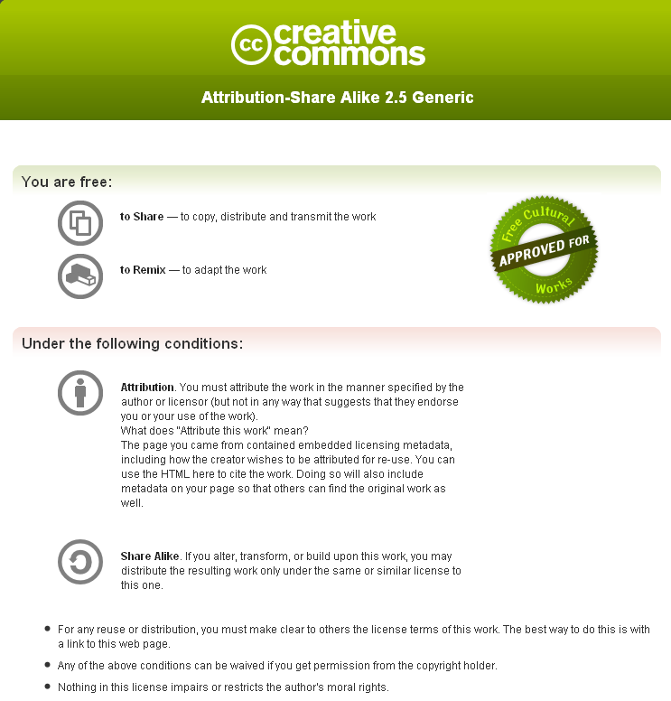
Notes:
47

