Slide 1


Towards a commons-based understanding of knowledge and information
Rainer Kuhlen
Department of Computer and Information Science
University of Konstanz, Germany

Slide 2
Messages
(1) For UNESCO and ORBICOM I would like to raise awareness for the importance of the concept of the commons, in our case of the immaterial commons such as knowledge and information, for the development of inclusive, just, and sustainable knowledge societies, as emphasized by the UNESCO in the WSIS process.
(2) The concept of knowledge and information as commons is useful in order to overcome the current deadlock in the worldwide copyright regulation which is currently heavily dominated by the commercial exploitation of knowledge and information, by strongly supporting exclusive private property rights claims and by broadly neglecting the public need for free and open access and use of published knowledge.

Slide 3
Commons

Slide 4
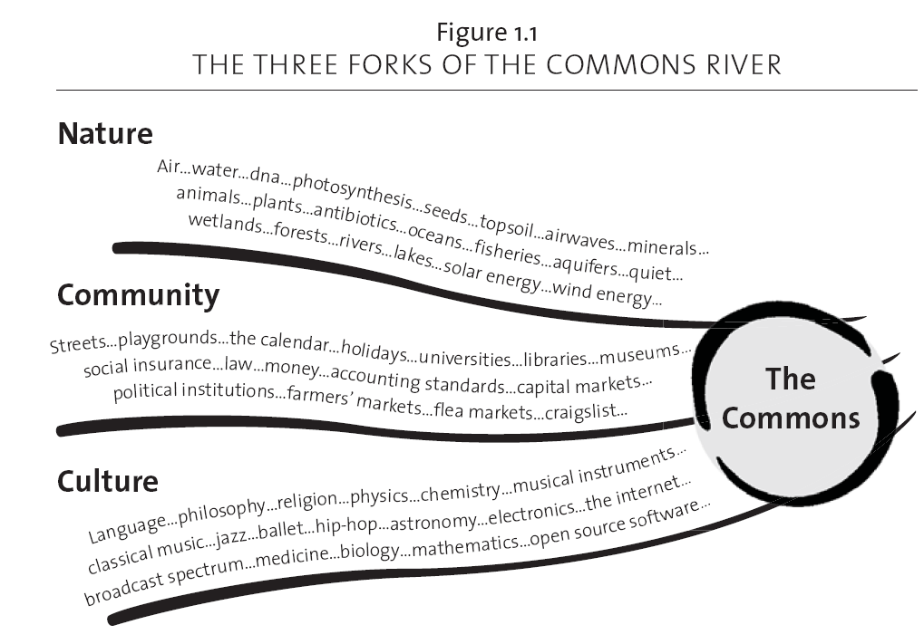
Common Pool Resources
Commons
Common heritage of nature
Commons are institutionalized „common-pool resources“
res nullius
res privatae
res publicae
res communes
Common heritage of social life
Commons heritage of cultural creativity
knowledge and information
From: Peter Barnes: Capitalism 3.0

Slide 5
Institutionalizing common-pool resources making them commons
Commons are socially constructed.
Common Pool Resources
principles
Commons
institution-alization
procedures
clean air and water
oil pools
air
knowledge
accessible
usable
under certain conditions
5

Slide 6
Institutionalizing common-pool resources making them commons
privatization
enclosure of the mind
profitability
scarce resource
sharing
justice, fairness
openness
inclusion
sustainabilty
It´s our choice
knowledge resources
Principles, values
access to information products
services
systems
institution-alization
procedures
communication (reaching a consensus)
commitments
contracts
rules, laws, legal norms
control mechanisms, sanctions
Private information markets
Commons-based information markets
6

Slide 7
Models for the institutionalization of knowledge on commons-based information markets
k&i objects
k&i objects
a property of mankind
exception: commercial exploitation
default: open access
attributed to
under the condition of
the creator of knowledge with personal moral rights
non-exclusive exploitation rights
free access to everyone is guaranteed
used as
sufficient compensation to the public
a means of personal and societal development
monetary, tax
value-adding effects
7

Slide 8
What needs to be done? Consequences

Slide 9
Consequences
Needed
a new understanding of intellectual property
knowledge as a commons is not to be considered a
res nullius, which can be used ad libitum by everyone for whatever purpose
Knowledge and its derivative information products cannot be the subject of exclusive private property rights

Slide 10
Consequences
a new understanding of intellectual property
a new understanding of copyright
free access → the default
commercial exploitation → the exception
developing a concept of common property rights without denying private individual property rights

Slide 11
Conclusion
Knowledge and its derivative information products cannot be the subject of exclusive private property rights
Production and use of knowledge and its derivative information products depend on commons-based institutionalization forms appropriate to electronic environments
Commons-based information markets do not make the commercial use of knowledge and its derivative information products impossible but rather are the realistic chance for the information economy to survive successfully
11

Slide 12
Questions?
Discussion
more Informationen - under a CC-Lizenz (share-alike)
www.kuhlen.name
Notes:
12

Slide 13

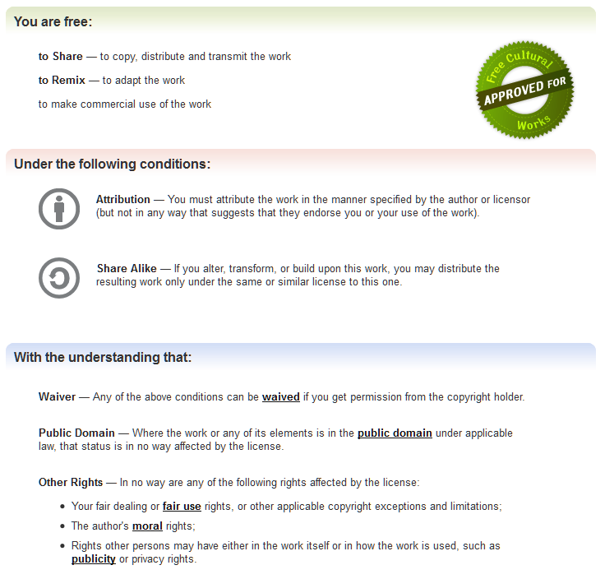
http://creativecommons.org/licenses/by-sa/3.0/
Notes:
13

Slide 14



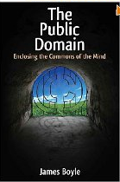
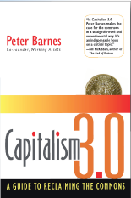
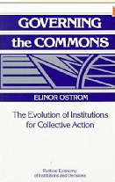

Silke Helfrich (Hrsg.): Wem gehört die Welt? Zur Wiederentdeckung der Gemeingüter 2009
Yochai Benkler: The Wealth of Networks: How Social Production Transforms Markets and Freedom, 2006
Erscheint 5/12
Transcript-Verlag
James Boyle: Enclosing the Commons of the Mind, 2008
Elinor Oström: Governing the Commons: The Evolution of Institutions for Collective Action 1990
Peter Barnes: Capitalism 3.0. A Guide to Reclaim the Commons. 2006, deutsch 2008

