Slide 1
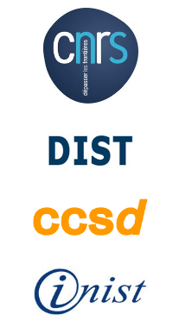
La situation de copyright en Allemagne et en Europe
Rainer Kuhlen Department of Computer and Information Science University of Konstanz, Germany
CC

Slide 2
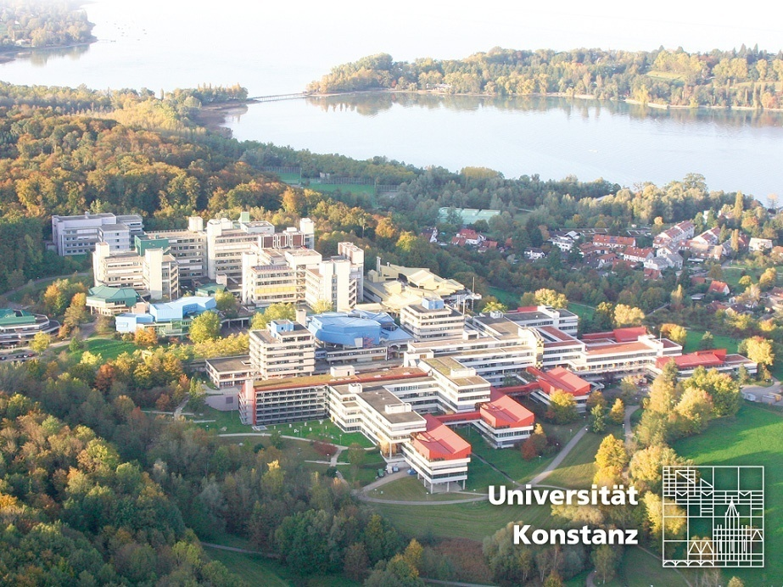
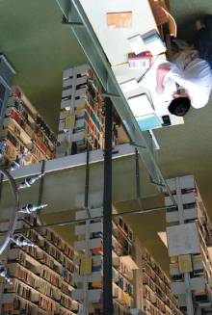
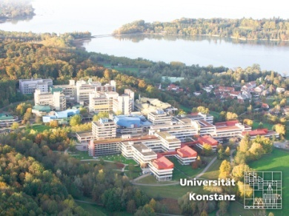
University of Konstanz
2

Slide 3
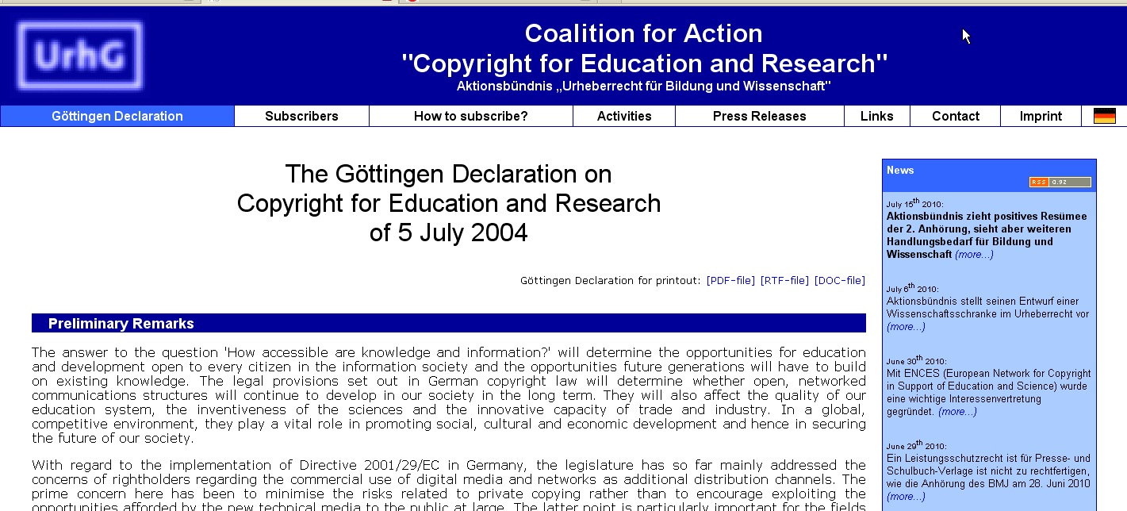

Slide 4
part of

Slide 5
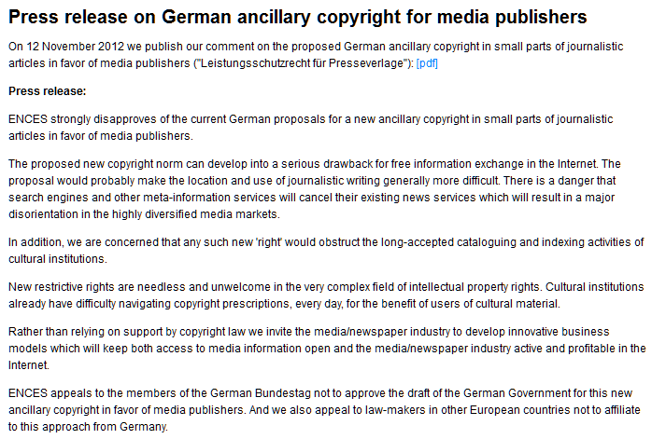

Slide 6
Content - Topics
Questions – Objectives – Assumptions
Limitations and exception
New Thinking in the EU?
Wittem
Green Paper – Copyright in the Knowledge Economy
Recommendation access to and preservation of scientific information
A generic clause for science and education
Consequences
6

Slide 7
Questions – Objectives – Assumptions
7

Slide 8
Questions – Objectives – Assumptions
Is a strong copyright an appropriate means to further progress in science and education?
It depends
on what one considers a strong copyright to be
8

Slide 9
Questions – Objectives – Assumptions
What is a strong copyright?
(a) One that makes knowledge and information a commodity – and thus a scarce good ?
or
(b) One that supports free and open access to knowledge and information ?
9

Slide 10
Questions – Objectives – Assumptions
Enforcement of strong copyright regulations
(type a)
in Europe and North America in the last 20 years,
makes it more and more difficult to freely and openly access the world-wide information resources
in principle available on world-wide information markets.
10

Slide 11
Questions – Objectives – Assumptions
Copyright regulation does not acknowledge
access to knowlegde as a right in itself
Copyright regulation does not find a systematic compromise between copyright norms and other humans rights
such as freedom of expression or
freedom of science
11

Slide 12
Limitations and exceptions
12

Slide 13
Limitations and exceptions
There is no special copyright privilege for science and education (or for libraries)
The interests of science and education are only taken into consideration by exception and limitation to exclusive rights of the right-holders
Exceptions and limitations are only allowed if and when they comply with a strong interpretation of the three-step-test
13

Slide 14
Limitations and exceptions - three-step-test
Article 13 Limitations and Exceptions [TRIPS/WTO]
(1) Members shall confine limitations or exceptions to exclusive rights to certain special cases which
(2) do not conflict with a normal exploitation of the work
(3) and do not unreasonably prejudice the legitimate interests of the right holder.
14

Slide 15
Limitations and exceptions in the EU
15

Slide 16
Limitations and exceptions
Does this directive leave sufficient space to adequate norms for research and education
and open access?
16

Slide 17
Limitations and exceptions
This Directive provides for an exhaustive enumeration of
exceptions and limitations to the reproduction right and
the right of communication to the public. (32)
Member States should be given the option of providing for certain exceptions or limitations for cases such as educational and scientific purposes, for the benefit of public institutions such as libraries and archives, … (34)
Member States may provide for an exception or limitation for the benefit of certain non-profit making establishments, such as publicly accessible libraries and
equivalent institutions, as well as archives. However, this should be limited to certain special cases covered by the reproduction right. Such an exception or limitation should not cover uses made in the context of on-line delivery of protected works or other subject-matter. (40)
17

Slide 18
Limitations and exceptions
(a) use for the sole purpose of illustration for teaching or scientific research, as long as the source, including the author's name, is indicated, unless this turns out to be impossible and to the extent justified by the non-commercial purpose to be achieved;
Art. 5, 3, a
but
When applying the exceptions and limitations provided for in this Directive, they should be exercised in accordance with international obligations. Such exceptions and limitations may not be applied in a way which prejudices the legitimate interests of the rightholder or which conflicts with the normal exploitation of his work or other subject-matter. (44)
18

Slide 19
Limitations and exceptions
Transforming
Art. 5, 3, a
into German Copyright Law
19

Slide 20
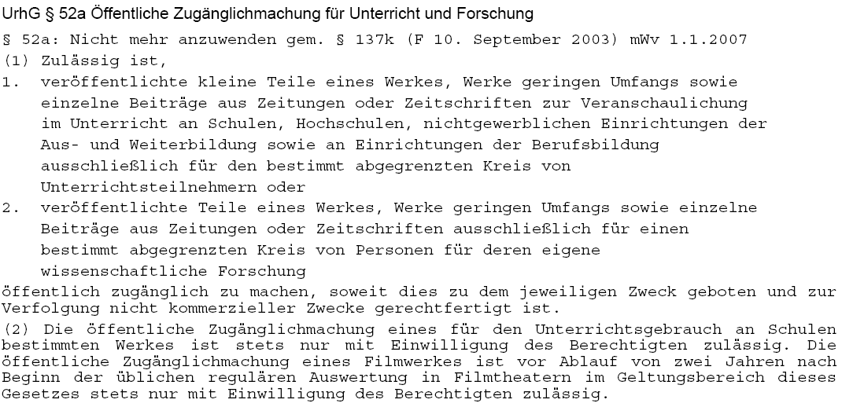
Exceptions for science, education (§ 52a German copyright law)
Only for use in classroom
Only small parts of works
Time limit end of 2006, then 2008, now 2012, again extended till 2014
For the use of defined research groups
A reasonable fee needs to be paid to collecting societies in any case
Only for registered students in classes
without any direct or indirect commercial interest
Use of copyrighted material in schools only with special permission of rightholders
Use of movie/video material only 2 years after public performance
Notes:
20

Slide 21
Legislation towards open access in Germany?
A long-lasting (never-ending) debate about an author´s right to a second publication, in addition to the first (normally) commercial one
Expecting/hoping that authors will use their new freedom for making their works available according to Open Access principles
Notes:
21

Slide 22
Legislation towards open access in Germany?
Everyone in Germany (even in different political parties) seems to be in favour of such a right
Diskussionspapier der CDU/CSU-Bundestagsfraktion zum Urheberrecht in der digitalen Gesellschaft – 12.6.2012
Obligatory right to a second publication
„Zudem setzen wir uns für die Verankerung eines verbindlichen Zweitveröffentlichungsrechts in den Förderrichtlinien für Autoren wissenschaftlicher Beiträge im Internet ein. Ziel ist es, dass öffentlich geförderte Forschungsprojekte nicht ausschließlich in Verlagspublikationen veröffentlicht werden.“
Publicly funded research should not be exclusively commercially published
Notes:
22

Slide 23
Legislation towards open access in Germany?
Everyone in Germany (even in different political parties) seems to be in favour of such a right
except for the goverment (Ministry of Justice) and
the publishers and some authors`rights fundamentalists
Strong objections towards the green OA approach:
“Free availability of significant proportions of a journal’s content may result in its cancell-ation and therefore destroy the peer review system upon which researchers and society depend“ BRUSSELS DECLARATION STM, International Association of STM Publishers http://www.stm-assoc.org/2012_07_17_STM_Press_Release_on_UK_Gov_Support_for_Finch.pdf.
Strong objections towards an OA mandate:
an author´s right to a second publication will actually force authors to OA publishing (public pressure)
This is considered against the constitutionally guaranteed freedom of science, in this case the freedom of publishing (if, when, how, and where to publish)
Notes:
23

Slide 24
New Thinking in the EU?
Notes:
24

Slide 25
a reconsideration of the three-step-test with its rigorous exceptions and limitations
needed
25

Slide 26
Limitations and exceptions - three-step-test - reconsidered
Development of a science-friendly copyright depends on a balanced liberal flexible interpretation of the three-step-test
DECLARATION
A BALANCED INTERPRETATION
OF THE “THREE-STEP TEST” IN COPYRIGHT LAW
(Geiger, Hilty, Griffiths, Suthersanen 2008)
The Three-Step Test does not require limitations and exceptions to be interpreted narrowly.
They are to be interpreted according to their objectives and purposes.
26

Slide 27
Limitations and exceptions - three-step-test
Development of a science friendly copyright depends on a balanced liberal flexible interpretation of the three-step-test
In applying the Three-Step Test, account should be taken of the interests of original rightholders, as well as of those of subsequent rightholders.
27

Slide 28
Limitations and exceptions - three-step-test
Development of a science friendly copyright depends on a balanced liberal flexible interpretation of the three-step-test
The Three-Step Test should be interpreted in a manner that respects the legitimate interests of third parties, including
interests deriving from human rights and fundamental freedoms; interests in competition, notably on secondary markets; and
other public interests, notably in scientific progress and cultural,
social, or economic development.
28

Slide 29
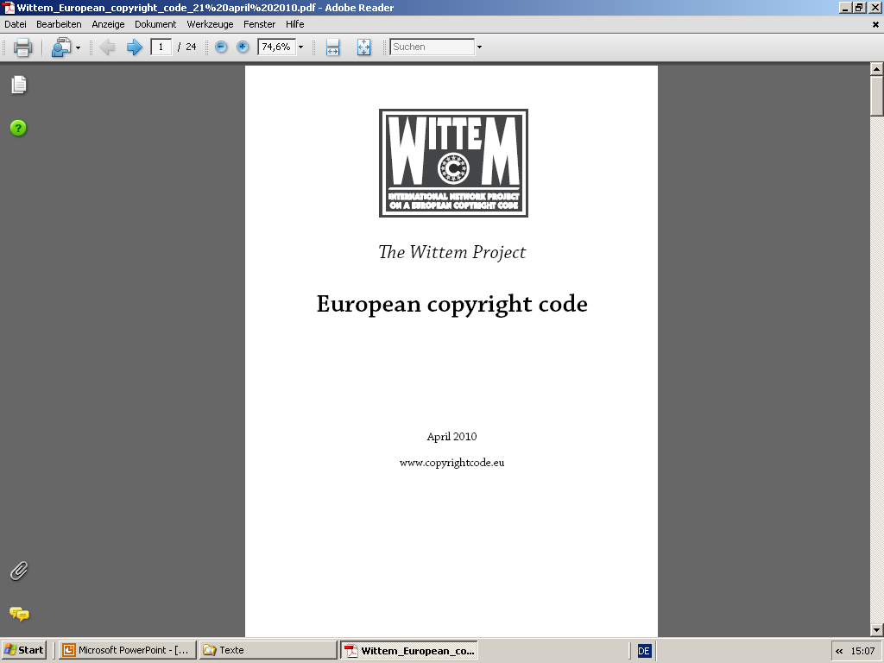
New Thinking in the EU?
29

Slide 30
The Wittem proposal – groundbreaking?
a first step
Art. 5.2– Uses for the purpose of freedom of expression and information
(2) The following uses for the purpose of freedom of expression and information are permitted without authorisation, but only against payment of remuneration and to the extent justified by the purpose of the use:
(a) use of single articles for purposes of internal reporting within an organisation;
(b) use for purposes of scientific research.
without authorisation, but only against payment of remuneration
unrestricted use for purposes of
scientific research
30

Slide 31
The Wittem proposal – groundbreaking?
a first step
Art. 5.3 – Uses permitted to promote social, political and cultural objectives
(2) The following uses for the purpose of promoting important social, political and cultural objectives are permitted without authorisation, but only against payment of remuneration, and to the extent justified by the purpose of the use:
(a) reproduction by a natural person for private use, provided that the source from which the reproduction is made is not an obviously infringing copy;
(b) use for educational purposes.
unrestricted use for educational purposes
without authorisation, but only against payment of remuneration
31

Slide 32
New Thinking in the EU?
http://ec.europa.eu/internal_market/copyright/docs/copyright-infso/greenpaper_en.pdf
32

Slide 33
The Green Paper will focus on how research, science and educational materials are disseminated to the public and whether knowledge is freely circulating in the internal market.
http://ec.europa.eu/internal_market/copyright/docs/copyright-infso/greenpaper_en.pdf
33

Slide 34
Exception Article 5, 3, a of the 2001 Copyright Directive
“has often been implemented in a narrow sense and distance or Internet-based learning at home is not covered.
Also, the exception often only covers copying excerpts of the research material rather than the entire work. Sometimes Member States have opted for a teaching exception, while having no exception for research.”
http://ec.europa.eu/internal_market/copyright/docs/copyright-infso/greenpaper_en.pdf
34

Slide 35
In the Member States where the exception for teaching and research is reflected in the national law, the relevant provisions differ to a significant extent.
Different treatment of the same act in different Member States may lead to legal uncertainty with regard to what is permitted under the exception, especially when teaching and research are carried out within a transnational framework
http://ec.europa.eu/internal_market/copyright/docs/copyright-infso/greenpaper_en.pdf
35

Slide 36
Questions
(19) Should the scientific and research community enter into licensing schemes with publishers in order to increase access to works for teaching or research purposes? …
(20) Should the teaching and research exception be clarified so as to accommodate modern forms of distance learning?
(21) Should there be a clarification that the teaching and research exception covers not only material used in classrooms or educational facilities, but also use of works at home for study?
(22) Should there be mandatory minimum rules as to the length of the excerpts from works which can be reproduced or made available for teaching and research purposes?
(23) Should there be a mandatory minimum requirement that the exception covers both teaching and research?
http://ec.europa.eu/internal_market/copyright/docs/copyright-infso/greenpaper_en.pdf
36

Slide 37
Therefore, there have been calls to introduce a mandatory exception for teaching and scientific research, with a clearly defined scope in the Directive.
For example, the Gowers Review recommends that the educational exception "should be defined by category of use and activity and not by media or location''.
Gowers Review of Intellectual Property 2006, para. 4.15
37

Slide 38
New Thinking in the EU?
on access to and preservation of scientific information
http://medoanet.sciencesconf.org/conference/medoanet/pages/recommendation_access_and_preservation_scientific_information_fr_copie.pdf
http://ec.europa.eu/research/science-society/document_library/pdf_06/recommendation-access-and-preservation-scientific-information_en.pdf
38

Slide 39
New Thinking in the EU?
RECOMMANDATION DE LA COMMISSION du 17.7.2012 relative à l'accès aux informations scientifiques et à leur conservation
with reference to the
Revised strategy on UNESCO’s contribution to the promotion of open access to scientific information and research
OECD Declaration on Access to Research Data from Public Funding
Cf. Commission Communication (12 Dec 2011) on open data - a proposal for a Directive amending Directive 2003/98/EC
39

Slide 40
New Thinking in the EU?
RECOMMANDATION DE LA COMMISSION du 17.7.2012 relative à l'accès aux informations scientifiques et à leur conservation
main objectives
Open access to scientific publications
Libre accès aux publications scientifiques
Open access to research data
Libre accès aux données de la recherche
Preservation and re-use of scientific information
Conservation et réutilisation des informations scientifiques
40

Slide 41
New Thinking in the EU?
RECOMMANDATION DE LA COMMISSION du 17.7.2012 relative à l'accès aux informations scientifiques et à leur conservation
Policies on open access to scientific research results should apply to all research that receives public funds.
Les politiques de libre accès aux résultats de la recherche scientifique devraient s'appliquer à toutes les activités de recherche financées par des fonds publics.
Open access is a key feature of Member States’ policies for responsible research and innovation by making the results of research available to all and by facilitating societal engagement.
Le libre accès est un élément clé des politiques des États membres en faveur d'une recherche et d'une innovation responsables: il permet de mettre les résultats de recherche à la disposition de tous et facilite la participation de la société.
41

Slide 42
New Thinking in the EU?
RECOMMANDATION DE LA COMMISSION du 17.7.2012 relative à l'accès aux informations scientifiques et à leur conservation
Recommendation
Define clear policies for the dissemination of and open access to scientific publications resulting from publicly funded research. These policies should provide for:
concrete objectives and indicators to measure progress;
implementation plans, including the allocation of responsibilities
associated financial planning.
de définir des politiques claires en matière de diffusion des publications scientifiques issues de la recherche financée par des fonds publics et du libre accès à ces dernières. Ces politiques devraient prévoir:
des objectifs et des indicateurs concrets permettant de mesurer les progrès accomplis
des plans de mise en oeuvre, incluant la répartition des responsabilités,
la programmation financière correspondante;
42

Slide 43
New Thinking in the EU?
RECOMMANDATION DE LA COMMISSION du 17.7.2012 relative à l'accès aux informations scientifiques et à leur conservation
result of these policies:
there should be open access to publications resulting from publicly funded research as soon as possible, preferably immediately and in any case no later than six months after the date of publication, and twelve months for social sciences and humanities;
à ce que les publications issues de la recherche financée par des fonds publics soient librement accessibles dans les meilleurs délais, de préférence immédiatement et, dans tous les cas, au plus tard six mois après leur date de publication, et au plus tard douze mois pour les publications dans les domaines des sciences sociales et humaines,
43

Slide 44
New Thinking in the EU?
RECOMMANDATION DE LA COMMISSION du 17.7.2012 relative à l'accès aux informations scientifiques et à leur conservation
result of these policies:
licensing systems contribute to open access to scientific publications resulting from publicly-funded research in a balanced way, in accordance with and without prejudice to the applicable copyright legislation, and encourage researchers to retain their copyright while granting licences to publishers;
à ce que les systèmes d'octroi de licences contribuent, de façon équilibrée, au libre accès aux publications scientifiques issues de la recherche financée par des fonds publics, dans le respect et sans préjudice de la législation applicable en matière de droit d'auteur, et encouragent les chercheurs à conserver leurs droits d'auteur tout en concédant des licences aux éditeurs,
44

Slide 45
New Thinking in the EU?
RECOMMANDATION DE LA COMMISSION du 17.7.2012 relative à l'accès aux informations scientifiques et à leur conservation
result of these policies:
the academic career system supports and rewards researchers who participate in a culture of sharing the results of their research, in particular by ensuring open access to their publications and by developing, encouraging and using new, alternative models of career assessment, metrics and indicators;
à ce que le système des carrières universitaires soutienne et récompense les
chercheurs qui adhèrent à une culture de partage de leurs résultats de
recherche, notamment en garantissant le libre accès à leurs publications et en
élaborant, en encourageant et en utilisant de nouveaux modèles, critères et
indicateurs alternatifs pour l'évaluation des carrières,
45

Slide 46
A generic clause for science and education
A proposal of the German Coalition for Action „Copyright for Research and Education“ – and revised by ENCES
Similar proposal by the German Alliance of the Research Organizations
Similar proposal by the Conference of Culture of the States in Germany
46

Slide 47
A generic clause for science and education
ENCES, the European Network for Copyright in favor of Education and Science,
proposes a unified copyright regulation for the use of published work in science and education in order to overcome the complex system of limitations and exceptions.
47

Slide 48
Objectives of a generic clause for science and education
1. Access to and use of commercially published works, without further authorization, for
a) personal use in scholarly environments
b) personal use in non-commercial institutions in education
c) non-commercial communication and intermediary services of culture and memory institutions such as libraries, archives, documentation and media centers, and museums
2. Making these works publicly available for well defined user groups in science and education
48

Slide 49
Objectives of a generic clause for science and education education
3. Free use (without authorization and without remuneration) for documentation, preservation, and long-term archiving purposes of non-commercial culture and memory institutions
4. The use may be subject to remuneration provided it does not affect the normal development of research activities and education.
5. Flat remuneration only and provided by the public state-owned science and education institutions
49

Slide 50
Perspectives

Slide 51
Perspectives
needed
needed
needed
A European-wide initiative for a research- and education friendly copyright
ENCES
Overcoming the shortcomings of the system of exceptions
Introducing a general clause for research and education
in order
„to promote the Progress of Science and useful Arts“ (US Constitution, Article I, Section 8, Clause 8)
Notes:
51

Slide 52
Perspective 1
The more restrictive copyright law is, the more likely it is that open acces will be the default in scientific publication
realistic
Perspective 2
A general copyright clause for science and education as a substitute for existing exceptions and limitations
Development of special science copyright
public (social) consensus already available
Politically realistic in the medium term
Perspective 3
New business models for the proprietary exploitation of knowledge and information
Approval of knowledge and information as commons.
part 1 - realistic in the medium term
part 2 –realistic in the long term
52

Slide 53
Will Open Access destroy commercial information markets?
It depends
yes
no
If publishers keep on insisting on exclusive exploitation rights protected by copyright
Open licensing of OA allows commercial exploitation
Green
Secondary exploitation
New value-added products
probably not profitable
protected by
Data base guideline
new auxiliary right
Copyright?
Notes:
53

Slide 54
Models of a commons-based information economy/society
Commons-based information markets
Licence for applying using rights to new products
Free and open access to information objects
Business models für value-added products
Commercial right to a secondary exploitation of information objects
realized by authors in education and science
multimedia presentation
hypertextification, dossiers
summaries, translations
retrieval and mining services
innovative reviewing models
personal und institutional background information
modified and developed in collaborative working environments
reversing OA green
legally protected by free licences (cf. CC)
Notes:
54

Slide 55
Thank you for your attention
Slides under a CC-Licence from www.kuhlen.name
Notes:
55

Slide 56
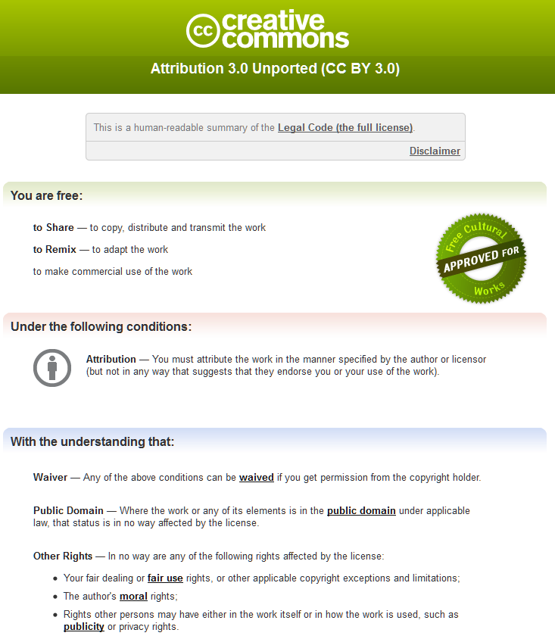
Notes:
56

