Slide 1
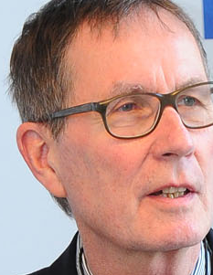
Open Access European Journal of Information Science EIS
Open Access for Science by Science
Rainer Kuhlen Department of Computer and Information Science University of Konstanz, Germany

Slide 2
Open Access European Journal of Information Science EIS
Questions
Objectives – Conceptual design – Quality control
Organization – Implementation strategy – Sustainability
Funding – Financing
Time schedule
Challenges

Slide 3
Open Access European Journal of Information Science EIS
Questions - Challenges
Q1 Is there a need for another information science journal?
Q2 Is there a need for another European information science journal/publication platform?
Q3 Is there a need for a information science publication platform as an initiative from science itself?
Q4 Is there a future for commercial publishing in science?

Slide 4
Q1 Is there a need for another information science journal?
International führend
in Deutschland
Journal of the Association for Information Science and Technology (ASIS&T)) – JASIS/T
Zeitschrift für Bibliotheks-wesen und Bibliographie - ZfBB
Information Processing & Management" - IPM
Information - Wissenschaft und Praxis - IWP
Journal of Documentation - JoD
Library and Information Science Research (LISR)
Proceedings of the American Society for Information
Science and Technology (and Proceedings of the ASIS&T Annual Meeting)
Scientometrics
Electronic Library
Information Technology and Libraries (and Journal of Library Automation)
Library Resources & Technical Services
Program—Automated Library and Information Systems
Journal of Library and Information Studies (Taiwan) OA
International Journal of Library and Information Science (IJLIS) OA , mainly Asia, Africa
….

Slide 5
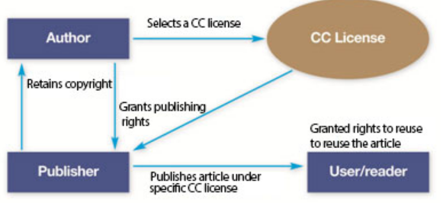
Q1 Is there a need for another information science journal?
Internationally leading
Journal of the Ass. for Inf. Sc. and Techn. - JASIS/T
Wiley
All members of the Editorial Board are from the USA or Canada – Editor in Chief Blaise Cronin
since 2008 green/yellow OA (preprints)
11 out of 37 members of the Editorial Board are from EU countries - Editor in chief Fabio Crestani, Lugano − OA: APC $1800
Information Processing & Management – IPM Elsevier
increasingly technologically oriented
Journal of Documentation - JoD
Thomson Reuters
16 out of 19 members of the Editorial Board are from EU countries - Editor in chief David Bawden, City University London

Slide 6
Q1 Is there a need for another information science journal?
Publications in international information science journals
Rank | Country | No. of articles | Rank | Country | No. of articles
1 | USA | 1631 | 11 | Singapur | 112
2 | Great Britain | 720 | 12 | Belgium | 97
3 | Canada | 271 | 13 | Israel | 91
4 | People’s Republic of China | 221 | 14 | Japan | 91
5 | Spain | 199 | 15 | Denmark | 87
6 | Taiwan | 170 | 16 | Sweden | 81
7 | Finland | 151 | 17 | Germany | 66
8 | Australia | 147 | 18 | France | 55
9 | The Netherlands | 147 | 19 | Italy | 51
10 | South Korea | 128 | 20 | Switzerland | 49
Source: Web of Science) (2000 – 2011) – Ranking according to countries (n=4395 articles); cf Schlögl Christian (2013): International visibility of European and in particular German-language publications in library and information science. In Hans-Christoph Hobohm (Hrsg.): Proceedings des 13. Internationalen Symposiums für Informationswissenschaft (ISI 2013), Glückstadt: Hülsbusch, 2013, 50-62.

Slide 7
Q2 Is there a need for another European information science journal/publication platform?
Science is international – all information science scholars are welcome in EIS
Is there a typical European understanding of information and information science?
Is this specific information understanding based in Europe´s cultural diversity and its law tradition - for instance copyright vs. authors´ rights ?

Slide 8
Q2 Is there a need for another European information science journal/publication platform?
European culture is deeply rooted in its language diversity
EIS´ primary publication language is English
all contributions will be made publicly available in the corresponding native language of the respective authors
either by the EIS server and/or by a publishing media of the respective country

Slide 9
Q3 Is there a need for a information science publication platform as an initiative from science itself?
There is evidence that open access will be the dominating publishing paradigm for the commercial publishing industry, too
But – so far no self-financing commercial publishing models have been developed by the publishing industry
The publishing industry still expect public funding of commercial open access publishing, not only for covering the publication/distribution costs but also for the profit forecasts (in the past about 25%)

Slide 10
Q3 Is there a need for a information science publication platform as an initiative from science itself?
Die Leistung der öffentlichen Zugänglichmachung kann aus der Wissenschaft selbst und/oder mit Hilfe der Bibliotheken erbracht werden
Herausgeber − Editorial Board – topics - authors
Setzen die Themen – finden und unterstützen die Autoren
AutorInnen übertragen ihre Forschungsergebnisse in kommunizierbare Dokumente selbst
Qualitätskontrolle (über verschiedene Formen des Revieweing) ist immer schon von der Wissenschaft selber geleistet worden

Slide 11
Q4 Is there a future for commercial publishing in science?
Das Leistungsmonopol der Verlage als „Vorleger“ von Kapital und technisch-methodischen Know How zur öffentlichen Zugänglichmachung besteht nicht mehr.
Das Know how der Verlagswirtschaft wird aber auch weiter im wissenschaftlichen Publikationsbereich gebraucht – unter der Bedingung
Verlagswirtschaft setzt den Zugriff auf die primären Dokumente frei (libre et gratuit)
Verlagswirtschaft finanziert sich selbst durch die lizenzierte Bereitstellung informationeller Mehrwertleistungen

Slide 12
Q4 Is there a future for commercial publishing in science?
The two information markets in science
Open Access (gratuit et libre) to information objects
Using free licences for commerical use
Business models für value-added products
realized by authors in education and science
multimedia presentation
hypertextification, dossiers
summaries, translations
retrieval, text and data mining tools
innovative reviewing models
personal und institutional background
etc. etc.
legally protected by free licences (cf. CC-BY)

Slide 13
Objectives - Ziele
OA-EIS soll den weiteren Bereich der Informations-wissenschaft abdecken, einschließlich der Bereiche Bibliothek, Archive, Museen etc.
Da „Information“ Gegenstand vielfältiger Disziplinen ist, sollen WissenschaftlerInnen anderer Disziplinen ermuntert werden, in OA-EIS zu publizieren.
OA-EIS soll durch den multilingualen Ansatz die Entwicklung nationaler informationswissenschaftlicher Fachverbände und deren Vernetzung in Europa unterstützen.

Slide 14
EIS – more than a journal
Q1 Is there a need for another information science journal?
Aber besteht weiterhin ein Bedarf nach Zeitschriften, deren wesentliche Leistung das öffentliche Zugänglichmachen von (text-basierten) Dokumenten ist?

Slide 15
EIS – more than a journal
EIS will take advantage of value-adding possibilities of electronic networks besides publishing – such as
semantic search and semantic representation
interactive mapping/visual navigation
communication features – social betworking
collaborative work
user-generated content
documents as pragmatic objects
EIS will rather be an information and communication platform ICP

Slide 16
Quality and performance characteristics
All contributions to EIS-ICP are in English per default.
In addition, all contributions, in particular articles, will be made publicly available in the corresponding native language of the respective authors – either by the EIS server and/or by a publishing media of the respective country

Slide 17
Quality and performance characteristics
EIS-ICP will be from the outset a scientific journal with quality requirements:
traditional peer-reviewing, combined with open web reviewing
EIS-ICP will be both
a peer-reviewed open access journal
a direct open access journal with delayed reviewing

Slide 18
Quality and performance characteristics
a peer-reviewed open access journal
direct open access journal
positive reviews will be made publicly available
according to the „publish first - filter later“ principle
positively peer-reviewed articles will be marked by the EIS quality label
all contributions will be made immediately publicly available
will be made immediately publicly available after reviewing
will be subject of
public commenting & reviewing
will be bundled in quarterly volumes

Slide 19
Quality and performance characteristics
In addition to traditional quality measurements such as impact factor or citation analysis
EIS-ICP will provide a broad spectrum of metrics (web analytics/web controlling devices) such as
pageviews
click analysis
download statistics
….
EIS-ICP will experiment with altmetrics services such as
Mendeley
CiteULike,
Zotero
….

Slide 20
Additional characteristics
multilingualism – English + corresponding native language
reviews and conference reports
a platform for curriculum development in information science.
a platform for excellent students´ theses

Slide 21
Additional characteristics
background information to authors and research/education institutions
long-term archiving
articles will be indexed by citation data bases such as Web of Science, Scopus, Google Scholar

Slide 22
Additional characteristics
EIS-ICP will provide manifold messaging functions
Electronic mailing lists
Job exchange
Conferences, lectures, training course information
Legal information (copyright, privacy, …)
Information politics

Slide 23
Additional characteristics – to be developed in a second phase
an open access platform for full texts (monographs, anthologies, proceedings, etc.)
a data server for providing
access to whole data collections and/or to data related to articles published in EIS and
retrieval and (text and data) mining techniques
interactive mapping/visual navigation
EIS-ICP will provide a platform for collaborative text production

Slide 24
Organization
The legal institution for EIS in Germany can be the Association for Information Science (Hochschulverband für Informationswissenschaft – HI - representing information science in Austria, Germany, Liechtenstein, and Switzerland)
The legal institution for EIS in Austria („Medienträger“) will be the Karl-Franzens-University in Graz)
As soon as EIS has started is operational work, an adequate European-wide legal form needs to be established

Slide 25
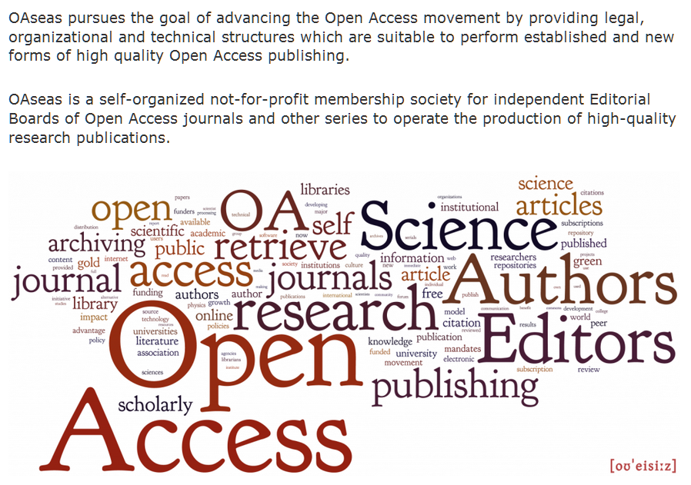
Organization
Open Access Science Editors and Authors Society
Development and management of EIS will be coordinated by OAseas

Slide 26
Organization
(Seven) EIS Editors, one of them will be the Editor-in-chief
An extended international EIS Editorial Board (as of 9/13 54 scholars from 24 countries)
A data base with the profiles of potential reviewers

Slide 27
Hosting
EIS Hosting will be distributedly organized – in collaboration with OAseas, ISN/Oldenburg, HTW Chur und IS-/KTI-Graz
Open Access Science Editors and Authors Society - OAseas
Institute for Science Networking (ISN)
University of Applied Sciences Chur – Department of Information Science
Institute for Informations Science and Information Management, University of Graz
Knowledge Technologies Institute at the Technical University of Graz (Know Center)

Slide 28
Financing
Everything depends on the successful application for grants
German Research Association (DFG)
Austrian Science Fonds (FWF)
Financial Support for three years – starting end of 2013 or beginning of 2014 (if approved)
Application for additional funding from the EU - 2014 - starting end of 2015 (if approved)

Slide 29
Covering the costs
detailed cost analysis
The Institut of Information Science and Information Management of the University of Graz provides the position (50%) of an information engineer – this covers (8) and (9) of the costs (~€25.000)
The University of Graz provides € 10.000 per year in case the apülication for funds to the Austrian Science Fonds (FWF) is successful
Remaining costs of € 31.000 to be covered by
Information science related associations
Information and documentation centers, intermediaries such as libraries
Sponsoring, information related advertising
If necessary: APC for about €500

Slide 30
Time schedule
Till mid 2013 applications for funding DFG, FWF
Till mid 2013 establisment of the Editorial Board
Beginning of 2014 application for funding in Switzerland
Beginning of 2014 application for funding in the EU

Slide 31
Time schedule
till the end of 2013 EIS-ICP concept and organizational structure made public
In the first half of 2014 a first EIS-ICP prototype
mid 2014 first EIS-ICP article to be published

Slide 32
Challenges
to make EIS an attractive platform for the information science community in order to achieve active participation (public commenting & reviewing)
to transform EIS-ICP from a primary publishing platform into a general information and communication platform

Slide 33
Vielen Dank für Ihre Aufmerksamkeit
Folien unter
http://www.kuhlen.name/vortraege.html

Slide 34
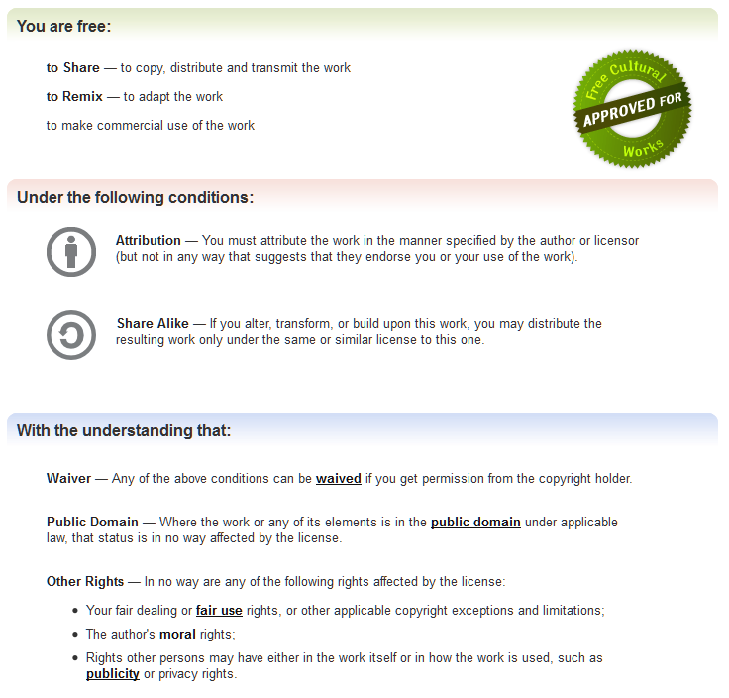
http://creativecommons.org/licenses/by-sa/3.0/
Notes:
34

Slide 35
Running costs per year - € 66.000
Back to financing
OAseas calculates € 500 Euro costs per article
Expected 30 articles per year ~ 15.000 Euro/year - hosting costs and maintenance costs for open source publishing software
€ 12.000 Euro for further software development – developing value-adding features.
€ 4.000 Marketing, advertisment, flyers development of the
€ 3.000 travel costs for the editors to European conferences
€4.500 Euro (30 x 150 Euro) for language check
€ 1.200 Current business necessities
€20.000 Assistant to the Editor
€ 5.000 Maintenance and further development of the website and the document data base
€1.300 Licences (software´data base, plagiarism control, provider fees,…

