Slide 1
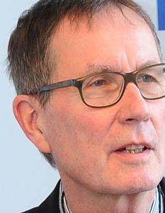
Open Access European Journal of Information Science EIS
Open Access for Science by Science
Rainer Kuhlen
Department of Computer and Information Science
University of Konstanz, Germany

Slide 2
Open Access European Journal of Information Science EIS
Questions - Challenges
Objectives – Conceptual design – Quality control
Organization – Implementation strategy – Sustainability
Funding – Financing
Time schedule

Slide 3
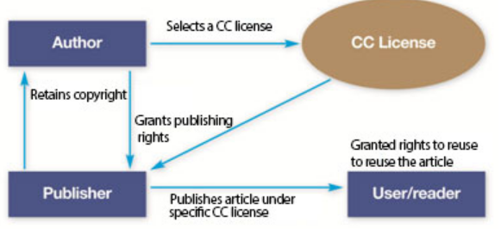
Questions – Challenges
Is there a need for another information science journal?
Internationally leading
Journal of the American Society of Information Science (and Technology) - JASIS/T
All members of the Editorial Board are from the USA or Canada
since 2008 green/yellow OA (preprints)
11 out of 37 members of the Editorial Board are from EU countries (Kalervo Järvelin) (Editor in chief Fabio Crestani, Lugano) − OA: APC $1800
Information Processing & Management - IPM
increasingly technologically oriented
Journal of Documentation - JoD
16 out of 19 members of the Editorial Board are from EU countries (Editor in chief David Bawden, City University London
Journal of Library and Information Studies (Taiwan) OA
International Journal of Library and Information Science (IJLIS) OA , mainly Asia, Africa

Slide 4
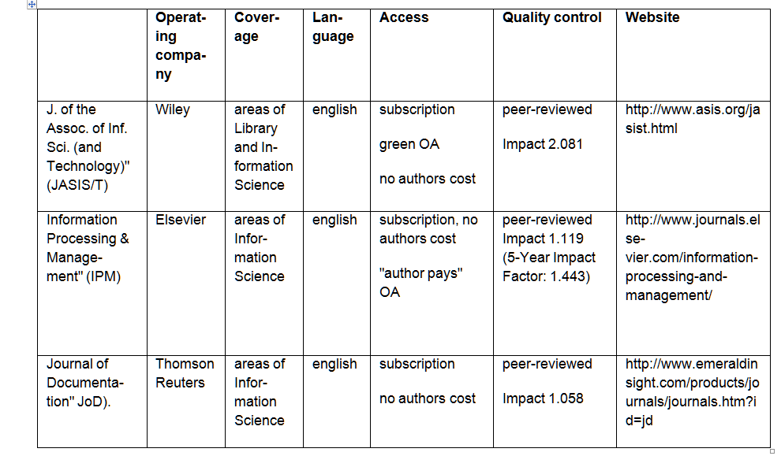
Questions – Challenges
Is there a need for another information science journal?

Slide 5
Questions – Challenges
Is there a need for another information science journal?
    Publications in international information science journals
Rank | Country | No. of articles | Rank | Country | No. of articles
1 | USA | 1631 | 11 | Singapur | 112
2 | Great Britain | 720 | 12 | Belgium | 97
3 | Canada | 271 | 13 | Israel | 91
4 | People’s Republic of China | 221 | 14 | Japan | 91
5 | Spain | 199 | 15 | Denmark | 87
6 | Taiwan | 170 | 16 | Sweden | 81
7 | Finland | 151 | 17 | Germany | 66
8 | Australia | 147 | 18 | France | 55
9 | The Netherlands | 147 | 19 | Italy | 51
10 | South Korea | 128 | 20 | Switzerland | 49
Source: Web of Science) (2000 – 2011) – Ranking according to countries (n=4395 articles); cf Schlögl Christian (2013): International visibility of European and in particular German-language publications in library and information science. In Hans-Christoph Hobohm (Hrsg.): Proceedings des 13. Internationalen Symposiums für Informationswissenschaft (ISI 2013), Glückstadt: Hülsbusch, 2013, 50-62.

Slide 6
Questions – Challenges
Is there a need for another European information science journal/publication platform?
Science is international – all information science scholars are welcome in EIS
Is there a typical European understanding of information and information science?
Is this specific information understanding based in Europe´s cultural diversity and its law tradition - for instance copyright vs. authors´ rights ?

Slide 7
Questions – Challenges
Is there a need for another European information science journal/publication platform?
European culture is deeply rooted in its language diversity
EIS´ primary publication language is English – in addition, the cultural and linguistic diversity will be recognized by encouraging to publish each article in the respective language of the author´s country
EIS focus are the pragmatic and social aspects of information – taking into account the variety of cognitive, cultural, economic, legal and ethical parameters

Slide 8
Questions – Challenges
Is there a need for a information science publication platform as an initiative from science itself?
There is evidence that open access will be the dominating publishing paradigm for the commercial publishing industry, too
But – so far no self-financing commercial publishing models have been developed by the publishing industry
The publishing industry still expect public funding of commercial open access publishing, not only for covering the publication/distribution costs but also for the profit forecasts (in the past about 25%)

Slide 9
Questions – Challenges
Is there a need for a information science publication platform as an initiative from science itself?
Science can make its products publicly available from its own resources
Editors
Editorial Board
Authors can translate their results into communicable documents
Quality control via diversified forms of assessment/ reviewing has always been done by scholars themselves (peer reviewing)
Distribution/making documents publicly available can by done by science itself and/or by support of intermediary institutions such as libraries

Slide 10
Is there a future for commercial publishing in science?
Commons-based information markets
Licence for applying using rights to new products
open access (gratuit et libre) to information objects
realized by authors in education and science
Business models für value-added products
Simple publishing model
multimedia presentation
hypertextification, dossiers
summaries, translations
retrieval, text and data mining tools
innovative reviewing models
personal und institutional background information
etc. etc.
Commercial right to a secondary exploitation of information objects
modified and developed in collaborative working environments
legally protected by free licences (cf. CC-BY)
reversing OA green

Slide 11
Objectives
EIS will foster progress in information science, in general but particularly in Europe, by applying international scientific standards for research and publishing
By following a multilingual approach, EIS will support the development of national information science associations and the establisment of a European network of information science organizations.

Slide 12
Objectives
EIS will be an open access journal (golden approach) – thus leaving all rights to the authors and allowing free access and unrestricted use for everyone
EIS will be open access for science by science – by taking the organization of publishing in its own hands

Slide 13
EIS – more than a journal
Maybe, there is no real need for a new information science journal
But is there still a need for journals with their main objective of making results of research publicly available in form of text-based documents?
EIS will take advantage of value-adding possibilities of electronic networks besides publishing – such as
using semantic web technology
communication – social betworking
collaborative work
user-generated content
documents as pragmatic objects
EIS will be an information and communication platform ICP

Slide 14
Quality and performance characteristics
All contributions to EIS-ICP are in English per default.
In addition, all contributions, in particular articles, will be made publicly available in the corresponding native language of the respective authors – either by the EIS server and/or by a publishing media of the respective country

Slide 15
Quality and performance characteristics
EIS-ICP will be from the outset a scientific journal with quality requirements:
traditional peer-reviewing, combined with open web reviewing
EIS-ICP will be both
a peer-reviewed open access journal
a direct open access journal with delayed reviewing

Slide 16
Quality and performance characteristics
a peer-reviewed open access journal
direct open access journal
positive reviews will be made publicly available
according to the „publish first - filter later“ principle
positively peer-reviewed articles will be marked by the EIS quality label
all contributions will be made immediately publicly available
will be made immediately publicly available after reviewing
will be subject of
public commenting & reviewing
will be bundled in quarterly volumes

Slide 17
Quality and performance characteristics
In addition to traditional quality measurements such as impact factor or citation analysis
EIS-ICP will provide a broad spectrum of metrics (web analytics/web controlling devices) such as
pageviews
click analysis
download statistics
….
EIS-ICP will experiment with altmetrics services such as
Mendeley
CiteULike,
Zotero
….

Slide 18
Additional characteristics
EIS-ICP will have a special section für reviews and conference reports
EIS -ICP will provide a platform for curriculum development in information science.
EIS-ICP will provide a platform for excellent students´ theses

Slide 19
Additional characteristics
EIS-ICP will provide (via hyperlinks) background information to authors and research/education institutions
EIS-ICP will secure long-term archiving
EIS-ICP articles will be indexed by citation data bases such as Web of Science, Scopus, Google Scholar

Slide 20
Additional characteristics – to be developed in a second phase
EIS-ICP will also become an open access platform for full texts (monographs, anthologies, proceedings, etc.)
EIS-ICP will develop a data server for providing storage and access to whole data collections and/or to data which underly the articles published in EIS

Slide 21
Additional characteristics – to be developed in the future
EIS-ICP will provide manifold messaging functions
  Electronic mailing lists
  Job exchange
  Conferences, lectures, training course information
  Legal information (copyright, privacy, …)
  Information politics
EIS-ICP will provide manifold communication functions
EIS-ICP will provide a platform for collaborative text production

Slide 22
Organization
At the beginning, the legal institution for EIS can be the Association for Information Science (Hochschulverband für Informationswissenschaft – HI - representing information science in Austria, Germany, Liechtenstein, and Switzerland)
As soon as EIS has started is operational work, an adequate European-wide legal form needs to be searched for

Slide 23
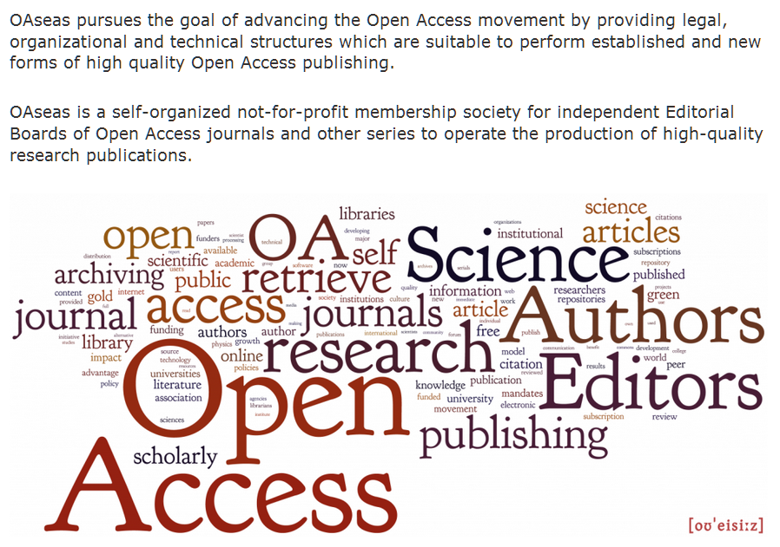
Organization
Open Access Science Editors and Authors Society
The management of EIS will be handled by OAseas

Slide 24
Organization
Seven EIS Editors, one of them will be the Editor-in-chief
An extended international EIS Editorial Board
A data base with the profiles of potential reviewers

Slide 25
Hosting
EIS Hosting will be distributedly organized – in collaboration with OAseas, ISN/Oldenburg, HTW Chur und IS-/KTI-Graz
Open Access Science Editors and Authors Society - OAseas
Institute for Science Networking (ISN)
University of Applied Sciences Chur – Department of Information Science
Institute for Informations Science and Information Management, University of Graz
Knowledge Technologies Institute at the Technical University of Graz

Slide 26
Financing
Everything depends on the successful application for grants
German Research Association (DFG)
Austrian Science Fonds (FWF)
Financial Support for three years – starting end of 2013 (if approved)
Application for additional funding from the EU - 2014 - starting end of 2015 (if approved)

Slide 27
Running costs per year - € 66.000
OAseas calculates € 500 Euro costs per article
Expected 30 articles per year ~ 15.000 Euro/year - hosting costs and maintenance costs for open source publishing software
€ 12.000 Euro for further software development – developing value-adding features.
€ 4.000 Marketing, advertisment, flyers development of the
€ 3.000 travel costs for the editors to European conferences
€4.500 Euro (30 x 150 Euro) for language check
€ 1.200 Current business necessities
€20.000 Assistant to the Editor
€ 5.000 Maintenance and further development of the website and the document data base
€1.300 Licences (software´data base, plagiarism control, provider fees,…

Slide 28
Covering the costs
The Institut of Information Science and Information Management of the University of Graz provides the position (50%) of an information engineer – this covers (8) and (9) of the costs (~€25.000)
The University of Graz provides € 10.000 per year in case the apülication for funds to the Austrian Science Fonds (FWF) is successful
Remaining costs of € 31.000 to be covered by
Information science related associations
Information and documentation centers, intermediaries such as libraries
Sponsoring, information related advertising
If necessary: APC for about €500

Slide 29
Challenges - problems
to develop a promissing PR strategy to make EIS-ICP
attractive for information science organizations and authors
to apply and maintain high quality standards and to achieve high metric values
to make EIS an attractive platform for the information science community in order to achieve active participation (public commenting & reviewing)

Slide 30
Challenges - problems
to secure long-term hosting and long-term archiving
to apply information science methodology (knowledge representation, indexing, abstracting, flexible search, attractive user interface, …) to EIS-ICP
to transform EIS-ICP from a primary publishing platform into a general information and communication platform

Slide 31
Time schedule
Till mid 2013 applications for funding DFG, FWF)
Till mid 2013 establisment of the Editorial Board
Beginning of 2014 application for funding in Switzerland
Beginning of 2014 application for funding in the EU

Slide 32
Time schedule
till the end of 2013 a first EIS-ICP prototype
till the end of 2013 EIS-ICP concept and organizational structure made public
mid 2014 first EIS-ICP article to be published

Slide 33
Thank you for your attention

Slide 34

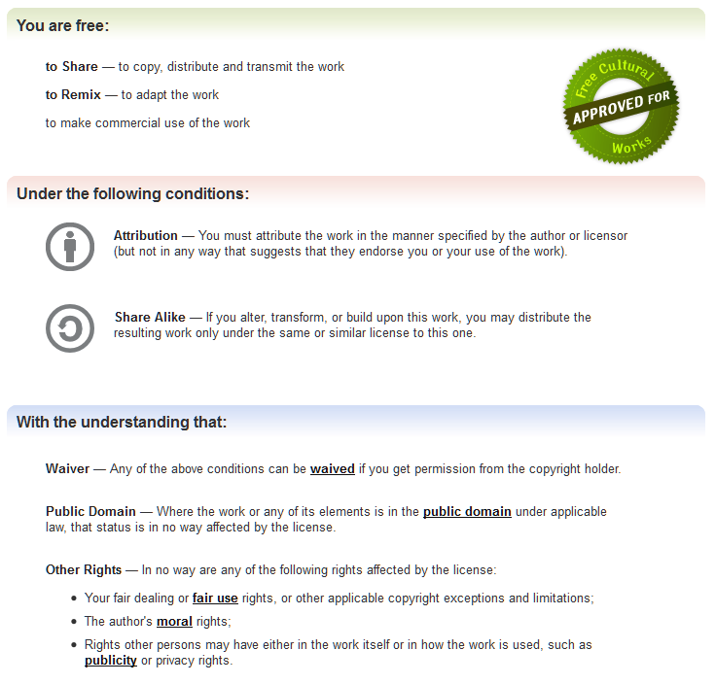
http://creativecommons.org/licenses/by-sa/3.0/
Notes:
34

