Slide 1
Rainer Kuhlen Fachbereich Informatik und Informationswissenschaft Universität Konstanz
Informationswissenschaft und Wirtschaftsinformatik
Verträglichkeit von Wissensökonomie und Wissensökologie - zu aktuellen Modellen für Open Access
CC

Slide 2
Content - Topics
Wissensökonomie und Wissensökologie
Proprietäre und offene Informationsmärkte
Open Access- erzwungen
Open Access - Geschäfts-/Finanzierungsmodelle
Kann Open Access kommerzielle Märkte zerstören? Kommt darauf an
Fazit - Thesen und Fragen
2

Slide 3
Wissensökonomie
Informationsmärkte
Wissensökologie
3

Slide 4
Proprietary and open Informations markets
Zugriff auf und Nutzen von Wissen und Information
Proprietäre
private
kommerzielle
Informationsmärkte
offene
öffentliche
commons-basierte
Informationsmärkte
Knowledge economy
Knowledge ecology
Wissensökonomie
Wissensökologie

Slide 5
Wissenökologie/-ökonomie
Ökonomie
Ökologie
?
Wissens-ökonomie
Wissens-ökologie
These
Wissensökologie steht nicht im Widerspruch zur kommerziellen Verwertung/Nutzung von Wissen,
unter der Annahme, dass Publikations- und Nutzungsmodelle nur dann akzeptabel sind
wenn sie den Status von Wissen als Gemeingut (Commons) anerkennen:
“allowing free and open access for everyone not claiming exclusive property rights”
5

Slide 6
Commons-Modell der Institutionenökonomik
6

Slide 7
Institutionenökonomik - theoretische Grundlage für Wissensökonomie und -ökologie
Privatisierung
„enclosure of the mind“
Profitabilität
verknappte Ressource
Gerechtigkeit, Fairness
Inklusion
Nachhaltigkeit, Offenheit, Teilen
Wissens-ressourcen
Prinzipien/Werte
Zugriff (access) zu Informations-objekten (Produkten und Dienstleistungen)
Institutiona-
lisierung
Verfahren
Kommunikation
Konsens
Verpflichtungen
Verträge
Regeln, Rechte, Gesetze, bindende Vorschriften
Kontrollmechanismen, Sanktionen
Private Güter
Gemeingüter
Commons
7

Slide 8
Knowledge economy
Wissensökonomie
8

Slide 9
Open Access - nachhaltige Institutionalisierungsform für das Commons Wissen
Wissenschaftliche Zeitschriftenmärkte der Wissensökonomie
Publikationsmärkte
der Wissensökonomie
5-10.000 wissenschaftliche Zeitschriftenverlage
privat organisiert
mehr als 28.100 scholarly peer-reviewed journals
geschützt durch starken Urheberrecht
Umsätze zu ca. 70% durch Subskription)
geschützt durch technische Schutzmaßnahmen
98% of STM online
etwa 1,5 Millionen peer review validierte Beiträge
In hohem Maße profitabel durch Verknappung
über 46 Millionen Artikel elektronisch recherchier- und downloadbar
stabilisiert „information rich“
M.Ware/M. Mabe; The stm report . an overview of scientific and scholarly journal publishing. STM, Third edition November 2012

Slide 10
Knowledge ecology
Wissensökologie
10

Slide 11
Knowledge ecology
Open information markets in science
Commons-based
Information markets
Directory of OA Journals:
journals, 650572 articles (19.10.2011)
7449 journals, 745962 articles (31.1.2012)
9411 journals, 1099912 articles (1.6.2013)
almost 4 journals per day since 10/2011
still only about 2,4 % of all commercially available articles

Slide 12
Scientific Impact
Open information markets in science
Commons-based
Information markets
Results
In medicine and health, OA journals founded in the last 10 years are receiving about as many citations as subscription journals launched during the same period.
Bo-Christer Björk; David Solomon: Open access versus subscription journals: a comparison of scientific impact. BMC Medicine 2012, 10:73 - http://www.biomedcentral.com/1741-7015/10/73

Slide 13
Scientific Impact
Open information markets in science
Commons-based
Information markets
Conclusions
Our results indicate that OA journals indexed in Web of Science and/or Scopus are approaching the same scientific impact and quality as subscription journals, particularly in biomedicine and for journals funded by article processing charges.
Bo-Christer Björk; David Solomon: Open access versus subscription journals: a comparison of scientific impact. BMC Medicine 2012, 10:73 - http://www.biomedcentral.com/1741-7015/10/73

Slide 14
Open access and information economy
14

Slide 15
Commercial adaptation of Open Access
More and more publishers (in particularly the four dominating ones) accept the OA-paradigm and see their future in OA publishing
Elsevier
Wiley
Thompson
Springer
enforced by
users
markets
legislation/ copyright
private or public foundations
political commit-ment
delayed subsequent subscription
golden
green
Zweitveröffentlichung
15

Slide 16
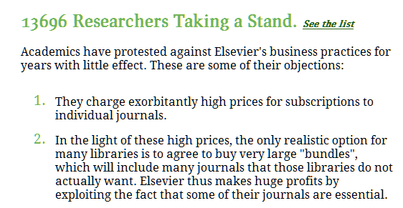
Open access enforced
authors
golden
16

Slide 17
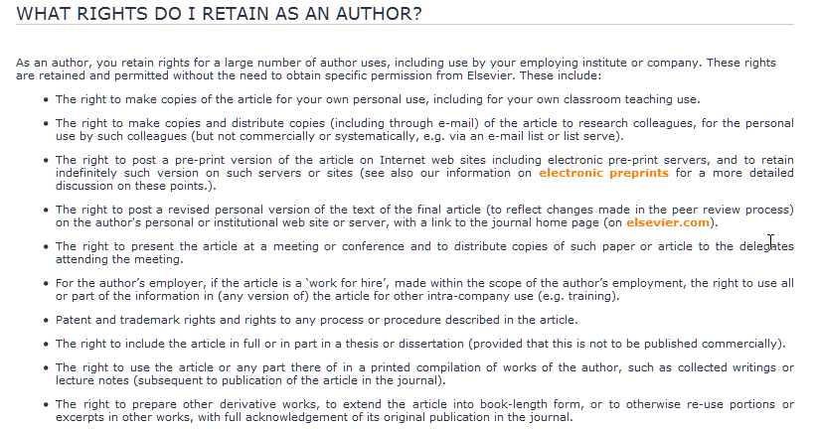
Open access enforced
markets
green
<<<<<<<<<<<<
17

Slide 18
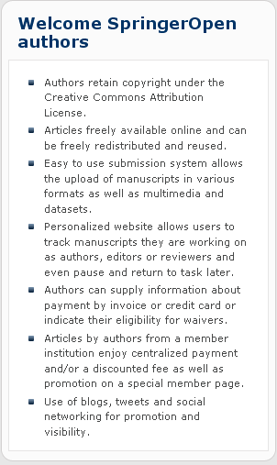
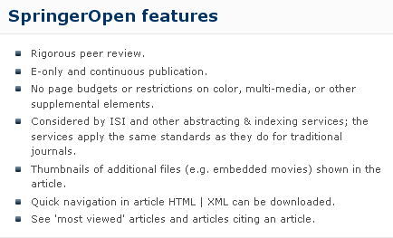
Open access enforced
markets
Springer Open
golden
18

Slide 19
Open access enforced
libraries, agencies
subscription costs
Open Access costs
golden
SCOAP
In this model, High-Energy Physics (HEP ) funding agencies and libraries, which today purchase journal subscriptions to implicitly support the peer-review service, federate to explicitly cover its cost, while publishers make the electronic versions of their journals free to read. Authors are not directly charged to publish their articles OA.
Today, most publishers quote a price in the range of 1’000–2’000 Euros per published article. On this basis, we estimate that the annual budget for the transition of HEP publishing to OA would amount to a maximum of 10 Million Euros/year, sensibly lower than the estimated global expenditure in subscription to HEP journals.
Each SCOAP³ partner will finance its contribution by canceling journal subscriptions. Each country will contribute according to its share of HEP publishing.
19

Slide 20
Open access enforced
Public foundations
NIH
require
golden
The law states:
The NIH Public Access Policy ensures that the public has access to the published results of NIH funded research. It requires scientists to submit final peer-reviewed journal manuscripts that arise from NIH funds to the digital archive PubMed Central upon acceptance for publication. To help advance science and improve human health, the Policy requires that these papers are accessible to the public on PubMed Central no later than 12 months after publication.
The NIH Public Access Policy applies to all peer-reviewed articles that arise, in whole or in part, from direct costs ¹ funded by NIH, or from NIH staff, that are accepted for publication on or after April 7, 2008. http://publicaccess.nih.gov/policy.htm
20

Slide 21
Open access enforced
Private foundations
require
golden
Wellcome Trust policy tightening (June 2012)
introducing sanctions for non-compliance and a move to CC-BY licenses
21

Slide 22
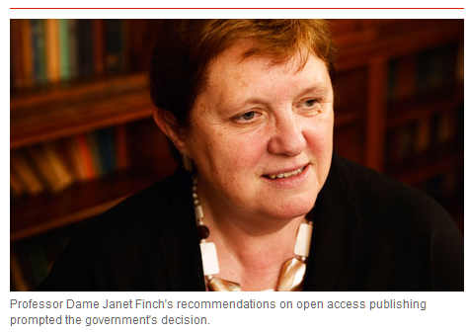
Open access enforced
Political
commitment
golden
Finch Report of the Working Group on Expanding Access to Published Research Findings – the Finch Group http://www.researchinfonet.org/publish/finch/
“Accessibility, sustainability, excellence: how to expand access to research publications”
UK
green
Policies on open access to scientific research results should apply to all research that receives public funds.
22

Slide 23
Open access enforced
Political
commitment
golden
green
UK
“British universities now pay around £200m a year in subscription fees to journal publishers, but under the new scheme, authors will pay "article processing charges" (APCs) to have their papers peer reviewed, edited and made freely available online. The typical APC is around £2,000 per article.”
“cost of the transition, which could reach £50m a year, must be covered by the existing science budget and that no new money would be found to fund the process.”
Minister of State for Universities and Science
23

Slide 24
Open access enforced
COMMISSION RECOMMENDATION of 17.7.2012
on access to and preservation of scientific information
Political
commitment
golden
green
EU
Cf. Commission Communication (12 Dec 2011) on open data - a proposal for a Directive amending Directive 2003/98/EC
Policies on open access to scientific research results should apply to all research that receives public funds.
All projects will be requested to immediately deposit an electronic version of their publications (final version or peer-reviewed manuscript) into an archive in a machine-readable format.
This can be done using the ‘Gold’ model (open access to published version is immediate), or the ‘Green’ model.
24

Slide 25
OA Business Models
25

Slide 26
OA Business/Financing Models
Publisher driven
Public pays
commercial reprints
APC -author-side payment” model
classified advertising
institutional memberships”
subscriptions to print editions
grants by foundations
sponsorship
establish open access across to major fields of science such
value-adding services
library/research budgets
26

Slide 27
Will Open Access destroy commercial information markets?
It depends
yes
no
If publishers keep on insisting on exclusive exploitation rights protected by copyright
Open licensing of OA allows commercial exploitation
Green (self archiving)
Secondary exploitation
New value-added products
probably not profitable
protected by
Data base guideline
new auxiliary rights
Copyright?
27
Notes:
27

Slide 28
Model of a commons-based information economy/society
Commons-based information markets
Licence for applying using rights to new products
Free and open access to information objects
Business models für value-added products
Commercial right to a secondary exploitation of information objects
realized by authors in education and science
multimedia presentation
hypertextification, dossiers
summaries, translations
retrieval, text and data mining
innovative reviewing models
personal und institutional background information
etc. etc.
modified and developed in collaborative working environments
legally protected by free licences (cf. CC)
28
Notes:
28

Slide 29
FAZIT
29

Slide 30
FAZIT
These1: Publikationsmärkte werden in mittlerer Perspektive tendenziell vollständig durch das Open-Access-Paradigma bestimmt
Alle Zeichen deuten darauf hin, dass Open Access der Default-Wert für wissenschaftliches Publizierens werden wird.
30

Slide 31
FAZIT
These2: Open-Access-Modelle entwickeln sich zunehmend auch im kommerziellen Umfeld
Alle Zeichen deuten darauf hin, dass Open Access Gold von den wissenschaftlichen Publikationsverlagen übernommen wird
31

Slide 32
FAZIT
Soll die Öffentlichkeit, wie es sich derzeit abzeichnet, die OA-Gold-Modelle auch für die Informationswirtschaft finanzieren?
im Prinzip nein
Die reine Basisinformation kann aus der Wissenschaft selber öffentlich zugänglich gemacht werden.
Eine kommerzielle Verwertung von mit öffentlichen Mitteln erzeugtes Wissen lässt sich nur über bereitgestellte informationelle Mehrwerte rechtfertigen.
32

Slide 33
FAZIT
Soll die Öffentlichkeit, wie es sich derzeit abzeichnet, die OA-Gold-Modelle auch für die Informationswirtschaft finanzieren?
Die Bereitschaft zur Finanzierung kommerzieller OA-Betreiber wird sinken - sollte sich herausstellen, dass der Finanzbedarf nicht kommerzieller OA-Betreiber niedriger als der der kommerziellen.
Fraglich, ob die Öffentlichkeit nicht nur die reinen Produktionskosten übernehmen, sondern auch den Gewinnerwartungen der kommerziellen Anbieter entsprechen sollte.
33

Slide 34
Vielen Dank für Ihre Aufmerksamkeit
Folien unter einer CC-Lizenz unter www.kuhlen.name
Notes:
34

Slide 35
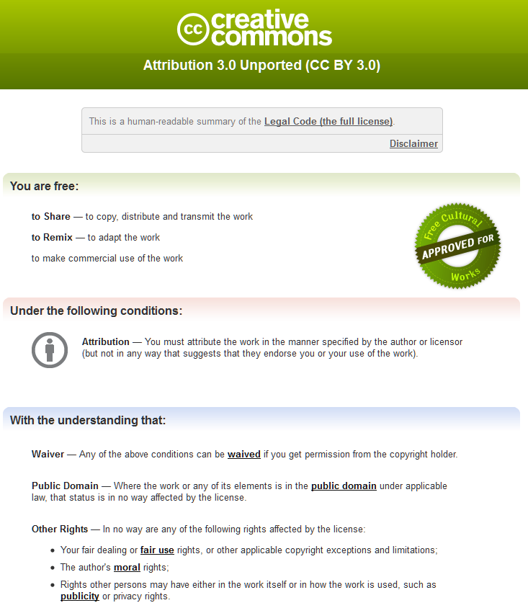
Notes:
35

