Slide 1


Knowledge economy and knowledge ecology - can they be compatible?
Rainer Kuhlen
Department of Computer and Information Science
University of Konstanz, Germany
CC

Slide 2
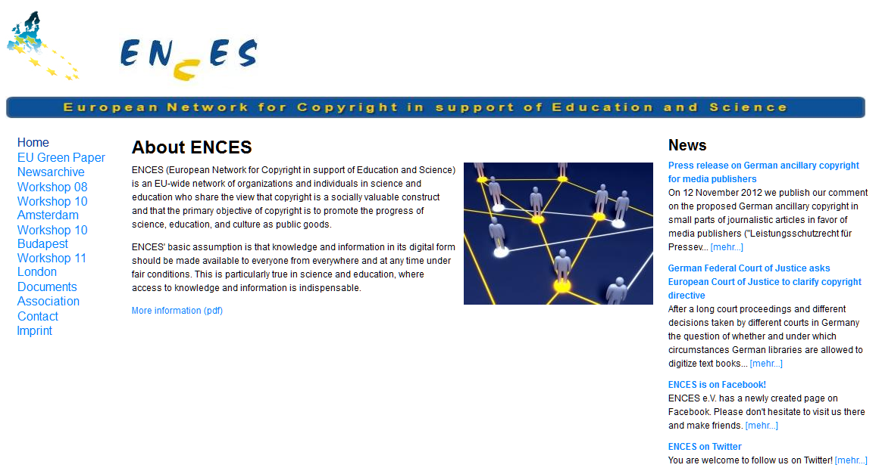


part of

Slide 3
EIS
European Information Science
Open access information and communication platform.
designed as a European initiative, EIS is open to authors from the entire world
a multilingual platform with English the default language
experimenting with different forms of reviewing and online web metrics for quality control
focus on the cognitive, pragmatic, social, political, cultural, legal and ethical aspects of information
strengthen information science in Europe

Slide 4
Content - Topics
Proprietary and open Informations markets
Knowledge economy
Knowledge ecology
Towards a commons-based understanding of knowledge and information
Open Access - way of institutionalizing knowledge as a commons
Open access and information economy
Open access enforced
OA Business/Financing Models
Will Open Access destroy commercial information markets? It depends
4

Slide 5
Knowledge economy
Knowledge ecology
5

Slide 6
Proprietary and open Informations markets
access to and use of knowledge and information
proprietary
private
commercial
Information markets
open
public
commons-based
Information markets
Knowledge economy
Knowledge ecology

Slide 7
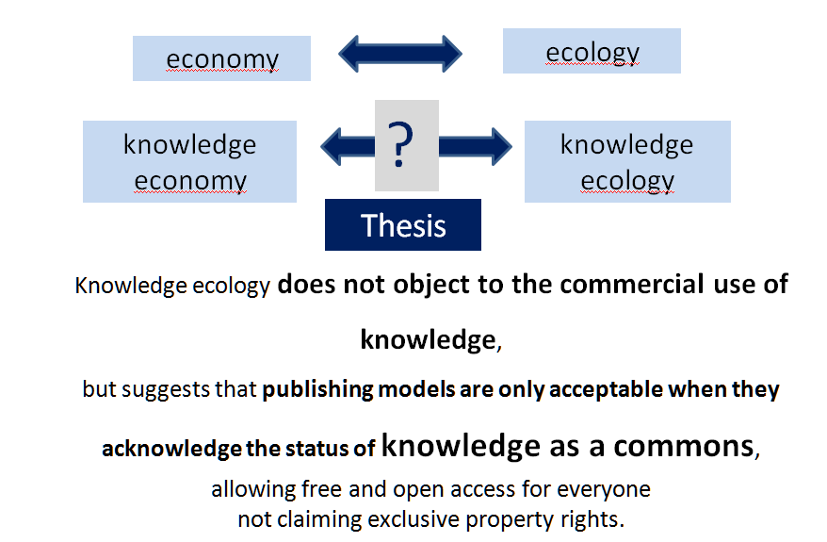
Knowledge economy – knowledge ecology

Slide 8
Knowledge economy
Knowledge economy the private commercial exploitation of knowledge and information
Distributed, sold or licenced on global information markets
Information products - protected by copyright and considered private intellectual property
people can thus be excluded from an unrestricted use of knowledge.

Slide 9
Knowledge economy
Publishing industry in science
Journal publishing

Slide 10
Knowledge economy
Publishing industry in science
commercial
Information markets
broader STM information publishing market (including journals, books, technical information and standards, databases and tools, and medical communications and some related areas) worth some $23.5 billion
annual revenues generated from English-language STM journal publishing are estimated at about $9.4 billion in 2011
M.Ware/M. Mabe; The stm report . an overview of scientific and scholarly journal publishing.
STM, Third edition November 2012

Slide 11
Knowledge economy
Publishing industry in science
commercial
Information markets
Journals publishing revenues are generated primarily from academic library subscriptions (68-75% of the total revenue)
Publishing industry employs an estimated 110,000 people globally
USA continues to dominates the global output of research papers with a share of about 21%
M.Ware/M. Mabe; The stm report . an overview of scientific and scholarly journal publishing.
STM, Third edition November 2012

Slide 12
Knowledge economy
Publishing industry in science
commercial
Information markets
About 5000–10,000 journal publishers globally, of which around 5000 are included in the Scopus database.
28,100 active scholarly peer-reviewed journals in mid 2012
grown steadily for over two centuries, by about 3% and 3.5% per year
M.Ware/M. Mabe; The stm report . an overview of scientific and scholarly journal publishing.
STM, Third edition November 2012

Slide 13
Knowledge economy
Publishing industry in science
commercial
Information markets
publishing about 1.8–1.9 million articles a year
the CrossRef database included over 56 million DOIs, of which 46 million refer to journal articles
10,675 journals included in Thomson Reuter’s Journal Citation Reports database (8200 in the Science Edition and 2900 in the Social Sciences Edition)
M.Ware/M. Mabe; The stm report . an overview of scientific and scholarly journal publishing.
STM, Third edition November 2012

Slide 14
Knowledge ecology
Knowledge ecology the sustainable treatment of knowledge and information.
This can only be achieved not by making knowledge a scarce resource but making it an open space and providing open access to and free use of it.

Slide 15
Towards a commons-based understanding of knowledge and information

Slide 16
Towards a commons-based understanding of knowledge and information
The concept of knowledge and information as commons will be used
to overcome both
the current deadlock in the worldwide copyright regulation
the dominance of the commercial exploitation of knowledge and information
And to restore the legitimate claims of the public need for free and open access and use of published knowledge.

Slide 17
Towards a commons-based understanding of knowledge and information
Commons

Slide 18
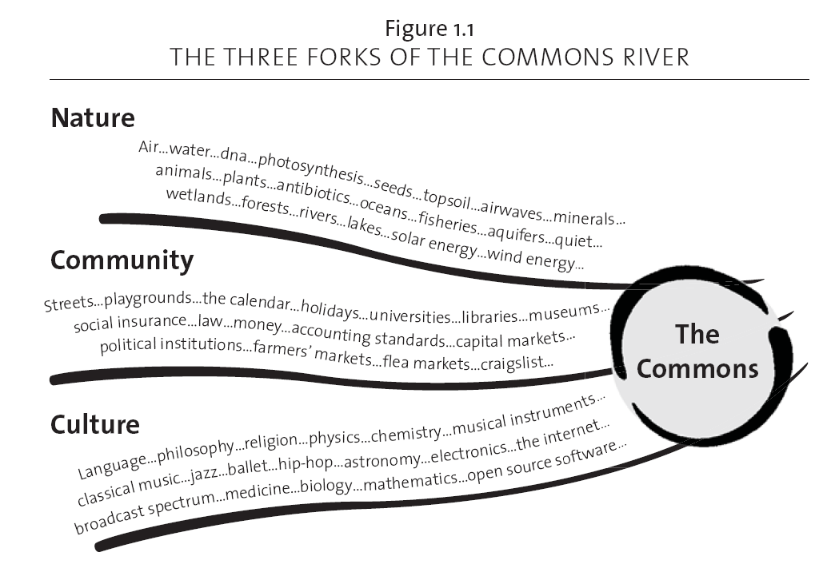
Towards a commons-based understanding of knowledge and information
Common Pool Resources
Commons
Common heritage of nature
Commons are institutionalized „common-pool resources“
Common heritage of social life
Commons heritage of cultural creativity
knowledge and information
From: Peter Barnes: Capitalism 3.0

Slide 19
Towards a commons-based understanding of knowledge and information
Commons are socially constructed.
Common Pool Resources
principles
Commons
institution-alization
procedures
clean air
water
oil
knowledge
accessible
usable
under certain conditions
19

Slide 20
Towards a commons-based understanding of knowledge and information
privatization
enclosure of the mind
profitability
scarce resource
sharing
justice, fairness
openness
inclusion
sustainabilty
It´s our choice
knowledge resources
Principles, values
access to information products
services
systems
institution-alization
procedures
communication (reaching a consensus)
commitments
contracts
rules, laws, legal norms
control mechanisms, sanctions
Private information markets
Commons-based information markets
20

Slide 21
Open Access a way of institutionalizing knowledge as a commons
21

Slide 22
Open Access - way of institutionalizing knowledge as a commons
Open access contributions must satisfy two conditions (according to Berlin OA Declaration):
„(1) The author(s) and right holder(s) of such contributions grant(s) to all users a free, irrevocable, worldwide, right of access to, and a license to copy, use, distribute, transmit and display the work publicly and to make and distribute derivative works, in any digital medium for any responsible purpose, subject to proper attribution of authorship (community standards, will continue to provide the mechanism for enforcement of proper attribution and responsible use of the published work, as they do now), as well as the right to make small numbers of printed copies for their personal use.”
Berlin Declaration on Open Access to Knowledge in the Sciences and Humanities
22

Slide 23
Open Access - way of institutionalizing knowledge as a commons
Open access contributions must satisfy two conditions:
„(2) A complete version of the work and all supplemental materials, including a copy of the permission as stated above, in an appropriate standard electronic format is deposited (and thus published) in at least one online repository using suitable technical standards (such as the Open Archive definitions) that is supported and maintained by an academic institution, scholarly society, government agency, or other well Established organization that seeks to enable open access, unrestricted distribution, inter operability, and long-term archiving.”
Berlin Declaration on Open Access to Knowledge in the Sciences and Humanities
23

Slide 24
Knowledge ecology
Open information markets in science
Commons-based
Information markets
Directory of OA Journals:
journals, 650572 articles (19.10.2011)
7449 journals, 745962 articles (31.1.2012)
9411 journals, 1099912 articles (1.6.2013)
almost 4 journals per day since 10/2011
still only about 2,4 % of all commercially available articles
“Ulrich’s Directory lists 4365 peer reviewed OA journals, or about 13% of the total number of peer reviewed journals included”
“Scopus covers 18,500 peer-reviewed journals, of which 1800 or 9.7% are open access, while the proportion of OA journals covered by Journal Citation Reports is about 8%.”
-
STM report 2012

Slide 25
Scientific Impact
Open information markets in science
Commons-based
Information markets
Results
Overall, average citation rates, … were about 30% higher for subscription journals. However, after controlling for discipline (medicine and health versus other), age of the journal (three time periods) and the location of the publisher (four largest publishing countries versus other countries) the differences largely disappeared in most subcategories except for journals that had been launched prior to 1996.
Bo-Christer Björk; David Solomon: Open access versus subscription journals: a comparison of scientific impact.
BMC Medicine 2012, 10:73 - http://www.biomedcentral.com/1741-7015/10/73

Slide 26
Scientific Impact
Open information markets in science
Commons-based
Information markets
Results
OA journals that fund publishing with article processing charges (APCs) are on average cited more than other OA journals. In medicine and health, OA journals founded in the last 10 years are receiving about as many citations as subscription journals launched during the same period.
Bo-Christer Björk; David Solomon: Open access versus subscription journals: a comparison of scientific impact.
BMC Medicine 2012, 10:73 - http://www.biomedcentral.com/1741-7015/10/73

Slide 27
Scientific Impact
Open information markets in science
Commons-based
Information markets
Conclusions
Our results indicate that OA journals indexed in Web of Science and/or Scopus are approaching the same scientific impact and quality as subscription journals, particularly in biomedicine and for journals funded by article processing charges.
Bo-Christer Björk; David Solomon: Open access versus subscription journals: a comparison of scientific impact.
BMC Medicine 2012, 10:73 - http://www.biomedcentral.com/1741-7015/10/73

Slide 28
Open access and information economy

Slide 29
Commercial adaptation of Open Access
More and more publishers (in particularly the four dominating ones) accept the OA-paradigm and see their future in OA publishing
Elsevier
Wiley
Thompson
Springer
enforced by
users
markets
legislation/ copyright
private or public foundations
political commit-ment
golden
delayed subsequent subscription
green

Slide 30

Open access enforced
authors
golden
Academics (12.663 – Stand 10092012) have protested against Elsevier's business practices for years with little effect. …
The key to all these issues is the right of authors to achieve easily-accessible distribution of their work.
I fully agree with this initiative - even more I hold the view that the commercial exploitation of knowledge should be the exception and free open access the default.

Slide 31
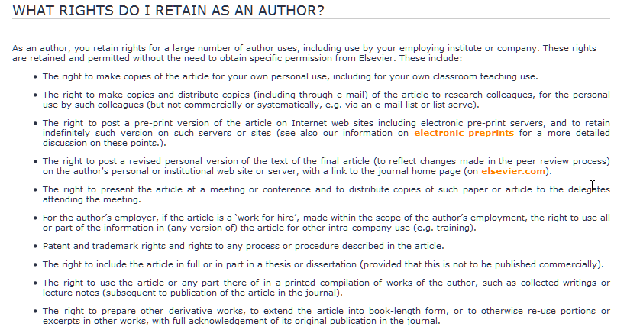

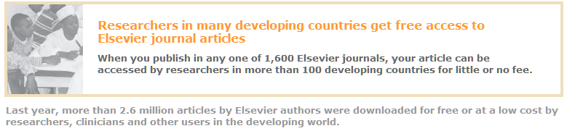

Open access enforced
markets
green
<<<<<<<<<<<<

Slide 32
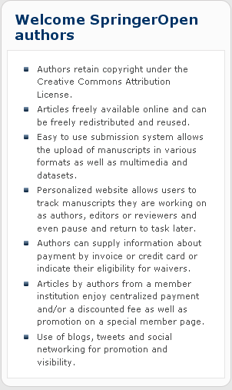

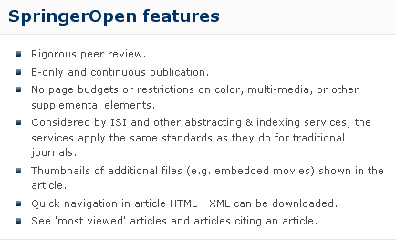
Open access enforced
markets
Springer Open
golden

Slide 33
Open access enforced
libraries, agencies
SCOAP
golden
In this model, High-Energy Physics (HEP ) funding agencies and libraries, which today purchase journal subscriptions to implicitly support the peer-review service, federate to explicitly cover its cost, while publishers make the electronic versions of their journals free to read. Authors are not directly charged to publish their articles OA.
Today, most publishers quote a price in the range of 1’000–2’000 Euros per published article. On this basis, we estimate that the annual budget for the transition of HEP publishing to OA would amount to a maximum of 10 Million Euros/year, sensibly lower than the estimated global expenditure in subscription to HEP journals.
Each SCOAP³ partner will finance its contribution by canceling journal subscriptions. Each country will contribute according to its share of HEP publishing.

Slide 34



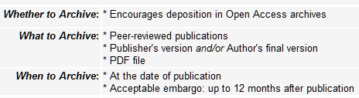

Open access enforced
foundations
golden
encourage
request, not require
Nach: http://www.sherpa.ac.uk/juliet/index.php?fPersistentID=5#oapublishing

Slide 35

Open access enforced
Public foundations
NIH
require
golden
The law states:
The NIH Public Access Policy ensures that the public has access to the published results of NIH funded research. It requires scientists to submit final peer-reviewed journal manuscripts that arise from NIH funds to the digital archive PubMed Central upon acceptance for publication. To help advance science and improve human health, the Policy requires that these papers are accessible to the public on PubMed Central no later than 12 months after publication.
The NIH Public Access Policy applies to all peer-reviewed articles that arise, in whole or in part, from direct costs ¹ funded by NIH, or from NIH staff, that are accepted for publication on or after April 7, 2008. http://publicaccess.nih.gov/policy.htm

Slide 36
Open access enforced
Private foundations
require
golden
Wellcome Trust policy tightening (June 2012)
introducing sanctions for non-compliance and a move to CC-BY licenses

Slide 37

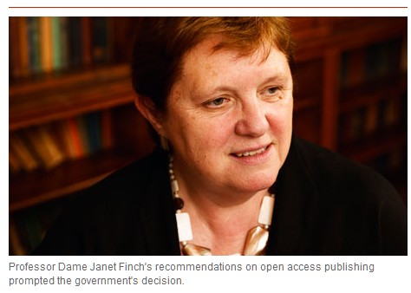
Open access enforced
Political
commitment
golden
Finch Report of the Working Group on Expanding Access to Published Research Findings – the Finch Group
http://www.researchinfonet.org/publish/finch/
“Accessibility, sustainability, excellence: how to expand access to research publications”
UK
green
Policies on open access to scientific research results should apply to all research that receives public funds.
Open access is a key feature of Member States’ policies for responsible research and innovation by making the results of research available to all and by facilitating societal engagement.

Slide 38

Open access enforced
Political
commitment
golden
green
UK
“British universities now pay around £200m a year in subscription fees to journal publishers, but under the new scheme, authors will pay "article processing charges" (APCs) to have their papers peer reviewed, edited and made freely available online. The typical APC is around £2,000 per article.”
"In all cases universities upon receipt of funding should transfer these charges to their institutional publication fund" …
"A university can then use these funds to pay for APCs for any article resulting from research council funding."
“cost of the transition, which could reach £50m a year, must be covered by the existing science budget and that no new money would be found to fund the process.”
Minister of State for Universities and Science

Slide 39
Open access enforced
COMMISSION RECOMMENDATION of 17.7.2012
on access to and preservation of scientific information
Political
commitment
golden
green
EU
Cf. Commission Communication (12 Dec 2011) on open data - a proposal for a Directive amending Directive 2003/98/EC
Policies on open access to scientific research results should apply to all research that receives public funds.
Open access is a key feature of Member States’ policies for responsible research and innovation by making the results of research available to all and by facilitating societal engagement.
39

Slide 40
Open access enforced
COMMISSION RECOMMENDATION of 17.7.2012
on access to and preservation of scientific information
Political
commitment
golden
green
EU
result of these policies:
there should be open access to publications resulting from publicly funded research as soon as possible, preferably immediately and in any case no later than six months after the date of publication, and twelve months for social sciences and humanities;
licensing systems contribute to open access to scientific publications resulting from publicly-funded research in a balanced way, in accordance with and without prejudice to the applicable copyright legislation, and encourage researchers to retain their copyright while granting licences to publishers;
40

Slide 41
Open access enforced
In Horizon 2020, both the ‘Green’ and ‘Gold’ models are considered valid approaches to achieve open access.
Political
commitment
EU
All projects will be requested to immediately deposit an electronic version of their publications (final version or peer-reviewed manuscript) into an archive in a machine-readable format.
This can be done using the ‘Gold’ model (open access to published version is immediate), or the ‘Green’ model.
In this case, the Commission will allow an embargo period of a maximum of six months, except for the social sciences and humanities where the maximum will be twelve months (due to publications’ longer ‘half-life’)
The European Commission will continue to fund projects related to open access. In 2012- 2013, the Commission will spend €45 million on data infrastructures and research on digital preservation. Funding will continue under the Horizon 2020 programme.
41

Slide 42
OA Business Models

Slide 43
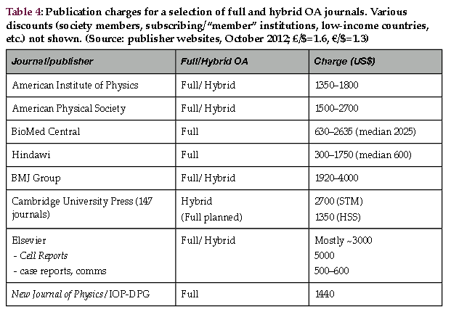
OA Business/Financing Models
“author-side payment” model, where the author (or usually his/her research funder or institution) pays a publication charge (article processing charges" (APCs) )

Slide 44
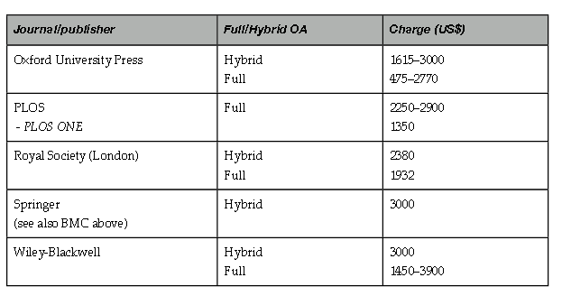
OA Business/Financing Models
“author-side payment” model, where the author (or usually his/her research funder or institution) pays a publication charge

Slide 45
OA Business/Financing Models
Publisher driven
Public pays
commercial reprints
APC -author-side payment” model
classified advertising
institutional memberships”
subscriptions to print editions
grants by foundations
sponsorship
establish open access across to major fields of science such
value-adding services
library/research budgets

Slide 46
Perspectives

Slide 47
Will Open Access destroy commercial information markets?
It depends
yes
no
If publishers keep on insisting on exclusive exploitation rights protected by copyright
Open licensing of OA allows commercial exploitation
Green (self archiving)
Secondary exploitation
New value-added products
probably not profitable
protected by
Data base guideline
new auxiliary right
Copyright?
Notes:
47

Slide 48
Models of a commons-based information economy/society
Commons-based information markets
Licence for applying using rights to new products
Free and open access to information objects
Business models für value-added products
Commercial right to a secondary exploitation of information objects
realized by authors in education and science
multimedia presentation
hypertextification, dossiers
summaries, translations
retrieval and data mining
innovative reviewing models
personal und institutional background information
etc. etc.
modified and developed in collaborative working environments
reversing OA green
legally protected by free licences (cf. CC)
Notes:
48

Slide 49
Thank you for your attention
Slides under a CC-Licence from www.kuhlen.name
Notes:
49

Slide 50
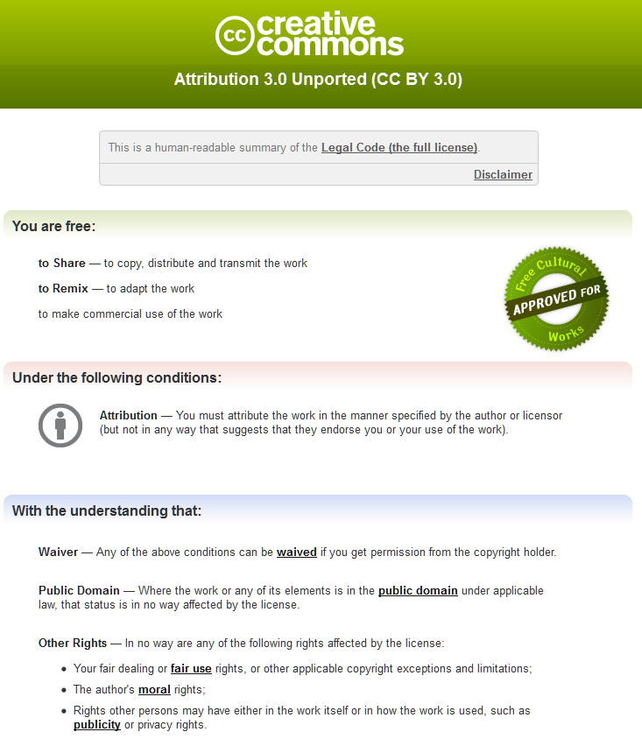
Notes:
50

