Slide 1
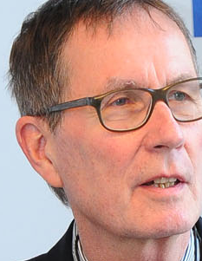
Conference on "Ethical Dilemmas in the Information Society: How Codes of Ethics Help to Find Ethically Based Solutions" 14 August 2014 in Geneva/Switzerland
Discourse ethics as a means for resolving information ethics dilemmas - challenges and consequences for the work ethics of information professionals
Rainer Kuhlen
FB Informatik und Informationswissenschaft - Universität Konstanz
www.kuhlen.name

Slide 2
Dilemma

Slide 3
What is a dilemma?
a problematic situation
where two (and only two) solutions to a given problem
both have undesirable consequences
whatever one decides, the result will be undesirable
negative dilemma
or

Slide 4
What is a dilemma?
a problematic situation
where two (and only two) solutions to a given problem
both have attractive desirable consequences
difficult or even impossible to decide which one is more desirable
positive dilemma
The positive dilemma can be solved just by throwing dice

Slide 5
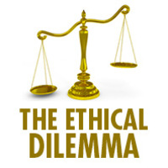
Ethical Dilemmma

Slide 6
What is an ethical dilemma?
a problematic situation
where two solutions to a given problem based on two different ethical theories
are different or even contradictory
or
http://freiheitundoptimismus.wordpress.com/2012/11/12/ein-moralisches-dilemma/

Slide 7
What is an ethical dilemma?
a problematic situation
where two solutions (a) and (b) to a given problem
are both ethically demanded
but only one can be carried out, not both
whatever one does: doing what is ethically correct (according to a) leads inevitably to ethical incorrectness (neglecting demand (b))

Slide 8
Information Ethics

Slide 9
Information ethics
We consider information ethics to be the reflection on beliefs, rules and values (in total: on morality) in electronic environments, in particular with respect to producing, exchanging, sharing and using knowledge and information.
This set cannot be derived from whatever law of nature, from however grounded metaphysics, let alone from religion or the will of God
It depends, in the Aristotelian tradition, on the environments in which humans live. These environments change in time and space.

Slide 10
Information ethics
Information ethics thus aims at attributing morality on ethical principles according to different theoretical/philosophical ethic theories.

Slide 11
Information ethics
No one can reasonably expect information ethics theory either to solve information dilemmas directly or to resolve concrete conflicts biuniquely.

Slide 12
Information ethics
Information ethics discourse cannot provide mandatory or prescriptive solutions.
Discourse ethics makes a specific dilemma, a specific case, at least transparent, shows different options and provides information about possible consequences.

Slide 13
Information Ethics Dilemma

Slide 14
What is an information ethics dilemma?
a problematic situation
where an ethically based solution to a given problem
is not compatible with other regulatory principles such as conflicting with the law
sometimes also conflicting with market principles/interests/contracts
or with current technological potentials
Information ethics polylemma

Slide 15
Polylemmas - regulatory contradictions

Slide 16
Information ethics polylemmas caused by regulatory contradictions
law
norms
K&I
market
Copyright data protection
law
technology
Information
market/ economy
Information
ethics
W&I
K&I
Information and
communication
technologies
Knowledge and Information
According to: Lawrence Lessig: Code and other laws of cyberspace. Basic Books, Perseus Books Group: New York 1999, second edition 2006

Slide 17
Information ethics polylemma/contradictions
Copyright data protection
law
Information
ethics
access only by permission of right owners
Free access to information
protection of personal data

Slide 18
Information ethics polylemma/contradictions
Copyright data protection
law
Information
market/ economy
Information
ethics
Information and
communication
technologies

Slide 19
Information ethics polylemma/contradictions
Information
market/ economy
Information
ethics
Access only by per-mission and remuner-ation of right owners
Free (libre et gratuit) access to information
Sharing of information
Licences for personal use only

Slide 20
Information ethics polylemma
access controlled by digital rights management
Free (libre et gratuit) access to information
Information
ethics
Information and
communication
technologies

Slide 21
Information ethics polylemma/contradictions
legally binding exceptions/limitations
Copyright data protection
law
Licences, contractual agreements
Information
market/ economy
Access to resources on the premises of libraries only
Information and
communication
technologies
Remote access to libraries services from workplace or from wherever one works
Data base property rights
Data mining algorithms

Slide 22
Information ethics discourse

Slide 23
Information ethics discourse
Information ethics discourse cannot provide mandatory or prescriptive solutions
even if one tries to apply deontic-based principles or imperatives as a means to decide on ethically correct or false behavior:

Slide 24
Information ethics discourse
Discourse ethics makes a specific dilemma, a specific case, at least transparent, shows different options for action and provides information about possible consequences of these options
According to a utilitarian ethical approach or to the ethics of responsibility/sustainability

Slide 25
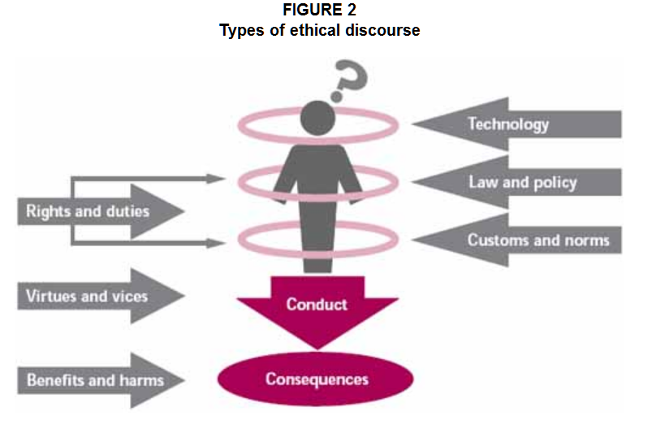
Information ethics discourse
law
The ethics of sustainable agricultural intensification. FOOD AND AGRICULTURE ORGANIZATION OF THE UNITED NATIONS. Rome, 2004
norms
K&I
market
technology
.Reproduction and dissemination of material in this
information product for educational or other non-commercial purposes are
authorized without any prior written permission from the copyright holders
provided the source is fully acknowledg
http://www.fao.org/docrep/007/j0902e/j0902e04.htm

Slide 26
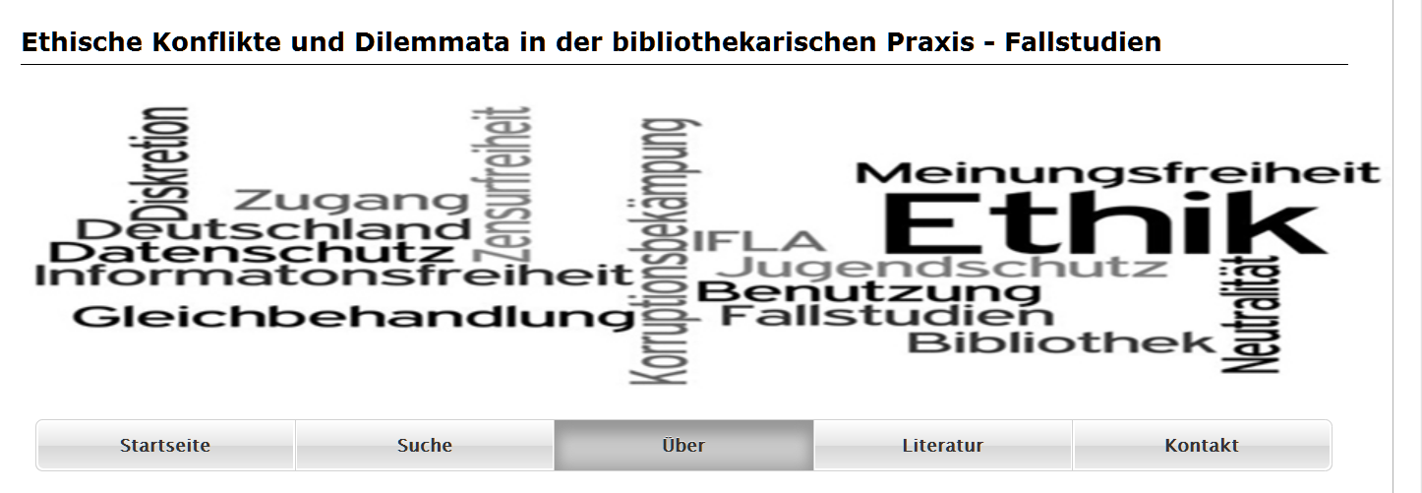
Using case studies to solve ethical conflicts and dilemmata
Project of Hermann Rösch
Institute for Information Science, University of Applied Sience, Cologne, Germany
https://www.fbi.fh-koeln.de/efubip/efubip-ueber.htm

Slide 27
Using case studies to solve ethical conflicts and dilemmata
Case study script according to Roesch
Metadata (title, type of libary, location, key words, ….)
Detailed description of the case
Ethical values at stake
Alternative options for solving the case dilemmata (with reference to ethical professional codes such as from IFLA)
References to the literature
User comments in an electronic forum
https://www.fbi.fh-koeln.de/efubip/efubip-ueber.htm

Slide 28
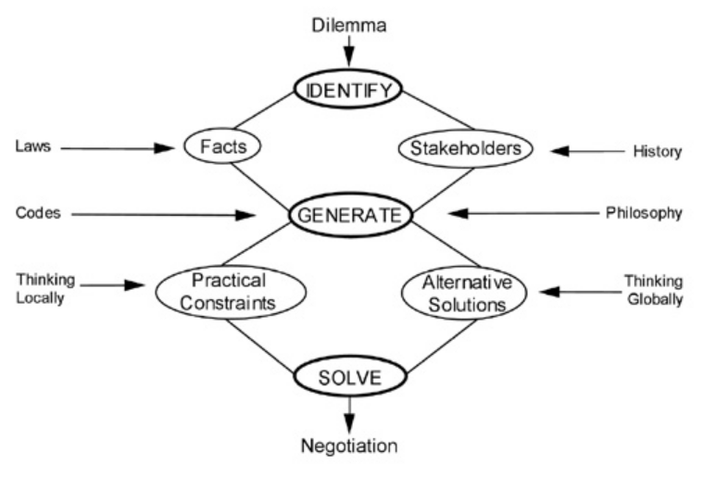
The Process of Thinking Through Ethical Dilemmas
Chart caption: A framework for ethical problem solving (Colwell-Chanthaphonh et al. in press, adapted from Swazey and Bird 1997:13).
Swazey, Judith P., and Stephanie J. Bird 1997 Teaching and Learning Research Ethics. In Research Ethics: A Reader, edited by Deni Elliott and Judy E. Stern, pp. 1-19. University Press of New England, Hanover.
http://humanitieslab.stanford.edu/WACEthics/41

Slide 29
The Process of Thinking Through Ethical Dilemmas
1. Identify the dilemma. What kind of problem is it? Is it truly an ethical dilemma, or is it a legal problem? In some cases, there may be more than one issue or concern.
2. Identify the facts. Identify all the known facts of the particular case and what is not known (but do not let them constrain how you imagine the possibilities).
3. Identify the stakeholders. Identify rightsholders, affected peoples, interest groups, and others who might have a connection to the issue. …Who are the people involved, and what is their stake in the predicament? …
4. Generate possible solutions. Be reasonable and consistent. Take other viewpoints into account; try to be impartial. Look for areas of moral agreement.
http://humanitieslab.stanford.edu/WACEthics/41

Slide 30
The Process of Thinking Through Ethical Dilemmas
5. Generate practical constraints. What might constrict possible solutions? …What resources (monetary or otherwise) are realistically available in the given situation? Think about the legal issues involved. What would be the consequences of the possible solutions?
6. Generate alternative solutions. Examine alternative possibilities, taking into account all of the above, as well different philosophical theories. Think about codes, principles, and guidelines that might already exist.
7. Solve the dilemma. What alternative solutions are possible? Arrive at a solution, or several possible solutions. …
8. Prepare for negotiation. Consider how you will negotiate your solution with others who are connected to the issue.
http://humanitieslab.stanford.edu/WACEthics/41

Slide 31
Information ethics checklist for discourse
Applied in information science/information ethics university courses (Berlin, Bern, Chur, Genf, Graz, Hildesheim, Konstanz, Potsdam)
Who are the actors in the case?
What are the different actors´ interests?
What are the conflicts in the case which may lead to dilemmas?

Slide 32
Information ethics checklist for discourse
Utilitarianism/Consequentialism
Moral duty, Deontology
Rawl´s theory of justice
Responsibility/Sustainability ethics
Which ethically based theories can be applied to the case?
Are there cultural differences involved?
Can professional ethical codes be applied to the case?

Slide 33
Information ethics checklist for discourse
Can professional ethical codes be applied to the case?
Guiding principles and values of librarianship
according to Michael Gorman
Stewardship
Service
Intellectual Freedom
Rationalism
Literacy & Learning
Equity of Access to Recorded Knowledge & Information
Privacy
Democracy
Foster, Catherine; McMenemy, David: Do librarians have a shared set of values? A comparative study of 36 Codes of Ethics based on Gorman’s Enduring Values
Journal of Librarianship and Information Science. 44 (4). 2012. pp

Slide 34
Information ethics checklist for discourse
Which legal constraints are involved in the case?
To which extent is the case determined by information and communication technologies?
Are there binding commercial contractual agreements/licences?
law
norms
k&i
market
technology

Slide 35
Information ethics checklist for discourse
Who are the actors in the case?
What are the different actors´ interests?
What are the conflicts in the case which may lead to dilemmas?
Which ethically based theories can be applied to the case?
Can professional ethical codes be applied to the case?
Are there cultural differences involved?
Which legal constraints are involved in the case?
To which extent is the case determined by information and communication technologies?
Are there binding commercial contractual agreements/licences?

Slide 36
K3 – an e-Learning Forum with Elaborated Discourse Functions for Collaborative Knowledge Management
http://www.kuhlen.name/MATERIALIEN/Vortraege_05Web/RK-presentation251005.ppt

Slide 37
K3 as a tool for collaborative work in virtual groups
Objectives
to let virtual groups (and in them, of course, individual learners) produce content and acquire knowledge in the special course domain
to acquire information and communication competence
http://www.kuhlen.name/MATERIALIEN/Vortraege_05Web/RK-presentation251005.ppt

Slide 38
K3 as a tool for collaborative work in virtual groups
Blended learning - didactic mix
Virtual group work
Individual work
Classic lectures
Class room discussion
Video conference presentations
http://www.kuhlen.name/MATERIALIEN/Vortraege_05Web/RK-presentation251005.ppt

Slide 39
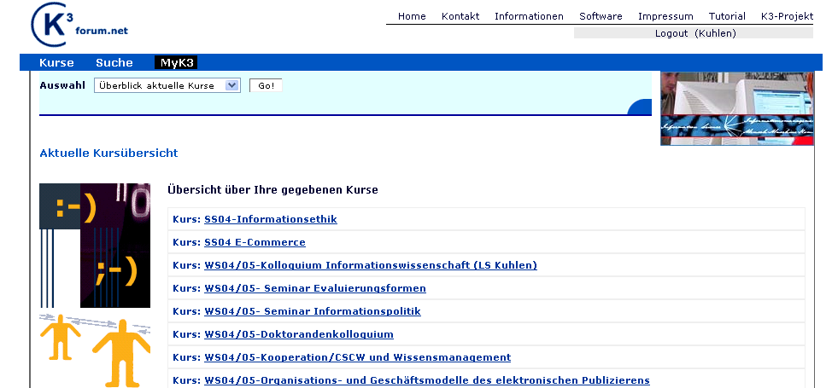
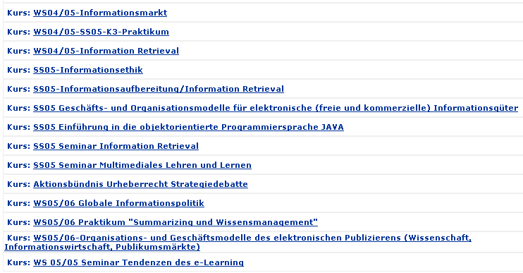
K3 Courses
Joined course Univ.Konstanz – Univ. Genf
technical course
Joined course Univ.Konstanz – Univ. Genf
technical course
Joined course Univ. Konstanz – Univ. Berlin
discourse-oriented
Joined course Univ. Konstanz – Univ. Berlin
discourse-oriented
Joined course Univ, Konstanz – Univ. Zürich
Joined course Univ, Konstanz – Univ. Zürich
Joined course Univ.Konstanz – Univ. Berlin – Univ. Hildesheim
Information ethics
Information ethics
Joined course Univ.Konstanz – Univ. Berlin – Univ. Hildesheim
Information ethics
Information ethics
http://www.kuhlen.name/MATERIALIEN/Vortraege_05Web/RK-presentation251005.ppt

Slide 40
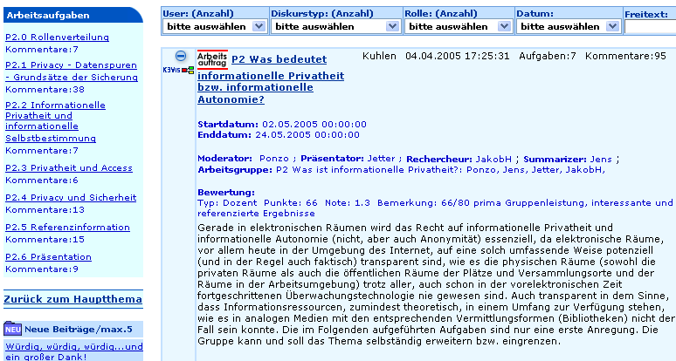
Work assignments
Work tasks
Filter:
discourse type
Filter:roles
Filter: date
Filter:user
What is information privacy?
Beginning/end of group work
Assigned roles for work assignment
Evaluation for group work - by course instructor
Work assigment description
http://www.kuhlen.name/MATERIALIEN/Vortraege_05Web/RK-presentation251005.ppt

Slide 41
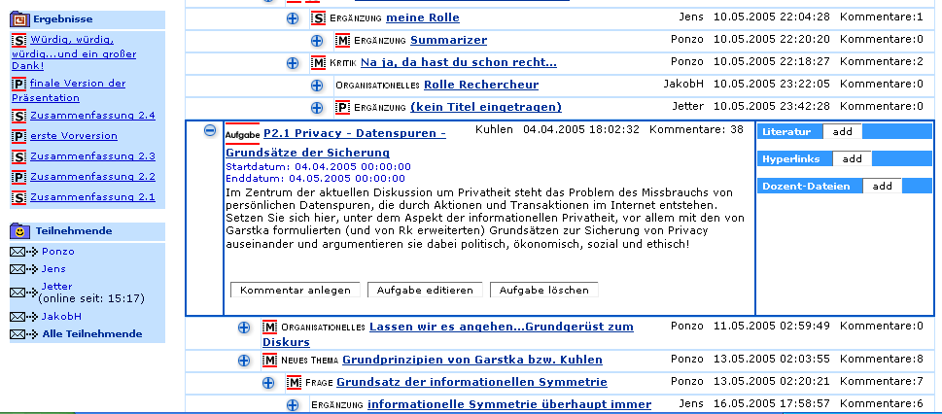
Work tasks
Results:
Summaries
presentation
Work task „Privacay – data traces“
discourse
http://www.kuhlen.name/MATERIALIEN/Vortraege_05Web/RK-presentation251005.ppt

Slide 42
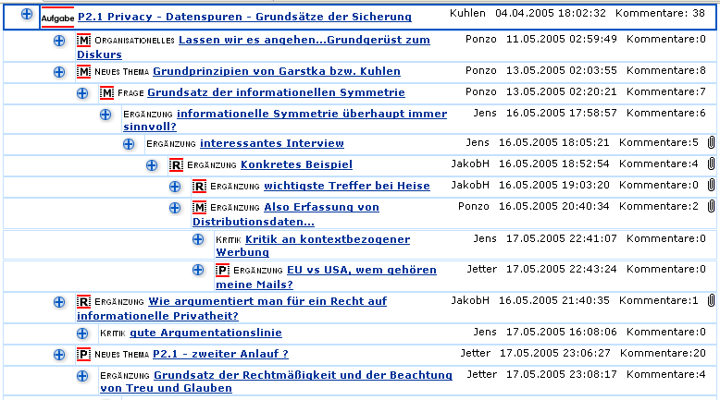
Work tasks
Discourse for works task „privacydata traces“
http://www.kuhlen.name/MATERIALIEN/Vortraege_05Web/RK-presentation251005.ppt

Slide 43
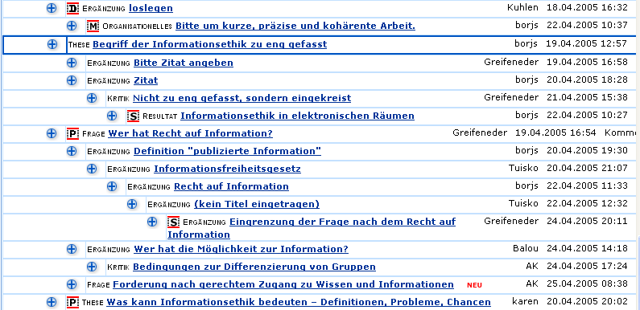
Discourse objects
(1) role specification (M=moderator; P= presentator; S= summarizer
(2) Discourse type (Kritik=criticism; These= thesis; Frage=question; Ergänzung=addendum;...
(3) new contribution, so far unread
http://www.kuhlen.name/MATERIALIEN/Vortraege_05Web/RK-presentation251005.ppt
Fig.4
K3 discourse with discourse objects – in the thread paradigm

Slide 44
Challenges - questions final assumptions

Slide 45
Information ethics discourses – challenges/questions
How to carry out information ethics discourses?
What can one expect from the outcome of information ethics discourses?
Are professional information ethics code useful or necessary?
What are the major conflicts between ethics, law, market, and technology?

Slide 46
Final assumption
In the longer term, neither law, nor market or technology can count on approval from the people
when legal norms, business models, commercial goods and services and technologies are not compatible with existing and developing moral behaviour and moral expectance of the majority of the people.

Slide 47
