Slide 1
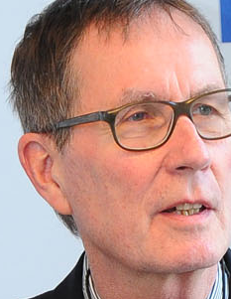
Universität Bern 6. Juni 2014
Conference on "Ethical Dilemmas in the Information Society: How Codes of Ethics Help to Find Ethically Based Solutions" 15 August 2014 in Geneva/Switzerland
Copyright and ethics
an insight
Rainer Kuhlen
FB Informatik und Informationswissenschaft - Universität Konstanz
www.kuhlen.name

Slide 2
Regulatory constraints for knowledge and information
Copyright data protection
law
Information
market/ economy
Information
ethics
Information and
communication
technologies

Slide 3
Information ethics – contradictory to law
Copyright data protection
law
Information
ethics
access only by permission of right owners
Free access to information
protection of personal data

Slide 4
What is wrong in the relation between information ethics and copyright?
Copyright regulation/laws still mirrors moral behaviour towards k&I developed in analogous environments/spaces
Berne Convention
Developed in the analogous world
WIPO
TRIPS
EU InfoSoc Guidline 2001
Copyright - partially changed because of recognizing the development of new Internet ICT challenges
Without fully recognizing the potentials of new Internet ICT
And with widely keeping old moral analogous values and widely ignoring new digital values

Slide 5
What is wrong in the relation between information ethics and copyright?
Morality (moral behaviour )develops in the environments/ spaces where we live and carry out actions
Moral behaviour towards k&I is highly influenced by inform-ation and communication technologies in the Internet
Morality changes/develops faster than copyright regulation/laws
k&i=knowledge and information

Slide 6
What is wrong in the relation between information ethics and copyright?
(Existing) copyright regulation/laws turn out to be an disabling means for new business models and information services in the Internet rather than an enabling one.

Slide 7
Priority of information ethics to copyright
In the longer term, neither law, nor market or technology can count on approval from the people
when legal norms, business models, commercial goods and services and technologies are not compatible with existing and developing moral behaviour and moral expectance of the majority of the people.

Slide 8
... is crying out for copyright reform

Slide 9
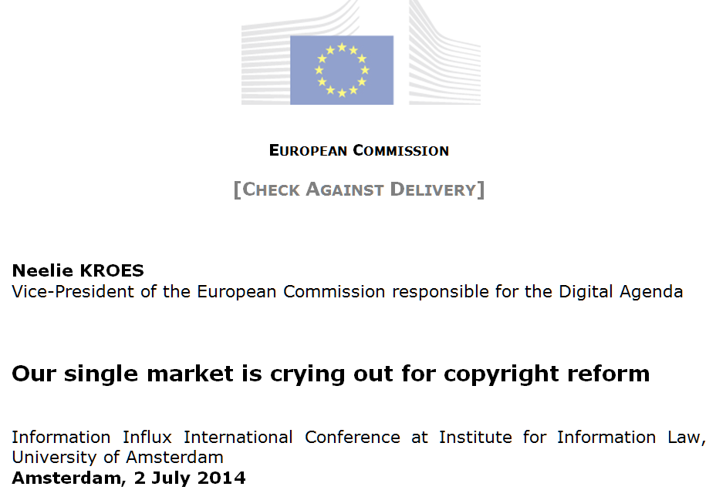
... is crying out for copyright reform
http://commentneelie.eu/speech.php?sp=SPEECH/14/528

Slide 10
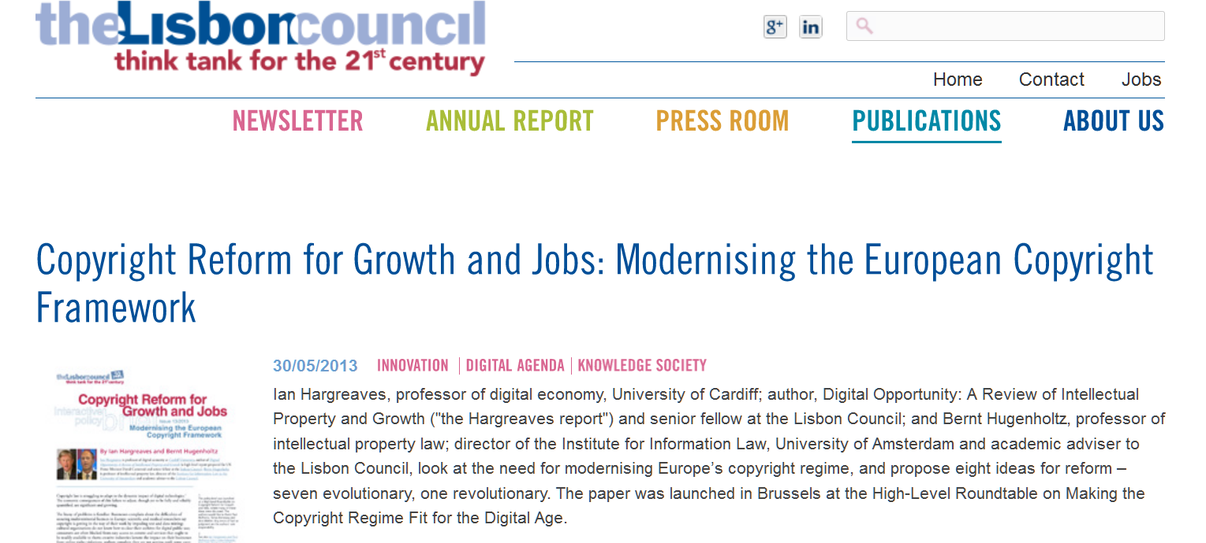
... is crying out for copyright reform
http://www.lisboncouncil.net/publication/publication/95-copyright-reform-for-growth-and-jobs-modernising-the-european-copyright-framework.html

Slide 11
... is crying out for copyright reform
Neelie KROES
“Transforming technology is changing how people use and re-use information. And disrupting a longstanding legal framework. “
“Already today that framework seems dated — if not irrelevant. Every day that passes it becomes more so.. “
needs to promote creativity and innovation. ...
it must remunerate and reward creators. ...
hould enable a digital single market. ...
the legal framework needs to take account of the needs of society. “
http://commentneelie.eu/speech.php?sp=SPEECH/14/528

Slide 12
... is crying out for copyright reform
Neelie KROES (some questions – not all of them listed here)
“When teachers are afraid to share teaching materials online, how does that help our society? “
“When museums have to take out insurance specifically against the risk of copyright lawsuits, because it's too complex and costly to figure out – how does that help promote European heritage? “
“When European scientists have to abandon text or data mining because they can't afford the legal fees – how does that help innovation and scientific progress? And by the way that restriction is costing our economy tens of billions of euros. “

Slide 13
... is crying out for copyright reform
Neelie KROES (need for a pragmatic reform)
“What does pragmatic reform mean?
It means more possibilities to access content online cross-border.
It means more harmonised exceptions: benefiting researchers, teachers, cultural heritage, and user-producers.
It means flexibility, so we don't have to have the same discussion every 5 years. “

Slide 14
... is crying out for copyright reform
Ian Hargreaves – Bernt Hugenholtz
“Copyright law is struggling to adapt to the dynamic impact of digital technologies … copyright law … has lost touch with the digital economy of today and tomorrow“
“scientific and medical researchers say copyright is getting in the way of their work by impeding text and data mining“
“cultural organisations do not know how to clear their archives for digital public use“
“creative industries lament the impact on their businesses
from online rights violations”
“authors complain they are not getting paid“

Slide 15
Suggestions for copyright reform
Ian Hargreaves – Bernt Hugenholtz
“1. Make limitations and exceptions more harmonised and flexible. …
“2. Reduce terms of protection. …”
“3. “Simplify online licensing across the EU. …provide regulatory incentives for setting up public databases of copyright metadata, and permit extended collective licensing.
“4. Recalibrate the Reproduction right…. If a technical copy has no economic significance, it should not count as reproduction.“

Slide 16
Suggestions for copyright reform
Ian Hargreaves – Bernt Hugenholtz
“5. Simplify legal protection of digital rights management systems … where circumvention is directly connected to copyright infringement.“
“6. Downsize the database right. Reduce the scope of the database right by limiting it to commercial uses of databases, and expanding limitations and exceptions”
“7. Rebalance copyright enforcement. Harmonise the rules on injunctive relief against intermediaries … make abusive copyright enforcement strategies (troll behaviour) unlawful.“

Slide 17
Information ethics challenges to copyright
mainly from the perspective of education and science
Memory organizations need more flexible support for digit-izing the cultural heritage and making it publicly available
Reform of norms in favour of orphan and out of print works
Criterion of diligent search unusable
Priority of legally binding exceptions and limitations to commercial licencing in copyright law
New norms in favour of text and data mining are needed

Slide 18
Information ethics challenges to copyright
mainly from the perspective of education and science
Memory organizations should be considered virtually organized rather than on-site organizations
Information services should be remotedly accessible and freely usable

Slide 19
Information ethics challenges to copyright
mainly from the perspective of education and science
Overcoming the complicated and restrictive system of exceptions and limitations in favour of education and science
A comprehensive education and science friendly clause is needed
European Copyright Code
„use for purposes of scientific research“ (Art. 5.2, b)
„use for educational purposes“ (Art. 5.3, b)

Slide 20
Information ethics challenges to copyright
mainly from the perspective of education and science
A comprehensive education and science friendly copyright clause
A proposal of the German Coalition for Action “Copyright for Education and Research” (2014)
(1) Copying and making published works available to the public is permitted for non-commercial use of scientific research and for the support of learning and teaching processes.
(2) Para (1) is also valid for documentation, archiving and preservation of mainly publicly financed memory organizations (such as libraries, archives, documentation centers and museums).
(3) Para (1) is also valid for information and communication services provided by memory
(4) Compensation for the use of services according to paras (1) and (3) will be paid on a a flat-rate basis by contractual agreement between rights holders (organizations) and the legal entities of the organizations addressed in paras (1-3).
(5) Contractual agreements which rule out paras (1-3) are invalid.

Slide 21
Information ethics challenges to copyright
mainly from the perspective of education and science
In the long term open access publication (gold) will be the standard in (commercial and open) science publication
Open access compatible (commercial) business and financing models are needed
Open access will be broadly accepted both of authors and commercial providers
A reinterpretation of the restrictive three-step-test

Slide 22
Information ethics challenges to copyright
mainly from the perspective of education and science
Open access will be broadly accepted both of authors and commercial providers
A reinterpretation of the restrictive three-step-test
1. Open access will be the norm, propriet-ary commercial publication the exception
2. Open access does not restrain commercial publication
3. Open access is fostering authors´ rights and interests

Slide 23
Consequences
Moral behaviour of information professionals cannot deny the validity of existing copyright regulation/laws
but
Information professionals should be convinced that the basic principle of moral behaviour in electronic environments/spaces is to enable free/open access to and use of published k&I to the broadest extent possible
consequently
Information professionals should should take initiatives wherever possible to fight for a just balance between ethics and copyright

Slide 24
