Slide 1
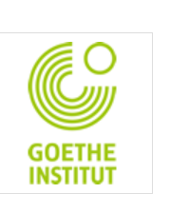
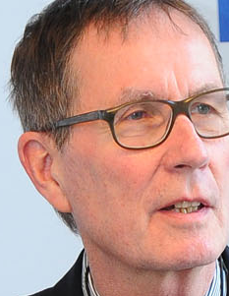
Universität Bern 6. Juni 2014
Will There Still be a Need for Copyright Regulation When Open Access Becomes the Default for Publishing in Science?
Rainer Kuhlen Professor of Information Science
Department of Computer and Information Science - University of Konstanz, Germany
www.kuhlen.name

Slide 2
Questions
Is there a crisis in copyright?
yes
2. Is there a crisis of commercial information markets?
yes
3. Is open access publishing a real competition to commercial publishing?
yes
4. Will commercial publishers accept the OA paradigm?
yes
5. Will public institutions be willing to pay for commercial OA publishing?
yes
6. Will open access(OA) become the default publishing in the foreseeable future?
yes
7 . Final question: If (5) and (6) - is there still a need for copyright related to science and education?

Slide 3
1. Is there a crisis in copyright?
Neelie KROES (former EU Commissioner for Digital Agenda)
“When teachers are afraid to share teaching materials online, how does that help our society? “
“When museums have to take out insurance specifically against the risk of copyright lawsuits, because it's too complex and costly to figure out – how does that help promote European heritage? “
“When European scientists have to abandon text or data mining because they can't afford the legal fees – how does that help innovation and scientific progress? And by the way that restriction is costing our economy tens of billions of euros. “
http://commentneelie.eu/speech.php?sp=SPEECH/14/528

Slide 4
What are the reasons for the copyright crisis?
Copyright regulation/laws still mirrors moral behaviour towards knowledge and information developed in analogous environments
Open unrestricted access to published knowledge is still considered an exception to the exclusive rights of the right holders (authors and, mainly, exploiters
Exceptions related to science an education are severely limited

Slide 5
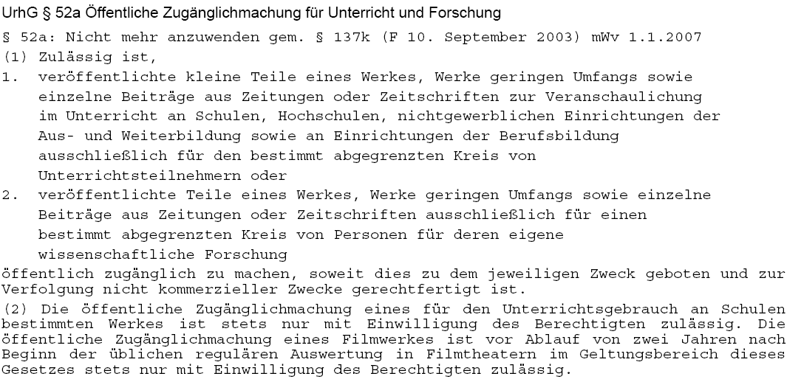
Exceptions for science, education (§ 52a German copyright law)
The right of making published work publicly available für education and research

Slide 6
Exceptions for science, education (§ 52a German copyright law)
only small parts of works
only for use in classroom
right to teachers only not for students
for the use of defined research groups
only for registered students in classes
an appropriate remuneration needs to be paid to collecting societies in any case
without any direct or indirect commercial interest
use of copyrighted material in schools only with special permission of rightholders
use of movie/video material only 2 years after public performance

Slide 7
2. Is there a crisis of commercial information markets?
Intermediate result - 1
Copyright regulation has turned copyright into a trade law rather than an author’s or user’s law
forced to
Authors´exploit- ation rights
transfer
Publishers´ using rights
Copyright related to science and education has become a disabling means for invention and innovation
Copyright has become to science and education what environmental pollution has become to the coral reeves

Slide 8
2. Is there a crisis of commercial information markets?
Knowledge economy - STM Market
5000–10,000 journal publishers globally
still a very powerful and profitable market
28,100 active scholarly peer-reviewed journals in mid 20
collectively publishing about 1.8–1.9 million articles a year
about 50 million articles subject to retrieval and download
annual revenues generated from English-language STM journal publishing are estimated at about $9.4 billion in 2011 - a broader STM information publishing market worth some $23.5 billion
M.Ware/M. Mabe; The stm report . an overview of scientific and scholarly journal publishing. STM, Third edition November 2012 - http://www.stm-assoc.org/2012_12_11_STM_Report_2012.pdf

Slide 9
2. Is there a crisis of commercial information markets?
Knowledge economy - STM Market
still a very powerful and profitable market
and mainly supported/financed by public money
German science libraries pay about 600 Mio Euros/y for commercial publications
the equivalent of approx. 90.000 APC to Elsevier
Contract between Baden-Württemberg and Springer starting 2015
Contract between Else-vier and France (Couperin and Agence bibliograph-ique de l’enseignement supérieur)
Free access to 1.917 Springer journals for 51 academic institutions in B.-W.
2014-2018 - 172 Mio. EURO for closed access journals
http://wisspub.net/2014/11/12/details-zum-elsevier-deal-in-frankreich/

Slide 10
2. Is there a crisis of commercial information markets?
Knowledge economy - STM Market
Cost for publications between 2010 and 2014 In the average 23,9%
still a very powerful and profitable market
but
http://bit.ly/1yJgsF5
More and more authors in science frustrated by publishers´ business models choose open access journals and free licenses as the primary or at least secondary means of publication
Open access gold
Open access green

Slide 11
3. Is OA publishing a real competition to commercial publishing?
Open access community markets
Increase of Open-Access-Journals
journals, 650.572 articles (19.10.2011)
7449 journals, 745.962 articles (31.1.2012)
9411 journals, 1.099.912 articles (1.6.2013)
9741 journals, 1.592.661 articles
(26.3.2014)
10.068 journals, 1.778.533 articles 5,942 searchable at article level (26.9.2014)
approx. 4 journals/day sind 10/2011
but still only 3,5 % of all commercially available articles
Directory of Open Access Journals (DOAJ) – 9/2014

Slide 12
4. Will commercial publishers accept the OA paradigm?
More and more publishers (in particularly the four dominating ones) accept the OA-paradigm and see their future in OA publishing
Elsevier
Wiley
Thompson
Springer
gold
green
enforced by
Markets
Moral behavior
Users, NGOs
science organisations
Research funding organisations
Political commit-ment

Slide 13
4. 4. Will commercial publishers accept the OA paradigm?
Open access enforced
markets
green
Publishers increasingly agree to open access green/self archiving
Sherpa/Romeo http://www.sherpa.ac.uk/romeo/
About 80 % of all published articles could be open access available (OA green) – mostly with an embargo time between 6 and 8 months
in reality probably less than 30 %
This might change if the right to a second open publication will be introduced to copyright law and will be mandated.
M. Laakso:, M.: Green open access policies of scholarly journal publishers: a study of what, when, and where self-archiving is allowed. Scientometrics 2014. In press. http://dx.doi.org/10.1007/s11192-013-1205-3.

Slide 14
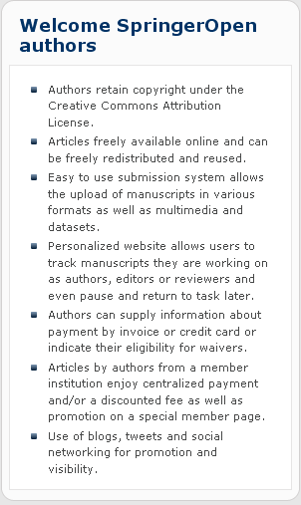
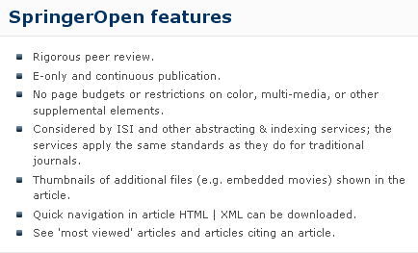
4. Will commercial publishers accept the OA paradigm?
Open access enforced
markets
SpringerOpen
gold

Slide 15
4. Will commercial publishers accept the OA paradigm?
Open access enforced
Moral behavior moral rights
More and more people claim that the public should have the right to freely access and use scientific work produced in public environments and supported by public money.

Slide 16
4. Will commercial publishers accept the OA paradigm?
Open access enforced
authors
Academics (12.663 – Stand 10092012) have protested against Elsevier's business practices – no longer willing to support Elsevier´s publishing procedures
The key to all these issues is the right of authors to achieve easily-accessible distribution of their work.

Slide 17
4. Will commercial publishers accept the OA paradigm?
NGOs
Open access enforced
http://www.urheberrechtsbuendnis.de/ge.html.en

Slide 18
4. Will commercial publishers accept the OA paradigm?
Open access enforced
NGOs
ENCES' basic assumption is that knowledge and information in its digital form should be made available to everyone from everywhere and at any time under fair conditions. This is particularly true in science and education, where access to knowledge and information is indispensable.
http://ences.eu/

Slide 19
4. Will commercial publishers accept the OA paradigm?
Public foundations
NIH
Open access enforced
green
require
The law states:
The NIH Public Access Policy ensures that the public has access to the published results of NIH funded research. It requires scientists to submit final peer-reviewed journal manuscripts that arise from NIH funds to the digital archive PubMed Central upon acceptance for publication. To help advance science and improve human health, the Policy requires that these papers are accessible to the public on PubMed Central no later than 12 months after publication.
The NIH Public Access Policy applies to all peer-reviewed articles that arise, in whole or in part, from direct costs ¹ funded by NIH, or from NIH staff, that are accepted for publication on or after April 7, 2008. http://publicaccess.nih.gov/policy.htm

Slide 20
4. Will commercial publishers accept the OA paradigm?
Open access enforced
Private foundations
require
gold
Wellcome Trust policy tightening (June 2012)
introducing sanctions for non-compliance and a move to CC-BY licenses

Slide 21
4. Will commercial publishers accept the OA paradigm?
Open access enforced
Political
commitment
golden
UK
green
Finch Report of the Working Group on Expanding Access to Published Research Findings – the Finch Group http://www.researchinfonet.org/publish/finch/
“Accessibility, sustainability, excellence: how to expand access to research publications”
Policies on open access to scientific research results should apply to all research that receives public funds.
Open access is a key feature of Member States’ policies for responsible research and innovation by making the results of research available to all and by facilitating societal engagement.

Slide 22
4. Will commercial publishers accept the OA paradigm?
Open access enforced
In Horizon 2020, both the ‘Green’ and ‘Gold’ models are considered valid approaches to achieve open access.
Political
commitment
EU
All projects will be requested to immediately deposit an electronic version of their publications (final version or peer-reviewed manuscript) into an archive in a machine-readable format.
This can be done using the ‘Gold’ model (open access to published version is immediate), or the ‘Green’ model.
In this case, the Commission will allow an embargo period of a maximum of six months, except for the social sciences and humanities where the maximum will be twelve months (due to publications’ longer ‘half-life’)
22

Slide 23
5. Will public institutions be willing to pay for commercial OA publishing?
Public pays
APC article-processing charge paid by the authors or, mainly by their institutions
APC payed by foundations/funding institutions
APC payed by a library for its scientists or by a flat-rate contract
By nation-wide (flat-rate) contractual agreements
SCOAP-model – a network of domain-specific institutions (High-Energy Physics) pays a remuneration to publishers of pertinent journals on a flat-rate basis

Slide 24
6. Will open access(OA) become gradually the default publishing in the foreseeable future (long-term prospective)?
Closed access journals (books)
Open access journals (books)
Commercial open access journals (books)
Community open access journals (books)
open access constrained
full open access
mainly by contractual licences agreements, e.g. read only
according to principles of the Berlin Open Access Declaration
The author(s) and right holder(s) of such contributions grant(s) to all users a free, irrevocable, worldwide, right of access to, and a license to copy, use, distribute, transmit and display the work publicly and to make and distribute derivative works

Slide 25
4. Will commercial publishers accept the OA paradigm?
5. Will public institutions be willing to pay for commercial OA publishing?
6. Will open access(OA) become gradually the default publishing in the foreseeable future (long-term prospective)?
7. Is there still a need for copyright related to science and education?
If the answers to 4, 5, 6 are “yes” then the answer to 7 is still “it depends”

Slide 26
7. Is there still a need for copyright related to science and education?
If everything will be published in the open access paradigm
Is there still a need for copyright protection for published objects?
yes
no
With comprehensive community open access
protection of moral rights
no need for exploitation rights
right to decide when and how to publish
no need for contractual licensing agreements
attribution of authorship
protection of works´ authenticity
Is this a realistic perspective?
Notes:
26

Slide 27
7. Is there still a need for copyright related to science and education?
If everything will be published in the open access paradigm
Is there still a need for copyright protection for published objects?
in addition to the protection of moral rights
yes
protection and exceptions for published works from the pre-OA-era
protection of new commercially produced value-added services
protection and exceptions for special products in the close access paradigm
multimedia presentation
hypertextification, dossiers
summaries, translations
retrieval and data mining
innovative reviewing models
personal und institutional background information
etc. etc.
Notes:
27

Slide 28
Conclusion
In the foreseeable future there will be still a need for copyright regulation
and from the perspective of science and education (the intermediaries such as libraries included):
The fight for a science- and education-friendly copyright must be continued
with the main objective
to replace the various existing insufficient and obstructive copyright exceptions by a single comprehensive copyright clause in favor of science and education

Slide 29
Objectives of a generic clause for science and education (proposed by the German Aktionsbündnis + ENCES)
Right to reproduce and making publicly available published works a) in well defined user groups in research and education b) without further authorization or restrictions, for the purpose of c) non-commercial research d) teaching and learning in publicly funded schools and academic institutions c) non-commercial communication and intermediary services of culture and memory institutions such as libraries, archives, documentation and media centers, and museums
Rights mentioned in para (1) cannot be waived.
Notes:
29

Slide 30
Conclusion
Will There Still be a Need for Copyright Regulation When Open Access Becomes the Default for Publishing in Science?
Yes and no - It depends

Slide 31
Thank you for your attention
Slides under a CC-Licence from www.kuhlen.name
Notes:
31

Slide 32
