Slide 1
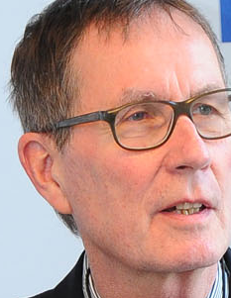
Thinking Beyond Capitalism
Institute for Philosophy and Social Theory, University of Belgrade
June 24-26, 2015, Belgrade
Commons-based information markets
as a means both for innovation in the economy and for progress in science
Rainer Kuhlen Department of Computer and Information Science University of Konstanz, Germany
CC

Slide 2
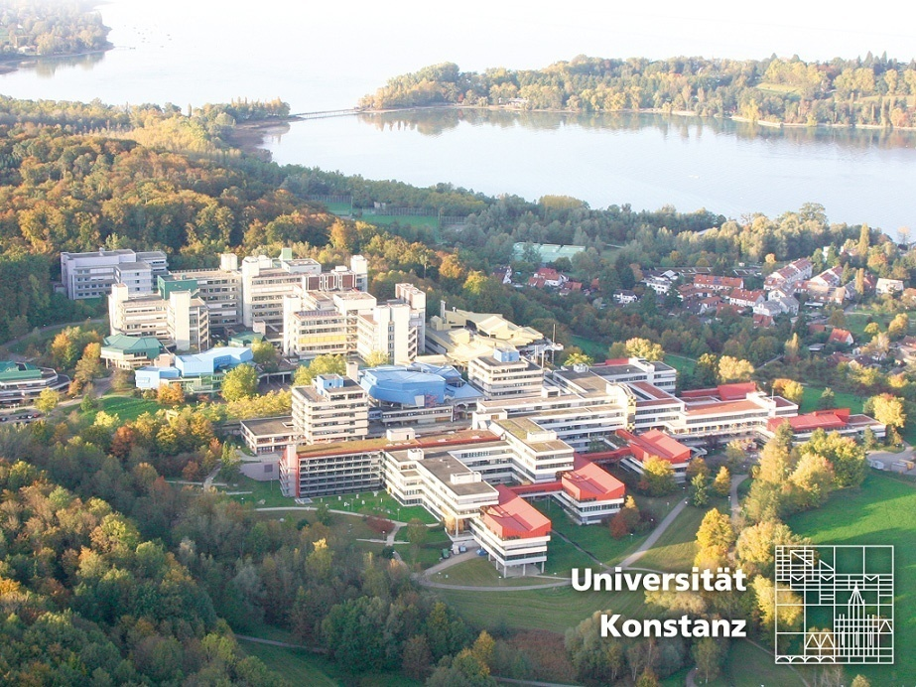
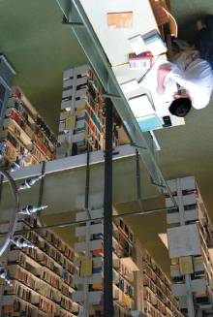
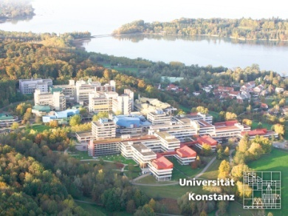
University of Konstanz
2

Slide 4
Content
Questions
Proprietary and open Informations markets
Knowledge economy – knowledge ecology
Towards a commons-based understanding of knowledge and information
Commercial scientific publishing market – knowledge economy
Knowledge ecology
Will commercial publishers accept the OA paradigm?
Models for commercial open access
Will open access(OA) become gradually the default publishing in the future
Is there still a need for copyright related to science and education?
Objectives of a generic clause for science and education

Slide 5
Questions
1. Is there a crisis of commercial information markets?
yes
2. Is there a crisis in copyright?
yes
3. Is open access publishing a real competition to commercial publishing?
yes
4. Will commercial publishers accept the OA paradigm?
yes
5. Will public institutions be willing to pay for commercial OA publishing? Should they?
yes - but
6. Will open access (OA) become the default publishing in the foreseeable future?
yes - but
8. Is there still a need for copyright regulation when OA publishing become the generally accepted norm?
yes - but

Slide 6
THE question
Are commons-based information markets a means both for innovation in the economy and for progress in science?
yes
Knowledge economy and knowledge ecology - can they be compatible?
yes - but

Slide 7
Proprietary and open Informations markets
access to and use of knowledge and information
proprietary
private
commercial
Information markets
open
public
commons-based
Information markets
Knowledge economy
Knowledge ecology
7

Slide 8
Knowledge economy – knowledge ecology

Slide 9
Towards a commons-based understanding of knowledge and information
Commons
Common Pool Resources
Common heritage of nature
water, air
Commons are institutionalized „common-pool resources“
Common heritage of social life
Public spaces law, libraries
Commons heritage of cultural creativity
the arts knowledge and information

Slide 10
Towards a commons-based understanding of knowledge and information
regulated by contracts
privatization
enclosure of the mind
profitability
scarce resource
sharing
free use
inclusion
sustainability
commitments, CC, Open Access
It´s our choice(?)
protected by copyright
enabled by copyright-limitations
knowledge resources
principles, values
access to and use of information products
services
institution-alization
procedures
communication (reaching a consensus)
commitments
contracts
rules, laws, legal norms
control mechanisms, sanctions
Knowledge economy
Commons-based information markets
Knowledge ecology
10

Slide 11
Knowledge Economy
regulated by contracts
privatization
enclosure of the mind
profitability
scarce resource
protected by copyright
knowledge resources
principles, values
institution-alization
procedures
communication (reaching a consensus)
commitments
contracts
rules, laws, legal norms
control mechanisms, sanctions
Knowledge economy
11

Slide 12
Knowledge economy Commercial scientific publishing market
5000–10,000 journal publishers globally (5000 in the SCOPUS database)
Science publishing industry employs an estimated 110,000 people globally, of which about 40% are employed in the EU
STM book market (about $5 billion annually) – ebooks 17% 2012 –rapidly increasing
still a very powerful and profitable market
28,100 active scholarly peer-reviewed journals late 2014
Publishing about 2.5 million articles a year
More than 50 million articles subject to retrieval and download
Virtually all STM journals are now available online
Annual revenues generated from English-language STM journal publishing are estimated at about $10 billion in 2013 - a broader STM information publishing market worth some $25,2 billion
Data-intensive research is challenging publishers to create new solutions to link publications to research data (and vice versa), to facilitate data mining
Mark Ware/Michael Mabe; The stm report . an overview of scientific and scholarly journal publishing. STM, Fourth edition March 2015 - http://www.stm-assoc.org/2015_02_20_STM_Report_2015.pdf

Slide 13
Commercial scientific publishing market – knowledge economy
Knowledge economy - the private commercial exploitation of knowledge and information
distributed, sold or licenced on global information markets
Information products - protected by copyright and considered private intellectual property
people can thus be excluded from an unrestricted use of knowledge.

Slide 14
Commercial scientific publishing market – knowledge economy
still a very powerful and profitable market
and supported/financed by public money
German science libraries pay about 600 Mio Euros/y for commercial publications
Contract between Baden-Württemberg and Springer starting 2015
Contract between Elsevier and France (Couperin and Agence bibliograph-ique de l’enseignement supérieur)
Free access to 1.917 Springer journals for 51 academic institutions in B.-W.
2014-2018 - 172 Mio. EURO for closed access journals
http://wisspub.net/2014/11/12/details-zum-elsevier-deal-in-frankreich/

Slide 15
Commercial scientific publishing market – knowledge economy
still a very powerful and profitable market
but
More and more people claim that the public should have the right to freely access and use scientific work produced in public environments and supported by public money.

Slide 16
Commercial scientific publishing market – knowledge economy
still a very powerful and profitable market
but
More and more authors in science frustrated by publishers´ business models choose open access journals and free licenses as the primary or at least secondary means of publication
Open access golden
Open access green

Slide 17
Knowledge ecology
sharing
free use
inclusion
sustainability
commitments, CC, Open Access
enabled by copyright-limitations
knowledge resources
principles, values
access to and use of information products
services
institution-alization
procedures
communication (reaching a consensus)
commitments
contracts
rules, laws, legal norms
control mechanisms, sanctions
Commons-based information markets
Knowledge ecology
17

Slide 18
Commons-based information markets – knowledge ecology
Open access as an alternative to traditional commercial publishing
Open-Access-based information markets
golden
DOAJ https://doaj.org/
DOAB http://www.doabooks.org/doab
journals, 650572 articles (19.10.2011)
7449 journals, 745962 articles (31.1.2012)
9411 journals, 1099912 articles (1.6.2013)
9741 journals, 1,592,661 articles (26.3.2014)
10,319 journals, 1,852,651 articles (18.3.2015)
3100 Academic peer-reviewed books from 107 publishers
(09.06.2015)
approx 4 journals/day since 2011
but still only about 4 % of all commercially available articles

Slide 19
Will commercial publishers accept the OA paradigm?
More and more publishers (in particularly the four dominating ones) accept the OA-paradigm and see their future in OA publishing
Elsevier
Wiley
Thompson
Springer
golden
green
enforced by
Markets
Moral behavior
Users, NGOs
science organisations
Research funding organisations
Political commit-ment

Slide 20
Will commercial publishers accept the OA paradigm?
Open access enforced
markets
green
Publishers increasingly agree to open access green/self archiving
Sherpa/Romeo http://www.sherpa.ac.uk/romeo/
About 80 % of all published articles could be open access available (OA green) – mostly with an embargo time between 6 and 8 months
in reality probably less than 30 %
This might change if the right to a second open publication will be introduced to copyright law and will be mandated.
M. Laakso:, M.: Green open access policies of scholarly journal publishers: a study of what, when, and where self-archiving is allowed. Scientometrics 2014. In press. http://dx.doi.org/10.1007/s11192-013-1205-3.

Slide 21
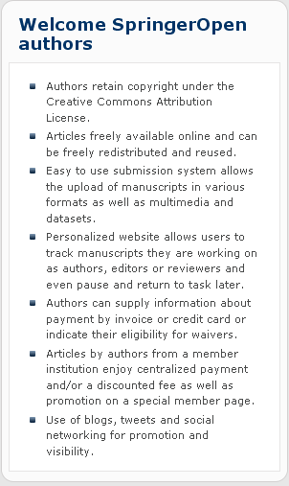
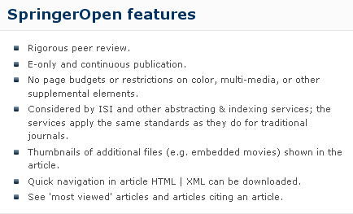
Will commercial publishers accept the OA paradigm?
Open access enforced
markets
Springer Open
golden

Slide 22
Will commercial publishers accept the OA paradigm?
Public foundations
NIH
Open access enforced
golden
require
The law states:
The NIH Public Access Policy ensures that the public has access to the published results of NIH funded research. It requires scientists to submit final peer-reviewed journal manuscripts that arise from NIH funds to the digital archive PubMed Central upon acceptance for publication. To help advance science and improve human health, the Policy requires that these papers are accessible to the public on PubMed Central no later than 12 months after publication.
The NIH Public Access Policy applies to all peer-reviewed articles that arise, in whole or in part, from direct costs ¹ funded by NIH, or from NIH staff, that are accepted for publication on or after April 7, 2008. http://publicaccess.nih.gov/policy.htm

Slide 23
Will commercial publishers accept the OA paradigm?
Open access enforced
Private foundations
require
golden
Wellcome Trust policy tightening (June 2012)
introducing sanctions for non-compliance and a move to CC-BY licenses

Slide 24
Will commercial publishers accept the OA paradigm?
Open access enforced
In Horizon 2020, both the ‘Green’ and ‘Gold’ models are considered valid approaches to achieve open access.
Political
commitment
EU
All projects will be requested to immediately deposit an electronic version of their publications (final version or peer-reviewed manuscript) into an archive in a machine-readable format.
This can be done using the ‘Gold’ model (open access to published version is immediate), or the ‘Green’ model.
In this case, the Commission will allow an embargo period of a maximum of six months, except for the social sciences and humanities where the maximum will be twelve months (due to publications’ longer ‘half-life’)
The European Commission will continue to fund projects related to open access. In 2012- 2013, the Commission will spend €45 million on data infrastructures and research on digital preservation. Funding will continue under the Horizon 2020 programme.
24

Slide 25
Models for commercial open access
Who pays?

Slide 26
Models for commercial open access
APC (article-processing charge) paid by the authors respectively by their institutions
Public pays
APC payed by foundations or by grants/sponsorships
APC payed by a library for its scientists or by a flat-rate contract
By library/research budgets
By nation-wide (flat-rate) contractual agreements
SCOAP-model – a network of domain-specific institutions (High-Energy Physics) pays
By nation-wide (flat-rate)
contractual agreements
etc. etc.

Slide 27
Models for commercial open access
Public pays
Is it reasonable and/or is it in line with market principles when commercial publishing organizations are subsidized by public institutions?
Is it more reasonable when publicly financed organizations (such as libraries together with research institutions) build an open access publishing infrastructures by themselves?

Slide 28
Is there still a need for copyright related to science and education?
Not for a copyright in the existing form
Almost everyone agrees that there is a need to overcome the current copyright crisis

Slide 29
Is there still a need for copyright related to science and education?
What are the reasons for the copyright crisis?
Copyright regulation/laws still mirrors moral behaviour towards knowledge and information developed in analogous environments
Access to published knowledge is still considered an exception to the exclusive rights of the right holders (authors and, mainly, exploiters )

Slide 30
Is there still a need for copyright related to science and education?
What are the reasons for the copyright crisis?
An enlightended copyright should avoid the termn “Exception” and should rather use the term “limitation”
Access to knowledge and informaton is not an exception but a right in itself

Slide 31
Consequences of existing copyright limitations to exclusive rights of right-holders both for scientific creativity and for economic innovation
(Existing) copyright regulation/laws turn out to be an disabling means for new business models and information services in the Internet rather than an enabling one.
Why is that?

Slide 32
Is there still a need for copyright related to science and education?
The copyright myth
Strong copyright will stimulate creativity in science and will further commercial innovation
The opposite is true (according to many empirical studies)
The more open the system of copyright limitations is the better creativity and innovation are promoted

Slide 33
Is there still a need for copyright related to science and education?
The more open the system of copyright limitations is the better creativity and innovation are promoted
“The analysis of these innovation processes has also often shown a puzzling phenomenon: innovating users often do not sell or license their innovations to manufacturers. Instead, they freely reveal details of their innovations to other users and to manufacturers.”
Dietmar Harhoff; Joachim Henkel; Eric von Hippel (2003): Profiting from voluntary information spillovers: how users benefit by freely revealing their innovation
Research Policy 32 (2003) 1753–17 - http://www.inno-tec.bwl.uni-muenchen.de/files/forschung/publikationen/harhoff/Profiting_20from_20voluntary_20information_20spillovers.pdf

Slide 34
Is there still a need for copyright related to science and education?
The more open the system of copyright limitations is the better creativity and innovation are promoted
“from the side of the copyright industries there is preference for a strong copyright (strong protection of the authors´ and exploiters´ rights): “, no more incentive to create or to invest in the creation of the new works will exist“ when „too much is taken away from right holder” (518).
“This Article takes the opposite position. It argues that in a knowledge-based society, a well - designed limitation system can greatly benefit innovation and creativity, and also readjust the copyright balance in favor of creators, assuring that they receive their fair share of profits generated by their works.” (518)
Christophe Geiger (2010): Promoting Creativity through Copyright Limitations: Reflections on the Concept of Exclusivity in Copyright Law.
Vanderbilt Journal of Entertainment & Technology Law, vol. 12, No. 3 (spring 2010)

Slide 35
Is there still a need for copyright related to science and education?
When everything will be published in the open access paradigm
yes
no
With comprehensive community open access
protection of moral rights
no need for exploitation rights
right to decide when and how to publish
no need for contractual licensing agreements
attribution of authorship
protection of works´ authenticity
But this is momentarily not a realistic perspective
Notes:
35

Slide 36
Is there still a need for copyright related to science and education?
in addition to the protection of moral rights
yes
protection and exceptions for published works from the pre-OA-era (still about 90%)
protection of new commercially produced value-added services
protection and exceptions for special products in the close access paradigm
multimedia presentation
hypertextification, dossiers
summaries, translations
retrieval and data mining
innovative reviewing models
personal und institutional background information
etc. etc.
A future market-oriented model for commercial publishing independent from public subsidy?
Notes:
36

Slide 37
Is there still a need for copyright related to science and education?
In the foreseeable future there will be still a need for copyright regulation in favor of education and science
The fight for a science- and education-friendly copyright must be continued
with the main objective
to replace the various existing insufficient and obstructive copyright exceptions by a single comprehensive copyright clause in favor of science and education

Slide 38
A comprehensive education- and science-friendly copyright clause
As a means for greater creativity in science and innovation in the economy
Notes:
38

Slide 39
Proposal of the German Coalition for Action “Copyright for Education and Research - http://www.urheberrechtsbuendnis.de/abws-text-2014-12.html.de
A comprehensive education- and science-friendly copyright clause
(1a) Copying and making published works available to the public is permitted for non-commercial use a) of scientific research of members in well-defined research groups and b) for the support of learning and teaching processes.
(1b) Para 1a is also valid for documentation, archiving and preservation of predominantly publicly financed memory and service organizations (such as libraries, archives, documentation centers and museums).
(1c) Para 1a is also valid for education and science supporting actions provided by organizations mentioned in para 1b.
Notes:
39

Slide 40
Proposal of the German Coalition for Action “Copyright for Education and Research - http://www.urheberrechtsbuendnis.de/abws-text-2014-12.html.de
A comprehensive education- and science-friendly copyright clause
.
(2) No remuneration is envisaged for the use of works which have been produced by predominantly publicly financed persons in predominantly publicly financed organizations and projects.
(3) Remuneration for the use of works and services according to paras (1a) and (1c) will be paid on a flat-rate basis by contractual agreement between rights holders (organizations) and the legal entities of the organizations addressed in paras (1a-1c). For the use of service according to para 2 no remuneration is envisaged .
(4) Contractual agreements which rule out paras (1a,b,c - 4) are invalid.
(5) With the implementation of this comprehensive copyright clause §§ 46, 47, 51, 52a, 52b, 53 und 53a are no longer valid.
Notes:
40

Slide 41
Proposal of the German Coalition for Action “Copyright for Education and Research - http://www.urheberrechtsbuendnis.de/abws-text-2014-12.html.de
A comprehensive education- and science-friendly copyright clause
(1a) Copying and making published works available to the public is permitted for non-commercial use a) of scientific research of members in well-defined research groups and b) for the support of learning and teaching processes.
(1b) Para 1a is also valid for documentation, archiving and preservation of predominantly publicly financed memory and service organizations (such as libraries, archives, documentation centers and museums).
(1c) Para 1a is also valid for education and science supporting actions provided by organizations mentioned in para 1b.
(2) No remuneration is envisaged for the use of works which have been produced by predominantly publicly financed persons in predominantly publicly financed organizations and projects.
(3) Remuneration for the use of works and services according to paras (1a) and (1c) will be paid on a flat-rate basis by contractual agreement between rights holders (organizations) and the legal entities of the organizations addressed in paras (1a-1c). For the use of service according to para 2 no remuneration is envisaged .
(4) Contractual agreements which rule out paras (1a,b,c - 4) are invalid.
(5) With the implementation of this comprehensive copyright clause §§ 46, 47, 51, 52a, 52b, 53 und 53a are no longer valid.
Notes:
41

Slide 42
Thank you for your attention
I am now at your disposal for questions.

Slide 43
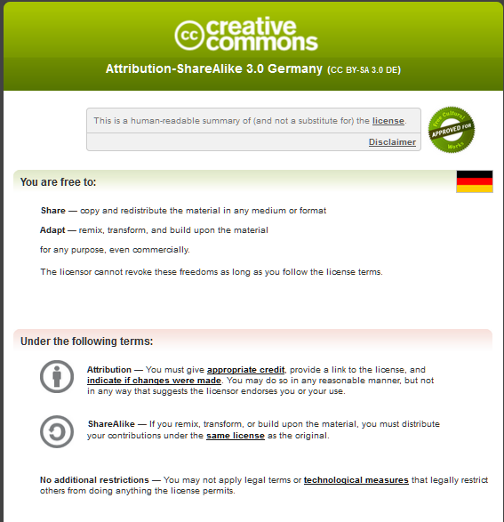

Slide 44
Will open access(OA) become gradually the default publishing in the foreseeable future (long-term prospective)?
Closed access journals (books)
Open access journals (books)
Commercial open access journals (books)
Community open access journals (books)
open access constrained
full open access
mainly by contractual licences agreement, e.g. read only
according to principles of the Berlin Open Access Declaration

