Slide 1
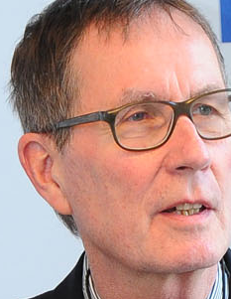
European Youth Conference on Internet as a Commons and the New Politics of Commoning
Mac 19-21 2016, Belgrade
Knowledge as a commons. Potential for innovation and creativity through open access and open copyright
Rainer Kuhlen
FB Informatik und Informationswissenschaft - Universität Konstanz
www.kuhlen.name

Slide 2
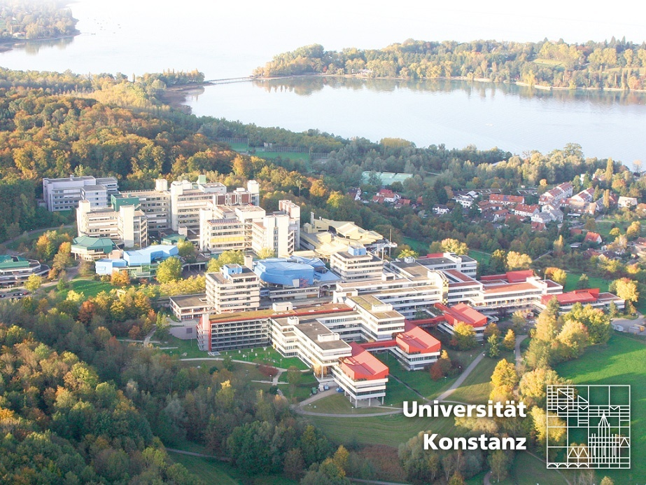
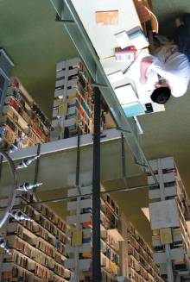
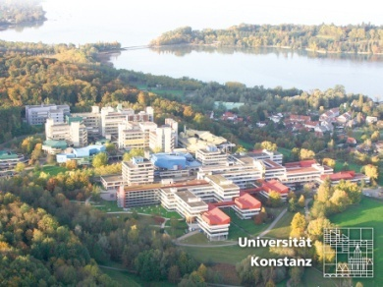

Slide 3
Topics
Creativity
Innovation
Creative destruction
Regulatory instances for knowledge and information
Closed and open information markets
Commercial open access markets
Who pays?
A future for closed information markets
Copyright still needed

Slide 4
Questions
1.Is there a crisis in commercial information markets?
2. Is Open access publishing competitive or even substitutable to commercial publishing?
3. Will commercial publisher accept and even apply open access?
4. Are public institutions wiliing to finance commercial open access publishing?
5. What are the consequences for libraries when open access becomes the default publishing model?
6. Will open access foster creativity in science?
7. Will open access foster innovation in economy?
8. Is there a need for a change in copyright policy?
9. Is there still a need for copyright regulation when access becomes the default publishing model?

Slide 5
Creativity

Slide 6
Creativity and Copyright
Intellectual Property Clause
Article I, Section 8, Clause 8, of the United States Constitution grants Congress the power
"To promote the progress of science and useful arts, by securing for limited times to authors and inventors the exclusive right to their respective writings and discoveries."

Slide 7
Creativity – scientific creativity
highly depends on access to and use of published knowledge
1) Motivation for scientific research.
2) Ability to correctly formulate research problems within a body of knowledge
3) Ability to create a comprehensive search space for the solution of a scientific problem.
4) Ability to assemble (or induce) and implemenat of heuristics to reduce the search space.
5) Patience and stamina for the exhaustive search for solving the scientific problem within the constrained search space.
S. Kocabas: Elements of scientifc creativity
https://www.aaai.org/Papers/Symposia/Spring/1993/SS-93-01/SS93-01-006.pdf

Slide 8
Innovation
innovation – the professional skill to make a difference
to make a difference is only possible if one is in the position to grab and then apply information which puts existing structures into question thus creating new - different ones.

Slide 9
Innovation
Innovation is paradigm of modernity and integral part of any economic policy - bound with progress and growth
Creative inventions
transformation
Innovation
From an economic point of view [Schumpeter] innovation is defined by the transformation of an idea/an invention (a piece of knowledge)
into a new profitable product or service or
into profitable value-added features of an existung product or service or
Into new profitable forms of production for existing products or
Into new profitable business models
Into new profitable financing models

Slide 10
Innovation
Innovation in the publishing industry/economy
Innovation is not limited to the sector of the general economy but refers also to all forms of production, processing, representation, distribution and use of knowledge

Slide 11
Innovation – Creative destruction
According to Joseph Schumpeter (interpreting Karl Marx)
The process of innovation is generally based on „creative destruction“:
“the process of industrial mutation that incessantly revolutionizes the economic structure from within, incessantly destroying the old one, incessantly creating a new one"
Schumpeter, Joseph A. (1994) [1942]. Capitalism, Socialism and Democracy. London: Routledge. pp. 82–83.
www.econlib.org/library/Enc/CreativeDestruction.html
https://en.wikipedia.org/wiki/Creative_destruction

Slide 12
Innovation – Creative destruction
Manuel Castells applies the concept of creative destruction for an exploratory theory of informational networks as part of the network society
The "spirit of informationalism" is the culture of "creative destruction" accelerated to the speed of the optoelectronic circuits that process its signals.
While technological innovation has enabled this unprecedented fluidity, this very process makes redundant whole areas and populations who are bypassed by informational networks.
Manuel Castells, Materials for an exploratory theory of the network society (2000)
Manuel Castells,The Information Age: Economy, Society and Culture (the first volume of which, The Rise of the Network Society, appeared in 1996)

Slide 13
Interim result
Invention
Innovation
knowledge
Information
The more permissive (free and open) and the more sustainable the production, dissemination and usage of knowledge and information are
the higher
The level of innovation
the level of economic profitability
the leveL of scientific creativity and inventions

Slide 14
Regulatory instances for knowledge and information
law
Innovative use of knowledge and information
norms
market
code/ICT
According: Lawrence Lessig: Code and other laws of cyberspace. Basic Books, Perseus Books Group: New York 1999, second edition 2006

Slide 15
Information markets

Slide 16
Informations markets
(1) Proprietary (commercial) closed markets
(2) Free open access exchange markets
(3) Commons-based information markets
(4) Commercial open access markets
(3) Freeconomics markets – zero marginal costs markets
(3) Commercial (closed) value-added markets

Slide 17
Informations markets – commercial knowledge economy
(1) Proprietary (commercial) closed markets
with the consequence of
objects
exclusive commercial exploitation rightsl
trade with information objects
with the consequence of
claimed to
manifold scarcity
private property rights
with the consequence of
protected by copyright law
reduced invention and innovation

Slide 18
Informations markets – commercial knowledge economy
5000–10,000 journal publishers globally (5000 in the SCOPUS database)
Science publishing industry employs an estimated 110,000 people globally, of which about 40% are employed in the EU
still a very powerful and profitable market
STM book market (about $5 billion annually) – ebooks 17% 2012 –rapidly increasing
Increase of costs for publications between 2010 and 2014 In the average 23,9%
28,100 active scholarly peer-reviewed journals late 2014
Publishing about 2.5 million articles a year
More than 50 mio articles subject to retrieval and download
Virtually all STM journals are now available online
http://bit.ly/1yJgsF5
Annual revenues generated from English-language STM journal publishing are estimated at about $10 billion in 2013 - a broader STM information publishing market worth some $25,2 billion
Data-intensive research is challenging publishers to create new solutions to link publications to research data (and vice versa), to facilitate data mining
Mark Ware/Michael Mabe; The stm report . an overview of scientific and scholarly journal publishing. STM, Fourth edition March 2015 - http://www.stm-assoc.org/2015_02_20_STM_Report_2015.pdf

Slide 19
Informations markets – commercial knowledge economy
still a very powerful and profitable market
and mainly supported/financed by public money
German science libraries pay about 600 Mio Euros/y for commercial publications
the equivalent of approx. 90.000 APC to Elsevier
Contract between Elsevier and France (Couperin and Agence bibliograph-ique de l’enseignement supérieur)
Contract between Baden-Württemberg and Springer starting 2015
Free access to 1.917 Springer journals for 51 academic institutions in B.-W.
2014-2018 - 172 Mio. EURO for closed access journals
http://wisspub.net/2014/11/12/details-zum-elsevier-deal-in-frankreich/

Slide 20
The influence of copyright to creativity and innovation
law
„Everyone says that the ownership and control of information is one of the most important forms of power in contemporary society … It is intellectual property … that provides the key to the distribution of wealth, power and access in the information society.
The intellectual property regime could make - or break - the educational, political, scientific and cultural promise of the Net.”
knowledge and information
norms
market
code/ICT
J. Boyle: A politics of intellectual property: Environmentalism for the net? (http://www.law.duke.edu/boylesite/intprop.htm )

Slide 21
The influence of copyright to creativity and innovation
law
Commercial information markets protected by existing copyright
knowledge and information
norms
market
With the consequence
(Existing) copyright regulation/laws turn out to be an disabling means for new business models and information services in the Internet rather than an enabling one.
code/ICT
Why is that?

Slide 22
Informations markets – commercial knowledge economy
Protected by existing copyright
law
The copyright myth
knowledge and information
norms
market
Strong copyright will stimulate creativity in science and will further commercial innovation
code/ICT
The opposite is true (according to many empirical studies)
The more open the system of copyright limitations is the better creativity and innovation are promoted
Dietmar Harhoff; Joachim Henkel; Eric von Hippel (2003): Profiting from voluntary information spillovers: how users benefit by freely revealing their innovation. Research Policy 32 (2003) 1753–17 -
Christophe Geiger (2010): Promoting Creativity through Copyright Limitations: Reflections on the Concept of Exclusivity in Copyright Law.
Vanderbilt Journal of Entertainment & Technology Law, vol. 12, No. 3 (spring 2010)

Slide 23
Informations markets – commercial knowledge economy
law
Existing strong copyright supports publishing models and business models from analogous information environments
knowledge and information
norms
market
code/ICT
two examples
“Bestands-akzessorietät”
(strict stock requirement)
restricted remote access to electronic library objects

Slide 24
Informations markets – commercial knowledge economy
no longer appropriate in a zero marginal cost society (Rifkin)
law
knowledge and information
norms
market
to protect publishers from creative destruction and thus hinders innovation
code/ICT
Attempts to soften the harsher aspects of creative destruction by trying to preserve jobs or protect industries will lead to stagnation and decline, short-circuiting the march of innovative progress.
W. Michael Cox and Richard Alm: Creative Destruction 2008
http://www.econlib.org/library/Enc/CreativeDestruction.html

Slide 25
Free open access markets - Commons-based information markets
Law
knowledge and information
norms
market
code/ICT
New moral behaviour towards knowledge and information in electronic environments

Slide 26
Free open access markets - Commons-based information markets
Law
change of moral behavior
knowledge and information
norms
market
code/ICT
knowledge sharing
collaboration
participation
open/free access
development rather than growth
sustainability
Open Innovation

Slide 27
Free open access markets - Commons-based information markets
Law
knowledge and information
norms
market
code/ICT
More and more people claim that the public should have the right to freely access and use scientific work produced in public environments and supported by public money.

Slide 28
Free use (illegal website?)
Law
knowledge and information
norms
market
code/ICT
Is sci-hub.org (Alexandra Elbakyan) with more than 48 mio freely available scientific articles a solution?

Slide 29
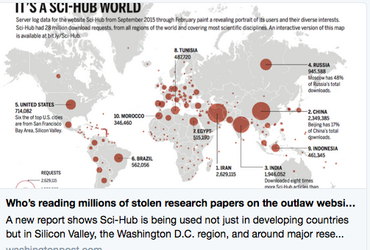
Free use (illegal website?)
https://twitter.com/costofknowledge

Slide 30
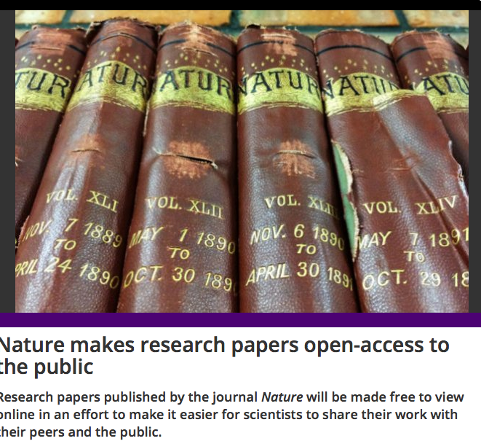
Free (?) access
making 48 of its journals free to access, including Nature Genetics, Nature Medicine and Nature Physics
The PDFs will only be viewable on a web browser, will be annotatable, and copying and printing will be disabled. Share and repost links will be made available for use in news articles in social media.
http://bit.ly/1YxR8OO

Slide 31
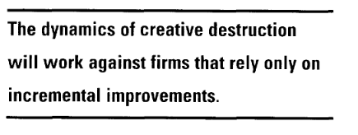
Free (?) access
The PDFs will only be viewable on a web browser, ...copying and printing will be disabled.
http://bit.ly/1YxR8OO
Stuart L Hart; Mark B Milste: Global Sustainability and the Creative Destruction of Industries. Sloan Management Review;Fall 1999; 41, 1 – http://bit.ly/1Tk78E4

Slide 32
Free open access markets - Commons-based information markets
Law
More and more authors in science frustrated by publishers´ business models choose open access journals and free licenses as the primary or at least secondary means of publication
knowledge and information
norms
market
code/ICT
Open access gold
Open access green

Slide 33
Free open access markets - Commons-based information markets
Open access as an alternative to traditional commercial publishing
Open-Access-based information markets
golden
DOAJ https://doaj.org/
DOAB http://www.doabooks.org/doab
journals, 650572 articles (19.10.2011)
7449 journals, 745962 articles (31.1.2012)
9411 journals, 1099912 articles (1.6.2013)
9741 journals, 1,592,661 articles (26.3.2014)
10,319 journals, 1,852,651 articles (18.3.2015)
8813 Journals, 1,974,607 articles (12.5.2016) (129 countries)
3100 Academic peer-reviewed books from 107 publishers
(09.06.2015)
4649 books from 154 publishers (12.5.2016)
approx 4 journals/day since 2011
but still only about 4 % of all commercially available articles

Slide 34
Will commercial publishers accept the OA paradigm?
More and more publishers (in particularly the four dominating ones) accept the OA-paradigm and see their future in OA publishing
Elsevier
Wiley
Thompson
Springer
golden
green
enforced by
Markets
Moral behavior
Users, NGOs
science organisations
Research funding organisations
Political commit-ment

Slide 35
Will commercial publishers accept the OA paradigm?
markets
Open access enforced
green
Publishers increasingly agree to open access green/self archiving
Sherpa/Romeo http://www.sherpa.ac.uk/romeo/
About 80 % of all published articles could be open access available (OA green) – mostly with an embargo time between 6 and 8 months
in reality probably less than 30 %
This will change with the right to a second open publication (added to copyright law) and even more when it will be mandated.
M. Laakso:, M.: Green open access policies of scholarly journal publishers: a study of what, when, and where self-archiving is allowed. Scientometrics 2014. In press. http://dx.doi.org/10.1007/s11192-013-1205-3.

Slide 36
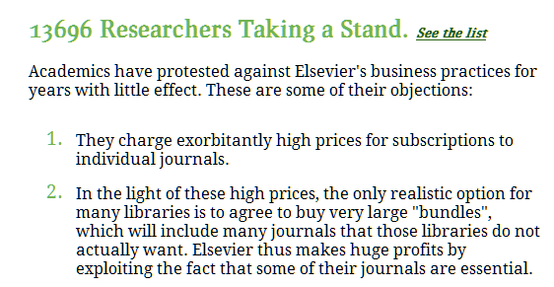
Will commercial publishers accept the OA paradigm?
Authors
gold
Open access enforced

Slide 37
Will commercial publishers accept the OA paradigm?
Public foundations
NIH
Open access enforced
golden
require
The law states:
The NIH Public Access Policy ensures that the public has access to the published results of NIH funded research. It requires scientists to submit final peer-reviewed journal manuscripts that arise from NIH funds to the digital archive PubMed Central upon acceptance for publication. To help advance science and improve human health, the Policy requires that these papers are accessible to the public on PubMed Central no later than 12 months after publication.
The NIH Public Access Policy applies to all peer-reviewed articles that arise, in whole or in part, from direct costs ¹ funded by NIH, or from NIH staff, that are accepted for publication on or after April 7, 2008. http://publicaccess.nih.gov/policy.htm

Slide 38
Will commercial publishers accept the OA paradigm?
Open access enforced
Private foundations
require
golden
Wellcome Trust policy tightening (June 2012)
introducing sanctions for non-compliance and a move to CC-BY licenses

Slide 39
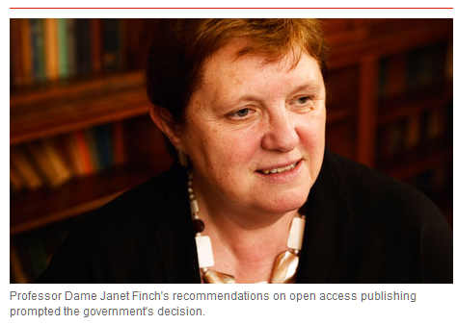
Will commercial publishers accept the OA paradigm?
Government
gold
Finch Report of the Working Group on Expanding Access to Published Research Findings – the Finch Group http://www.researchinfonet.org/publish/finch/
“Accessibility, sustainability, excellence: how to expand access to research publications”
UK
green
Policies on open access to scientific research results should apply to all research that receives public funds.

Slide 40
Who pays?

Slide 41
Public pays for commercial open access
Public pays
APC (article-processing charge) paid by the authors respectively by their institutions
APC payed by foundations or by grants/sponsorships
APC payed by a library for its scientists or by a flat-rate contract
By library/research budgets
By research institutions
By nation-wide (flat-rate) – contractual agreements
SCOAP-model – a network of domain-specific institutions (High-Energy Physics)
etc. etc.

Slide 42
Public pays for commercial open access – reasoable?
Public pays
Is it reasonable and/or is it in line with market principles when commercial publishing organizations are subsidized by public institutions?
Would it be more reasonable (efficient?) when publicly financed organizations (such as libraries together with research institutions) build an open access publishing infrastructure by themselves?

Slide 43
Public pays for commercial open access – reasoable?
Science can make its products publicly available from its own resources
Editors
Editorial Boards
Authors transfer their results into communicable documents, anyway
Quality control by scholars themselves (peer reviewing)
Distribution/making documents publicly available can by done by science itself and/or by support of intermediary institutions such as libraries
Powerful search engines can provide access to distributed resources

Slide 44
Is there a future for commercial publishing in science?
information markets
Licence for applying using rights to new products
open access (gratuit et libre) to information objects
realized by authors in education and science
Business models für value-added products
Simple publishing model
multimedia presentation
hypertextification, dossiers
summaries, translations
retrieval, text and data mining tools
innovative reviewing models
personal und institutional background information
etc. etc.
Commercial right to a secondary exploitation of information objects
modified and developed in collaborative working environments
legally protected by free licences (cf. CC-BY)
reversing OA green

Slide 45
Is there still a need for copyright regulation in science and education?

Slide 46
Is there still a need for copyright related to science and education?
When everything will be published in the open access paradigm
With comprehensive community open access
yes
no
protection of moral rights
no need for exploitation rights
right to decide when and how to publish
no need for contractual licensing agreements
attribution of authorship
But is it momentarily a realistic perspective?
protection of works´ authenticity
Notes:
46

Slide 47
Is there still a need for copyright related to science and education?
in addition to the protection of moral rights
yes
protection and exceptions for published works from the pre-OA-era (still about 90%)
protection of new commercially produced value-added services
protection and exceptions for special products in the close access paradigm
multimedia presentation
hypertextification, dossiers
summaries, translations
retrieval and data mining
innovative reviewing models
personal und institutional background information
etc. etc.
A future market-oriented model for commercial publishing independent from public subsidy?
Notes:
47

Slide 48
Questions – Answers
1.Is there a crisis in commercial information markets?
ja
2. Is Open access publishing competitive or even substitutable to commercial publishing?
ja
3. Will commercial publisher accept and even apply open access?
ja
4. Are public institutions wiliing to finance commercial open access publishing? Should they?
ja
??
5. What are the consequences for libraries when open access becomes the default publishing model?
??
6. Will open access foster creativity in science?
ja
7. Will open access foster innovation in economy?
ja
8. Is there a need for a change in copyright policy?
ja
9. Is there still a need for copyright regulation when access becomes the default publishing model?
ja

Slide 49
Thank you very much for your attention
time for discussion (?)

Slide 50
