Slide 1
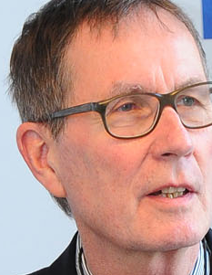
Universität Bern 13. Mail 2016
Vernissage des neuen Bandes von "Informationswissenschaft: Theorie, Methode und Praxis“
Gastvortrag von Prof. Dr. Rainer Kuhlen Open Access – ein neues Geschäftsmodell und/oder ein Kreativitäts- und Innovationspotenzial für Wissenschaft und Wirtschaft
Donnerstag
12. Mai 2016, 18.15 Uhr, Universität Bern, Hauptgebäude, Hochschulstrasse 4, Raum 106
Rainer Kuhlen
FB Informatik und Informationswissenschaft - Universität Konstanz
www.kuhlen.name

Slide 2
Fragen
1.Gibt es eine Krise im kommerziellen Informationsmarkt?
2. Ist Open Access Publizieren kompetitiv oder sogar substitutiv zum kommerziellen Publizieren?
3. Werden kommerzielle Verleger Open Access akzeptieren?
4. Sind öffentliche Institutionen bereit, kommerzielles Open Access zu finanzieren? Sollten sie das tun?
5. Wird Open Access in absehbarer Zukunft zum Default- Publikationsmodell? Warum?
6. Ist Open Access kreativitätsfördernd für Wissenschaft?
7. Ist Open Access innovationsfördernd für Wirtschaft?
8. Stärkt durchgängiges Open Access die Arbeit der Bibliotheken?
9. Wird noch Urheberrechtsregulierung gebraucht, wenn Open Access das Default- Publikationsmodell wird?

Slide 3
DIE Fragen
Sind commons-based Informationsmärkte kreativitäts- und innovationsfördernd?
Wissensökonomie und Wissensökologie – sind sie miteinander verträglich?

Slide 4
Proprietary and open Informations markets
access to and use of knowledge and information
proprietary
private
commercial
Information markets
open
public
commons-based
Information markets
Knowledge economy
Knowledge ecology
4

Slide 5
Knowledge economy – knowledge ecology

Slide 6
Towards a commons-based understanding of knowledge and information
Commons
Common Pool Resources
Common heritage of nature
water, air
Commons are institutionalized „common-pool resources“
Common heritage of social life
Public spaces law, libraries
Commons heritage of cultural creativity
the arts knowledge and information

Slide 7
Towards a commons-based understanding of knowledge and information
Common Pool Resources
Commons

Slide 8
Towards a commons-based understanding of knowledge and information
regulated by contracts
privatization
enclosure of the mind
profitability
scarce resource
sharing
free use
inclusion
sustainability
commitments, CC, Open Access
It´s our choice(?)
protected by copyright
enabled by copyright-limitations
knowledge resources
principles, values
access to and use of information products
services
institution-alization
procedures
communication (reaching a consensus)
commitments
contracts
rules, laws, legal norms
control mechanisms, sanctions
Knowledge economy
Commons-based information markets
Knowledge ecology
8

Slide 9
Knowledge Economy
9

Slide 10
Knowledge Economy
regulated by contracts
privatization
enclosure of the mind
profitability
scarce resource
protected by copyright
knowledge resources
principles, values
institution-alization
procedures
communication (reaching a consensus)
commitments
contracts
rules, laws, legal norms
control mechanisms, sanctions
Knowledge economy
10

Slide 11
Commercial scientific publishing market – knowledge economy
Knowledge economy - the private commercial exploitation of knowledge and information
distributed, sold or licenced on global information markets
Information products - protected by copyright and considered private intellectual property
people can thus be excluded from an unrestricted use of knowledge.

Slide 12
Knowledge economy Commercial scientific publishing market
5000–10,000 journal publishers globally (5000 in the SCOPUS database)
Science publishing industry employs an estimated 110,000 people globally, of which about 40% are employed in the EU
STM book market (about $5 billion annually) – ebooks 17% 2012 –rapidly increasing
still a very powerful and profitable market
28,100 active scholarly peer-reviewed journals late 2014
Publishing about 2.5 million articles a year
More than 50 million articles subject to retrieval and download
Virtually all STM journals are now available online
Annual revenues generated from English-language STM journal publishing are estimated at about $10 billion in 2013 - a broader STM information publishing market worth some $25,2 billion
Data-intensive research is challenging publishers to create new solutions to link publications to research data (and vice versa), to facilitate data mining
Mark Ware/Michael Mabe; The stm report . an overview of scientific and scholarly journal publishing. STM, Fourth edition March 2015 - http://www.stm-assoc.org/2015_02_20_STM_Report_2015.pdf

Slide 13
Commercial scientific publishing market – knowledge economy
still a very powerful and profitable market
and supported/financed by public money
German science libraries pay about 600 Mio Euros/y for commercial publications
Contract between Baden-Württemberg and Springer starting 2015
Contract between Elsevier and France (Couperin and Agence bibliographique de l’enseignement supérieur)
Free access to 1.917 Springer journals for 51 academic institutions in B.-W.
2014-2018 - 172 Mio. EURO for closed access journals
http://wisspub.net/2014/11/12/details-zum-elsevier-deal-in-frankreich/

Slide 14
Commercial scientific publishing market – knowledge economy
still a very powerful and profitable market
but
More and more people claim that the public should have the right to freely access and use scientific work produced in public environments and supported by public money.

Slide 15
Commercial scientific publishing market – knowledge economy
still a very powerful and profitable market
but
More and more authors in science, frustrated by publishers´ business models, choose open access journals and free licenses as the primary or at least secondary means of publication
Open access golden
Open access green

Slide 16
Knowledge Ecology
16

Slide 17
Knowledge ecology
sharing
free use
inclusion
sustainability
commitments, CC, Open Access
enabled by copyright-limitations
knowledge resources
principles, values
access to and use of information products
services
institution-alization
procedures
communication (reaching a consensus)
commitments
contracts
rules, laws, legal norms
control mechanisms, sanctions
Commons-based information markets
Knowledge ecology
17

Slide 18
Commons-based information markets – knowledge ecology
Open access as an alternative to traditional commercial publishing
Open-Access-based information markets
golden
DOAJ https://doaj.org/
DOAB http://www.doabooks.org/doab
journals, 650572 articles (19.10.2011)
7449 journals, 745962 articles (31.1.2012)
9411 journals, 1099912 articles (1.6.2013)
9741 journals, 1,592,661 articles (26.3.2014)
10,319 journals, 1,852,651 articles (18.3.2015)
8813 Journals, 1,974,607 articles (12.5.2016) (129 countries)
3100 Academic peer-reviewed books from 107 publishers
(09.06.2015)
4649 books from 154 publishers (12.5.2016)
approx 4 journals/day since 2011
but still only about 4 % of all commercially available articles

Slide 19
Closed – Open
Closed access journals (books)
Open access journals (books)
Commercial open access journals (books)
Community open access journals (books)
open access constrained
full open access
mainly by contractual licences agreement, e.g. read only
according to principles of the Berlin Open Access Declaration

Slide 20
Will commercial publishers accept the OA paradigm?
More and more publishers (in particularly the four dominating ones) accept the OA-paradigm and see their future in OA publishing
Elsevier
Wiley
Thompson
Springer
golden
green
enforced by
Markets
Moral behavior
Users, NGOs
science organisations
Research funding organisations
Political commit-ment

Slide 21
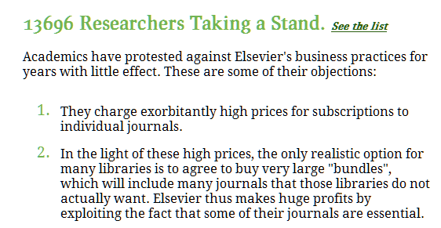
Anpassungsdruck zugunsten Open Access
Autoren
gold
Open access enforced

Slide 22
Will commercial publishers accept the OA paradigm?
markets
Open access enforced
green
Publishers increasingly agree to open access green/self archiving
Sherpa/Romeo http://www.sherpa.ac.uk/romeo/
About 80 % of all published articles could be open access available (OA green) – mostly with an embargo time between 6 and 8 months
in reality probably less than 30 %
This will change with the right to a second open publication (added to copyright law) and even more when it will be mandated.
M. Laakso:, M.: Green open access policies of scholarly journal publishers: a study of what, when, and where self-archiving is allowed. Scientometrics 2014. In press. http://dx.doi.org/10.1007/s11192-013-1205-3.

Slide 23
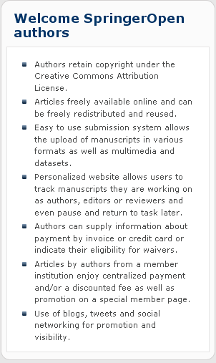
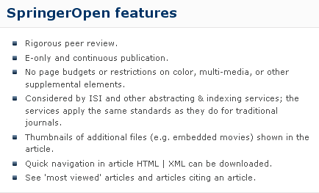
Will commercial publishers accept the OA paradigm?
markets
Open access enforced
Springer Open
golden

Slide 24
Will commercial publishers accept the OA paradigm?
Public foundations
NIH
Open access enforced
golden
require
The law states:
The NIH Public Access Policy ensures that the public has access to the published results of NIH funded research. It requires scientists to submit final peer-reviewed journal manuscripts that arise from NIH funds to the digital archive PubMed Central upon acceptance for publication. To help advance science and improve human health, the Policy requires that these papers are accessible to the public on PubMed Central no later than 12 months after publication.
The NIH Public Access Policy applies to all peer-reviewed articles that arise, in whole or in part, from direct costs ¹ funded by NIH, or from NIH staff, that are accepted for publication on or after April 7, 2008. http://publicaccess.nih.gov/policy.htm

Slide 25
Will commercial publishers accept the OA paradigm?
Open access enforced
Private foundations
require
golden
Wellcome Trust policy tightening (June 2012)
introducing sanctions for non-compliance and a move to CC-BY licenses

Slide 26
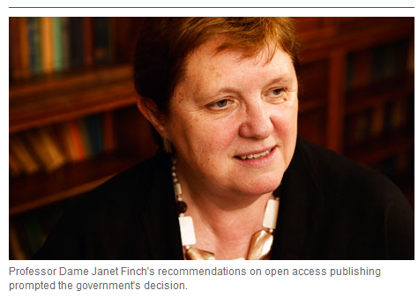
Will commercial publishers accept the OA paradigm?
Government
gold
Finch Report of the Working Group on Expanding Access to Published Research Findings – the Finch Group http://www.researchinfonet.org/publish/finch/
“Accessibility, sustainability, excellence: how to expand access to research publications”
UK
green
Policies on open access to scientific research results should apply to all research that receives public funds.

Slide 27
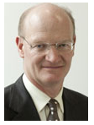
Will commercial publishers accept the OA paradigm?
Government
gold
green
UK
“British universities now pay around £200m a year in subscription fees to journal publishers, but under the new scheme, authors will pay "article processing charges" (APCs) to have their papers peer reviewed, edited and made freely available online. The typical APC is around £2,000 per article.”
“cost of the transition, which could reach £50m a year, must be covered by the existing science budget and that no new money would be found to fund the process.”
Minister of State for Universities and Science

Slide 28
Will commercial publishers accept the OA paradigm?
Open access enforced
In Horizon 2020, both the ‘Green’ and ‘Gold’ models are considered valid approaches to achieve open access.
Political
commitment
EU
All projects will be requested to immediately deposit an electronic version of their publications (final version or peer-reviewed manuscript) into an archive in a machine-readable format.
This can be done using the ‘Gold’ model (open access to published version is immediate), or the ‘Green’ model.
In this case, the Commission will allow an embargo period of a maximum of six months, except for the social sciences and humanities where the maximum will be twelve months (due to publications’ longer ‘half-life’)
The European Commission will continue to fund projects related to open access. In 2012- 2013, the Commission spent €45 million on data infrastructures and research on digital preservation. Funding will continue under the Horizon 2020 programme.
28

Slide 29
Who pays?

Slide 30
Financing models for commercial open access
Public pays
APC (article-processing charge) paid by the authors respectively by their institutions
APC payed by foundations or by grants/sponsorships
APC payed by a library for its scientists or by a flat-rate contract
By library/research budgets
By research institutions
By nation-wide (flat-rate) – contractual agreements
SCOAP-model – a network of domain-specific institutions (High-Energy Physics)
etc. etc.

Slide 31
Financing models for commercial open access
Public pays
Is it reasonable and/or is it in line with market principles when commercial publishing organizations are subsidized by public institutions?
Is the “public pays” model a threat to libraries?
Is it more reasonable (efficient?) when publicly financed organizations (such as libraries together with research institutions) build an open access publishing infrastructure by themselves?

Slide 32
Beyond traditional publishing and traditional business models
Without publisher
Direct open access publishing without journals
With publisher
Freeconomics (Google etc.)
With publisher
Zero marginal cost economy (Rifkin)

Slide 33
Is there still a need for copyright regulation in science and education?

Slide 34
Is there still a need for copyright related to science and education?
(Existing) copyright regulation/laws turn out to be an disabling means for new business models and information services in the Internet rather than an enabling one.
Why is that?

Slide 35
Is there still a need for copyright related to science and education?
The copyright myth
Strong copyright will stimulate creativity in science and will further commercial innovation
The opposite is true (according to many empirical studies)
The more open the system of copyright limitations is the better creativity and innovation are promoted

Slide 36
The more open the system of copyright limitations is the better creativity and innovation are promoted
“The analysis of … innovation processes has also often shown a puzzling phenomenon: innovating users often do not sell or license their innovations to manufacturers. Instead, they freely reveal details of their innovations to other users and to manufacturers.”
Dietmar Harhoff; Joachim Henkel; Eric von Hippel (2003): Profiting from voluntary information spillovers: how users benefit by freely revealing their innovation
Research Policy 32 (2003) 1753–17 - http://www.inno-tec.bwl.uni-muenchen.de/files/forschung/publikationen/harhoff/Profiting_20from_20voluntary_20information_20spillovers.pdf

Slide 37
The more open the system of copyright limitations is the better creativity and innovation are promoted
“from the side of the copyright industries there is preference for a strong copyright (strong protection of the authors´ and exploiters´ rights): “, no more incentive to create or to invest in the creation of the new works will exist“ when „too much is taken away from right holder” (518).
“This Article takes the opposite position. It argues that in a knowledge-based society, a well - designed limitation system can greatly benefit innovation and creativity, and also readjust the copyright balance in favor of creators, assuring that they receive their fair share of profits generated by their works.” (518)
Christophe Geiger (2010): Promoting Creativity through Copyright Limitations: Reflections on the Concept of Exclusivity in Copyright Law.
Vanderbilt Journal of Entertainment & Technology Law, vol. 12, No. 3 (spring 2010)

Slide 38
Is there still a need for copyright related to science and education?
When everything will be published in the open access paradigm
With comprehensive community open access
yes
no
protection of moral rights
no need for exploitation rights
right to decide when and how to publish
no need for contractual licensing agreements
attribution of authorship
But this is momentarily not a realistic perspective
protection of works´ authenticity
Notes:
38

Slide 39
Is there still a need for copyright related to science and education?
in addition to the protection of moral rights
yes
protection and exceptions for published works from the pre-OA-era (still about 90%)
protection of new commercially produced value-added services
protection and exceptions for special products in the close access paradigm
multimedia presentation
hypertextification, dossiers
summaries, translations
retrieval and data mining
innovative reviewing models
personal und institutional background information
etc. etc.
A future market-oriented model for commercial publishing independent from public subsidy?
Notes:
39

Slide 40
Is there still a need for copyright related to science and education?
in addition to the protection of moral rights
???
Everything may change in zero marginal cost publishing markets
Notes:
40

Slide 41
Fragen – „Antworten“
1.Gibt es eine Krise im kommerziellen Informationsmarkt?
ja
2. Ist Open Access Publizieren kompetitiv oder sogar substitutiv zum kommerziellen Publizieren?
Ja – aber
3. Werden kommerzielle Verleger Open Access akzeptieren?
ja
4. Sind öffentliche Institutionen bereit, kommerzielles Open Access zu finanzieren? Sollten Sie das tun?
Ja – aber
5. Wird Open Access in absehbarer Zukunft zum Default- Publikationsmodell?
Ja – aber
6. Ist Open Access kreativitätsfördernd für Wissenschaft?
ja
7. Ist Open Access innovationsfördernd für Wirtschaft?
Ja – aber
8. Stärkt durchgängiges Open Access die Arbeit der Bibliotheken?
Ja – aber
9. Wird noch Urheberrechtsregulierung gebraucht, wenn Open Access das Default- Publikationsmodell ist?
Ja – aber

Slide 42
DIE Fragen
Sind commons-based Informationsmärkte sowohl kreativitäts- als auch innovationsfördernd?
ja
Wissensökonomie und Wissensökologie – sind sie miteinander verträglich?
Ja – aber
aber nur in commons-based Informationsmärkten

Slide 43
Vielen Dank für Ihre Aufmerksamkeit
wenn noch Zeit ist, freue ich mich auf eine Diskussion

Slide 44
